Slide 1

We are India’s fastest moving technology startup in the co-living and student housing spaces with the ambition of being the with the ambition of being the largest provider of managed residences..
With an aim to provide a completely hassle-free long term living experience to working professionals as well as students, our living spaces offer all kinds of basic and luxury living amenities.
Our biggest USP for a resident comes from a vibrant resident community, omni channel platform and top notch service - all enabled by technology. We started in 2015 and are currently present in 10 cities - and have served 1 lac+ happy residents to date.

Slide 2
The role of the Trainee - Student Housing would encompass the following:
Approach all the prospective customers (Campus) and explain them our product
Cold calling to the campus and fix up the meeting
Identify their requirement and brief them about the Services and benefits
Prepare and provide a presentation to the campus VC and Directors
Close sales transactions and hit monthly target
Liaison with the other verticals and complete the documentation requirements to complete the transaction

Slide 3
Skills required for the role of Sales Executive would encompass the following:
Excellent Communication and Negotiation Skill
Extremely energetic and one who is Self motivated
Persuasive and one who is prepared to grind
Customer Service Orientation
High level of Passion and Ownership
One who can work with minimal supervision
Result Driven Individual

Slide 4


Slide 5










With Tears, Blood, Sweat and Much Love of 4 passionate individuals, Zolo was Born
Launch of Chennai and Kota
Hit the first 1000
INR 250 Cr.
Revenue (ARR)
Launch of First Zolo Co-Living – Zolo Green Garden
mark for Zoloites and 100 mark for Zolo Associates
$ 28 Mn Fund Raise, 10 Cities, 20,000 Residents
Launch of Ahmedabad
2000+ Property
Associates, 600+ Corporate Associates
2015
2016
2017
2018
2019
2020
2015
2015
2016
2017
2019
2019
$ 90 Mn Total Funds Raised, 3 Marquee Investors
11 Cities, 34,000
Happy Residents, 1 Lac Zoloites served
Launch of Zolo Co-Living in Pune
Launch of Investment Sales – Zolo’s first Subsidiary Company
10000 Beds,
8 Cities
Seed Funded by Nexus Venture Partners
Series A Funding of
$5 Mn
Series C Funding of
$56 Mn

Slide 6
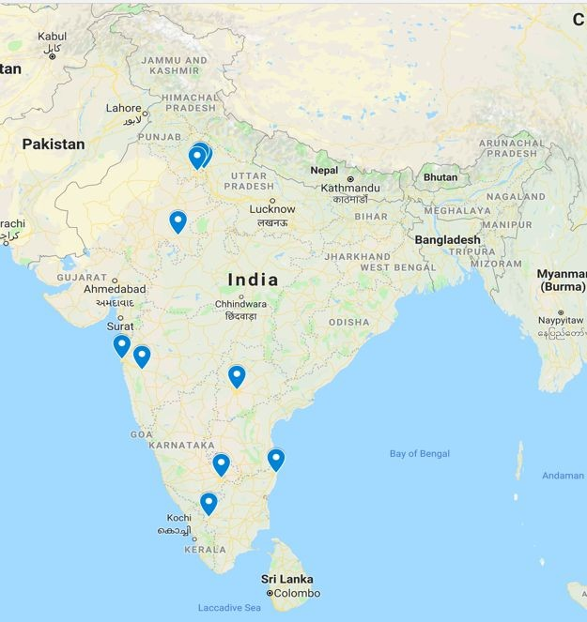
Noida, Delhi & Gurugram
Kota
Mumbai
Pune
Hyderabad
Bangalore
Chennai
Coimbatore

Slide 7





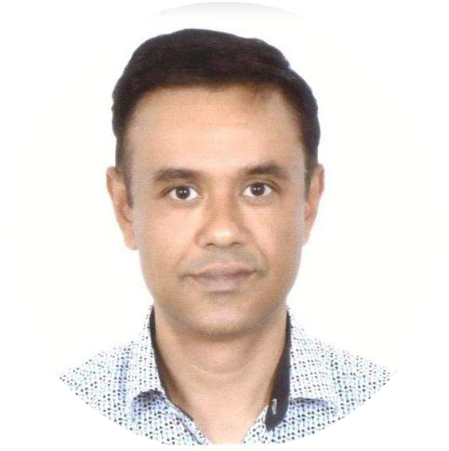





Slide 8
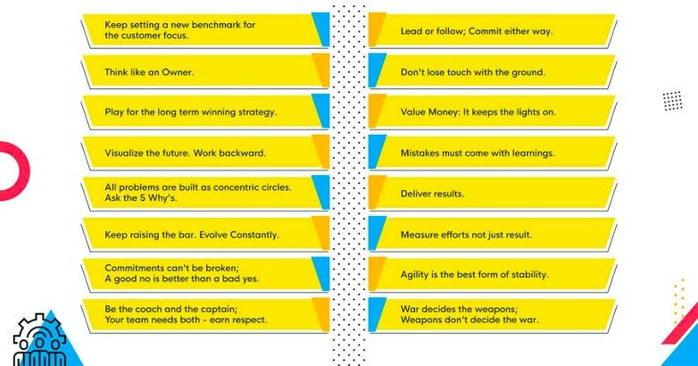

Slide 9

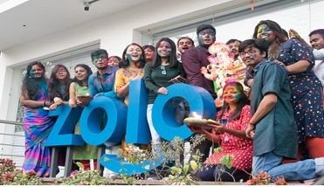

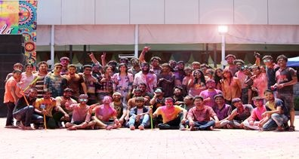
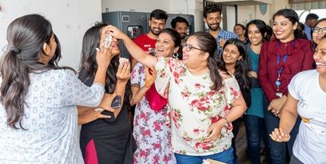

Diwali Party 2k19
Ganesha Chaturthi
Independence Day
Holi at Pune celebration
Typical B'Day celebration
4th Anniversary Celebration

Slide 10

https://zolostays.com/blog/zolo-stays-redefines-living-experience-f or-students-and-singles/
https://yourstory.com/2018/08/zolo-stays-redefines-living-experienc e-students-singles
https://yourstory.com/2020/07/funding-zolostays-series-c-investcor p-nexus-ventures
https://www.youtube.com/watch?v=TYfSa2ZEsGA
https://www.youtube.com/watch?v=jFETu-eLTks

