Slide 1


Think Positive, Think Innovation

Slide 2



We are an
IT Consulting Company
Solarix Technology is a dynamic consulting firm focused on providing its clients and partners with a complete suite of End -to -End Business Solutions.

Slide 3







Our Services
Cloud Solutions
Web Design
& UI/UX
eCommerce
Solutions
AI, ML,DML Development
Mobile App
Development
Web, Web app, PWA

Slide 4




At Solarix Technologies,
We’re with a Mission!
At Solarix Technologies, we’ve set ourselves one core mission: to get businesses and brands flying high in the world of strangers online. We want to take the technology and branding headaches away from your operation, and get you focused on what you do best – spotting and embracing new opportunities for growth.
Strong relationships : we don’t believe in building a client roster, but a group of partners invested in each other’s success.
Excellence at work: the will to go the extra mile, the desire to be better than we were yesterday and the instinct to win – all boil down to one thing : Excellence
Innovation & Creativity : the tenacity to consistently think out of the box, even when it borders on bizarre, is how the world changes.

Slide 5












  Technologies, We Support!
  WEB TECHNOLOGIES
Ecommerce
Content management
CRM systems
Mobile web technologies
Web-enabled applications
Intranet systems
API Integration
Analytics and Search Engines
Security and Identity Management
Mobile Applications
E-learning
Open Source Customization
Digital Technologies
Bespoke Development

Slide 6


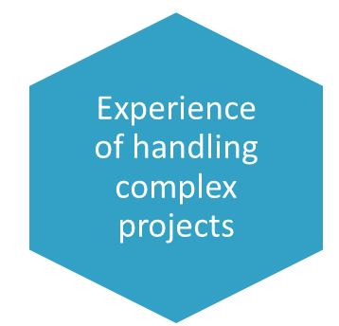
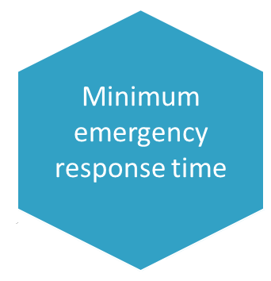

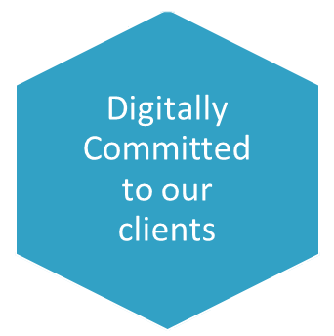
What makes us Special?

Slide 7














Industries we are currently working with:
Transport & Logistics
Travel & Hospitality
Information Services
Manufacturing
Healthcare
Education
Banking
Oil & Natural Gas
Communication, Media, & Technology

Slide 8


The Banking segments we serve
At Solarix Technology, we help our Banking partners through our three key principles:
It is as complex as ever
Our teams understand the payment environs. With Solarix Technology, you get a partner to help frame complex problems—and access to the most innovative technologies and providers
Details are our specialty
We track existing and upcoming regulations and assess the impact/ burden on your business, processes and technology
A transformational change is needed to stay relevant
Our offers drive enterprise value by helping financial services providers with their growth agenda, improving their customer engagement and optimizing their cost to serve.

Slide 9


Our Services for Healthcare
In digital health we offer operational transformation, Consumer experience and high impact consulting companies deliver personalized, efficient and informed care through:
High-Impact Healthcare Consulting
Digital Health Strategies
Operational Transformation
Consumer Experience Management

Slide 10




Transforming Communication, Media & Technology Industry
Our data-driven, open-platform models and agile services are extendable and designed to drive growth across our clients’ business, which include:
Customer Insight growth
  Agile solution to modern world problems
  Consumer centric digital service strategy
Intelligent Advertising Services
  Multimedia Advertising Platform
  Platform Companies
Digital Video
  Content Creation & Broadcasting
  Solarix Technology Media Services

Slide 11


Leading the change in Education Industry:
At Solarix Technology, we are dedicated to close the gap between what education provides and the skills needed by students, through solutions that offers:
A 360-degree student view, unlocking learning potential
Personalized Learning Tools
Enhanced research capacity through our Analytics & AI tools
Digital Solutions to enhance experience in students’ journey

Slide 12

Through our Information Services, we provide Tailored Information for Success
We always strive to accelerate creativity with new products, systems, services, and business models, increase agility and accelerate digital transformation, helping our clients to Shape their Approach as per ever-evolving industry trends.

Slide 13



Not just IT Solutions, we go Above & Beyond Call of Duty with our Transport & Logistics Services
We collaborate with Local Tour Guides & Program Managers for our clients, as we believe that it helps in widening our perception on individuals, locations, and communities.
Always working to find the best hotel accommodation and meeting venues according to clients’ budget and goals.
An in-house travel team capable of managing all transportation, lodging and logistics for groups with a huge number of people.

Slide 14

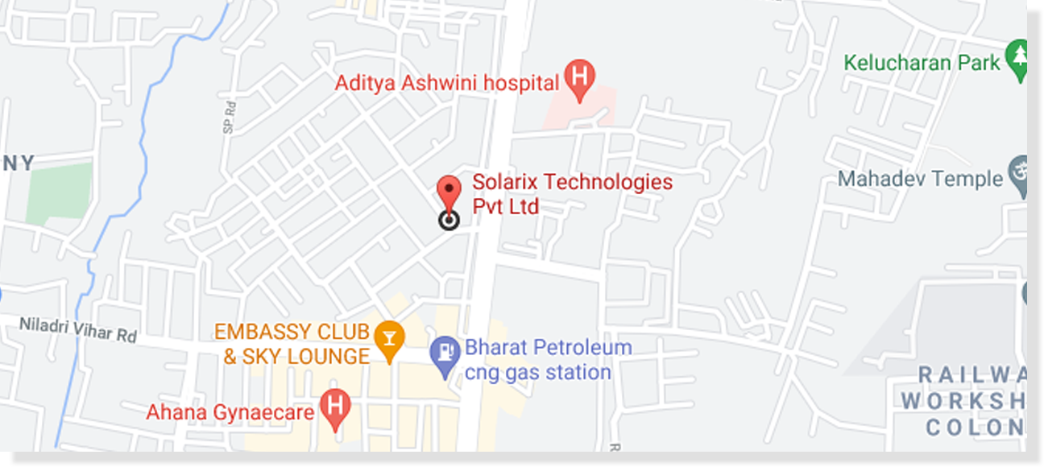
WE LOVE MEETING PEOPLE AND LISTENING TO THEM !
  Thank You!
Get in Touch With Us
The meeting of two persons is like meeting of two personalities; is like the contact of two chemical substances: if there is any reaction, both are transformed.
Send us a message or visit us
Whenever you like
Solarix Technologies Pvt Ltd, 2nd Floor, Plot no - 450/4507,
Opposite SBI ATM, Patia, Bhubaneswar, Odisha 751031

