Slide 1



Slide 2
Sustained
Growth
High Quality
Talent
Long term
player & value
creator
Socially
Responsible
and Ethical
Global
Presence
23%
1000
22
#
6
CAGR
growth
in last 3 years
Average
work experience
of 6 years
Years of
servicing global
customers
Multiple CSR
Globally and Member
SCCE
Offices
in
US and India
Passionate about Customer Success
Providing Engaging Workplaces
Utmost importance to Cost Effectiveness
Helping enterprises transcend digital generations through digital excellence

Slide 3




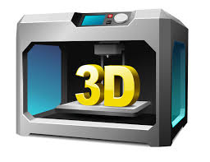
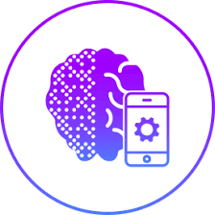










Banking, Financial Services, Insurance
Manufacturing & Hi-Tech
Healthcare, Life Science &
Services
CONSULTING SERVICES
DIGITAL SERVICES
APPLICATION SERVICES
INFORMATION MANAGEMENT & ANALYTICS
INNOVATION LABS

Slide 4
BUSINESS APPLICATION SERVICES
Enterprise
Content
Management
Enterprise
Application
Services
Enterprise
System
Integration
Legacy IT
ADM Services
Testing
Services
Enterprise
Security
En-Route to the ‘Digital Enterprise’
Enhancing customer experience
Business agility through integrated and secure IT ecosystems
Standardize IT operations robust architecture

Slide 5
Information Management and Analytics
BI
Reporting
Enterprise
Data Management
Performange
Management
Analytics
Data
Transformation
Advanced
Analytics
Data Warehousing
En-Route to the ‘Digital Enterprise’
Analytics driven business transformation
Performance objective focused environment with consistent information infrastructure
Complete Big Data and Analytics outsourcing

Slide 6
Consulting Services
Business
Transformation
Change
Management
System
Integration
Process
Excellence
Cyber
Security
Digital
Transformation
En-Route to the ‘Digital Enterprise’
Helping CXO agenda
Create seamless customer experiences along the journey
Enhancing Cross-sell
Business Service Redesign
Driving online customer
acquisition
Developing deep insight into customer behavior
New ways of working in IT and Operations

Slide 7
Digital Continuum
01
06
Tetra DREAM
Two Mode IT teams
02
07
CoEs
Points of failures exploding
03
Areas to be
covered today
08
Digital Ready Delivery
Adaptability is key
04
09
Talent Academy
Digital@Tetrasoft
05
10
Innovation Labs

Slide 8


Tetrasoft helps enterprises’ goals of optimizing the RUN and leading the CHANGE for FUTURE READINESS
1
  Serve customers, partners and employees effectively
2
  Support optimization and continuous improvement
  in business operations (RUN)
3
  Disrupt existing business and markets
4
  Invent new business opportunities and
  new business models

Slide 9
Technical
Architecture
Ways of
Working
Hardware
&
Protocols
Digital
Transformation
Continuum
Programming
Languages
Data
Model

Slide 10


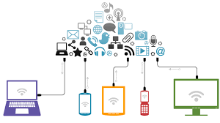
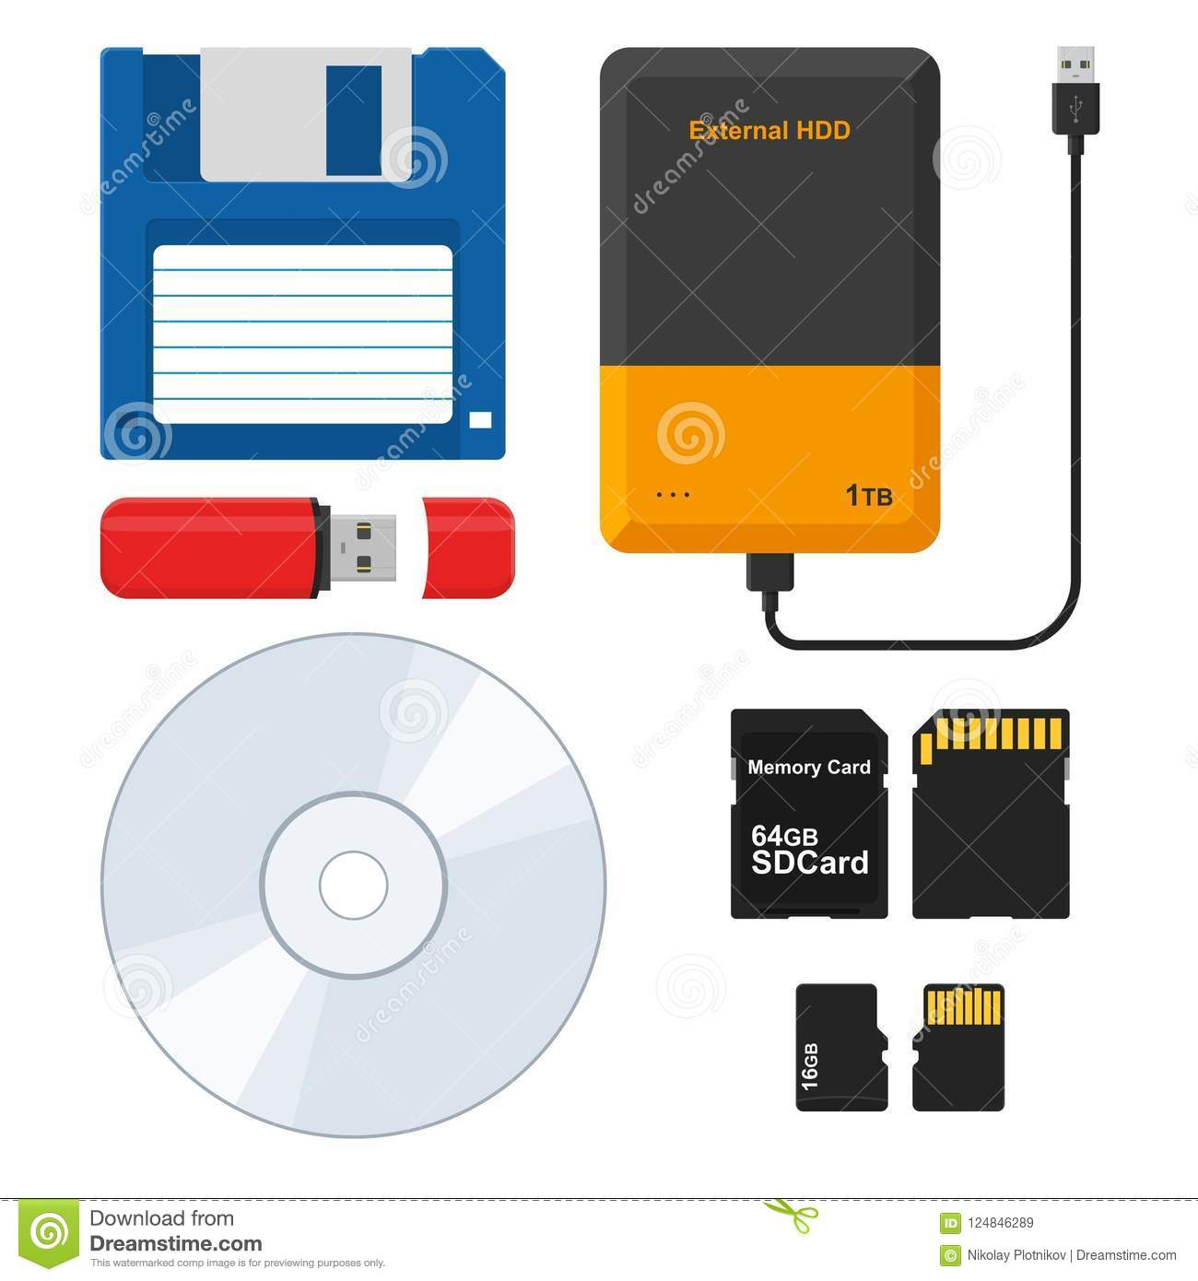
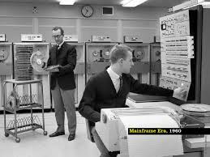
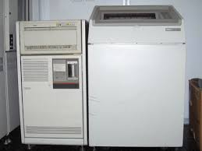


Slide 11

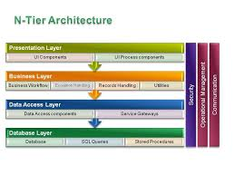
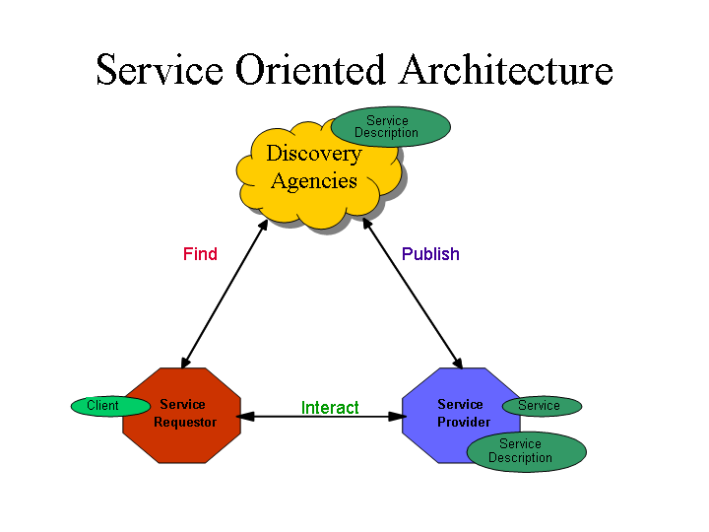
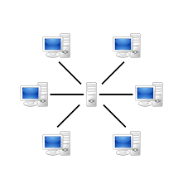
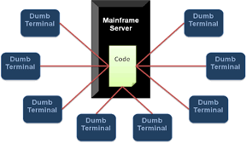
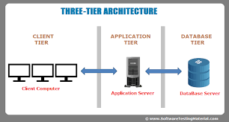

Slide 12
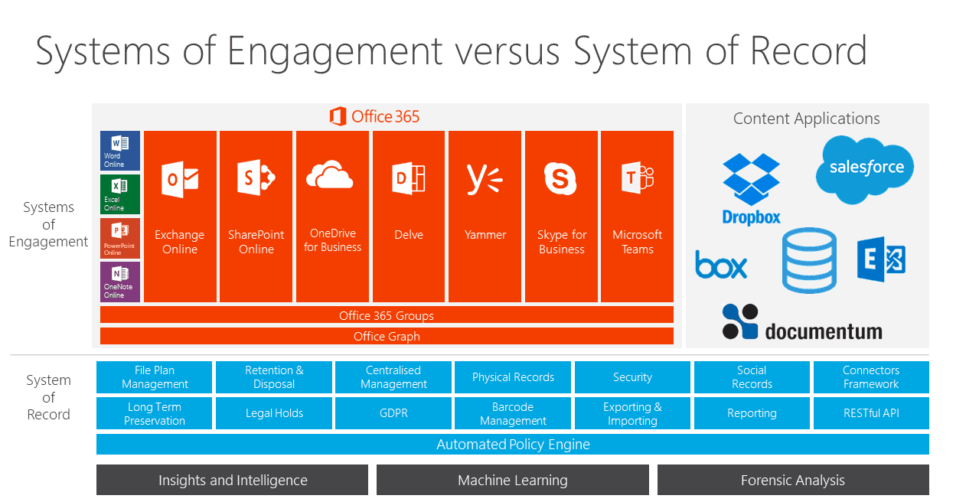
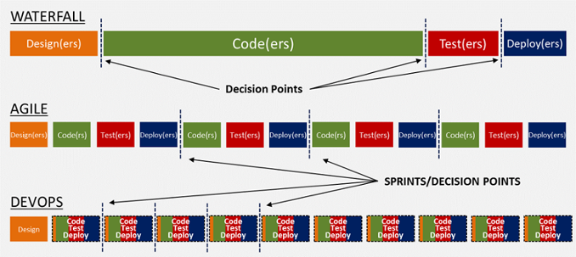
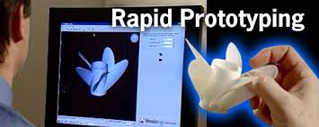

Slide 13
Evolution of Data Models and Technologies
GENERATION
TIME
MODEL
EXAMPLES
COMMENTS
First
1960-70s
File System
VMS/VSAM
Use mainly on mainframe systems
Managed records not relationships
IMS
ADABAS
IDS-II
Early database systems
Navigational access
Second
1970s
Heirarchial and Network
DB 2
ORACLE
SYBASE
Conceptual simplicity
Entity Relationship modeling
Support for relational data modeling
Third
Mid 1970s to present
Relational
Object Oriented/Extended Relational
FAST OBJECTS
ORACLE 10g
DB2 UDB
Supported complex data
Extended relationships product support
Objects and datawarehousing
Web database support
Fourth
Mid 1980s to present
MS SQL Server
Oracle 10g
dbXML
Organization and Management of unstructured data
Fifth
2000 to present
XML
Hadoop
Mapreduce
HIVE
Structured and Unstructured data
All types of content including text, image, video, sensor data
Next Generation
Present to Future
Big Data
Confidential & Proprietary

Slide 14
Language Generations
GENERATION
CLASSIFICATION
1st
Machine Languages
2nd
Assembly Languages
3rd
Procedural Languages
4th
Application Languages (4GLs)
5th
AI Techniques, Inference Languages
6th
Neural Networks (?), others…

Slide 15
Dissection of Current Digital Transformation trends – Industry wide
  -- BFSI
  -- Healthcare
  -- Government
  -- Manufacturing
  -- Healthcare
  -- BFSI
  -- Government
  -- Transportation
  -- Transportation
  -- Healthcare
  -- Automobile
  -- Manufacturing
  -- Telecom
  -- Healthcare
  -- Government
  -- Education
  -- Retail
  -- Manufacturing
  -- Government
  -- Healthcare
BIG DATA ANALYTICS
DIGITALIZATION
MOBILITY
IoT
CLOUD SERVCES
Digital Transformation Trends
SOCIAL MEDIA
OPEN INNOVATION
AUTOMATION
SMART ENERGY
ARTIFICIAL INTELLEGENCE
  -- Retail
  -- Education
  -- Government
  -- Healthcare
  -- BFSI
  -- Government
  -- Transportation
  -- Transportation
  -- Healthcare
  -- Automobile
  -- Manufacturing
  -- Telecom
  -- Healthcare
  -- Government
  -- Manufacturing
  -- Retail
  -- Manufacturing
  -- Banking
  -- Healthcare

Slide 16


We enable our teams to work in two modes
BOTH MODES ARE ESSENTIAL
THINKING LIKE A MARATHON RUNNER
(TRADITIONAL)
THINKING LIKE A SPRINTER
(DIGITAL)
Reliability
Price for Performance
Waterfall, V-Model, High-ceremony IID
Plan driven, Approval based
Good at conventional process and projects
IT centric, removed from customer
Long (Months)
Downstream driven
GUI based
Seperate testing phase/Time boxed agile
Functional level
Requirements driven
Regression automation
Legacy Platform, Enterprise Applications
Consolidation, Centralization
Tried and Tested commercial tools
Cost efficiency
Low-Medium
Traditional QA
Time boxed phases, Cost, Quality (98% DRE)
GOAL
VALUE
APPROACH
GOVERNANCE
TALENT
CULTURE
CYCLE TIMES
BUSINESS IMPACT
AUTOMATION
LIFE-CYCLE
FOCUS
SOURCE
APPROACH
PLATFORMS
ORGANIZATION
TOOLS STRATEGY
CUSTOMER PRIORITY
DEGREE OF ENGINEERING
QUALITY
ASSURANCE PRIORITIES
Agility
Revenue, Brand, Customer Experience
Agile, Kanban, low-ceremony IID
Emperical, continuous, process-based
Good at new and uncertain projects
Business centric, close to customer
Short (days, weeks)
Upstream driven
API for function, GUI for the form
Continuous testing with parallel API driven development
Technical level
Design, Code and Analytics driven
Progressive/in-sprint automation
New age platforms built from scratch
Dedicated Scrum teams
Appetite for Open Source
Time to Market
Medium-High
Next gen QA or Quality Engineering
Test as you build (speed), Experience, Iterative Development (MVP)

Slide 17
Points of failures are constantly increasing
  Global
  exposure of brand
  Unified
  Customer Experience
  Need for Speed
  Expectation
  of Ubiquity
  Hybrid provisioning
  infrastructure
  Expectation of Ubiquity

Slide 18
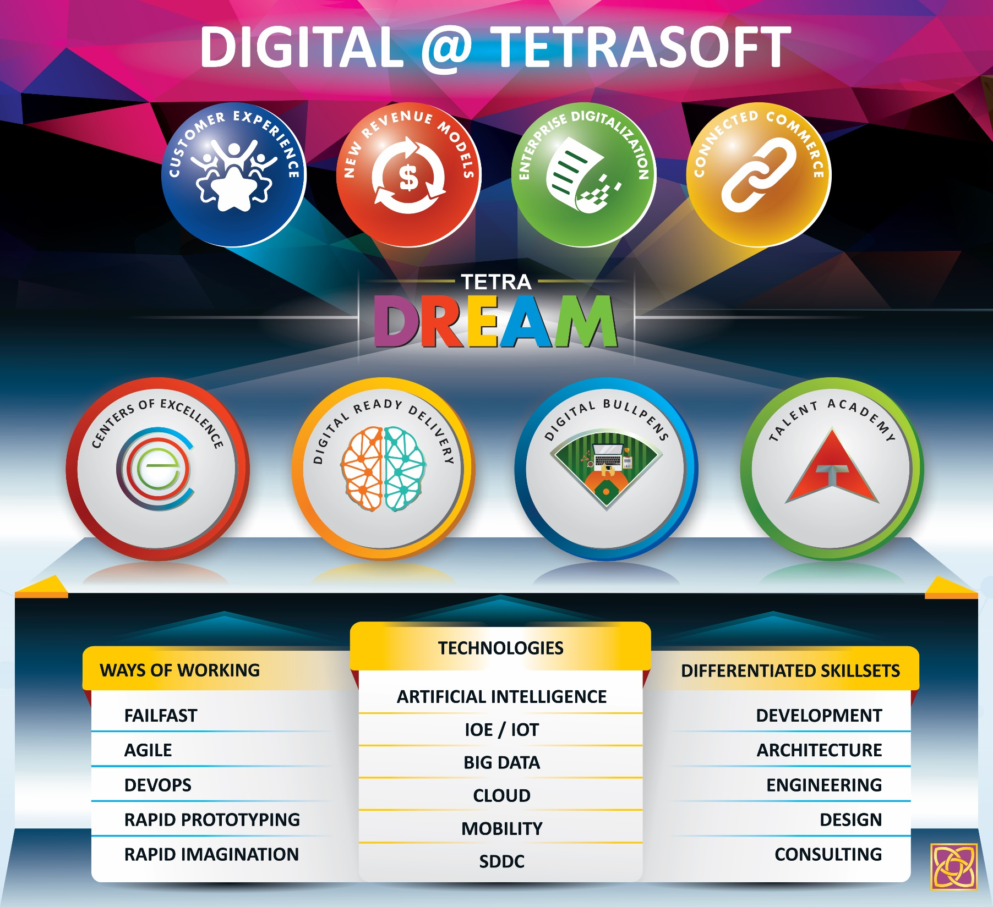

Slide 19

DIGITAL READY EXECUTION APPROACH & MODEL

Slide 20



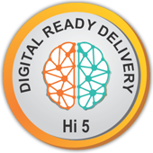
Digital Adaptability is key for IT services companies
We should continuously
enable our team to perform
at the base level and next level to
support customers’
digital transformation
Digital adaptability doesn’t
mean a separate team focusing
only on new technologies/new
ways of working/new skillsets

Slide 21
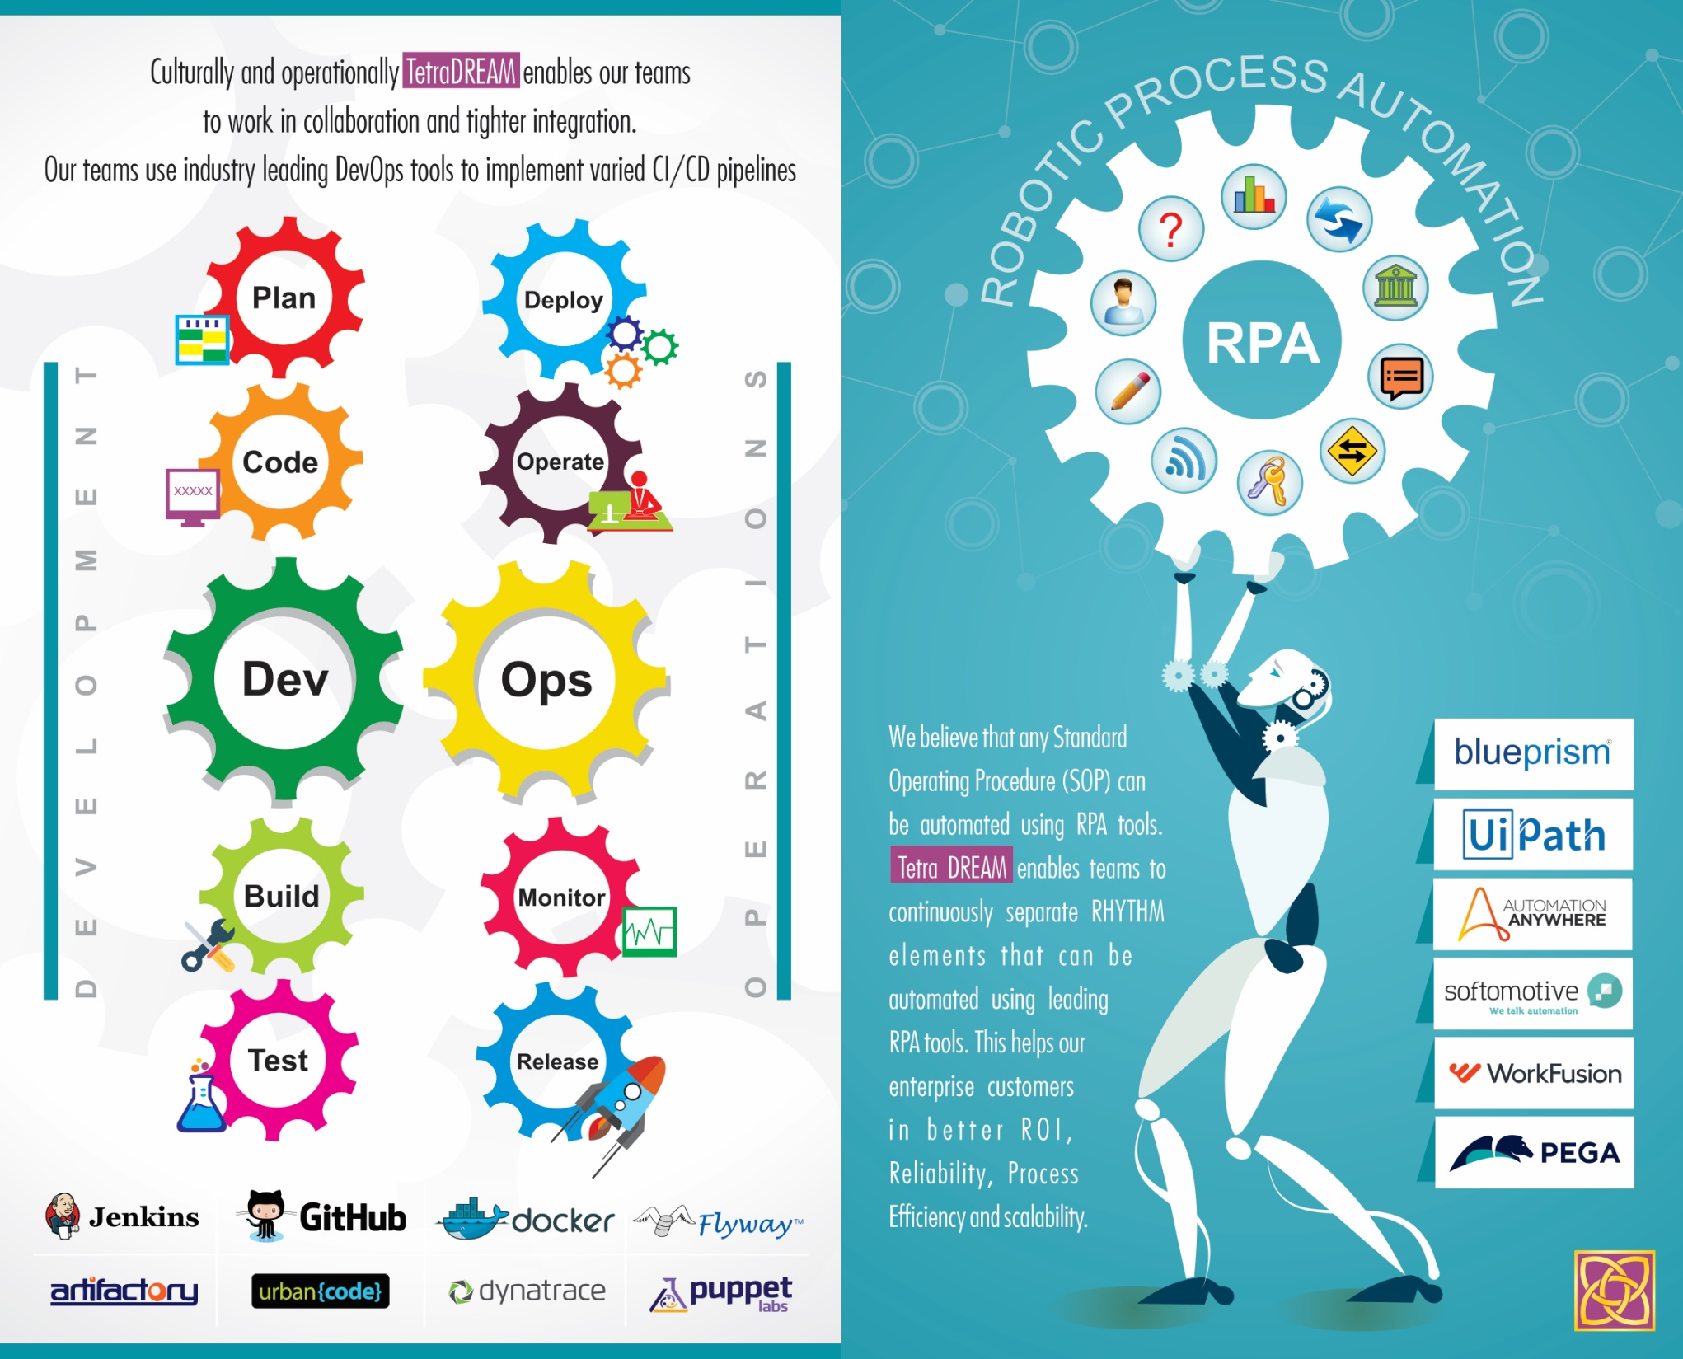

Slide 22
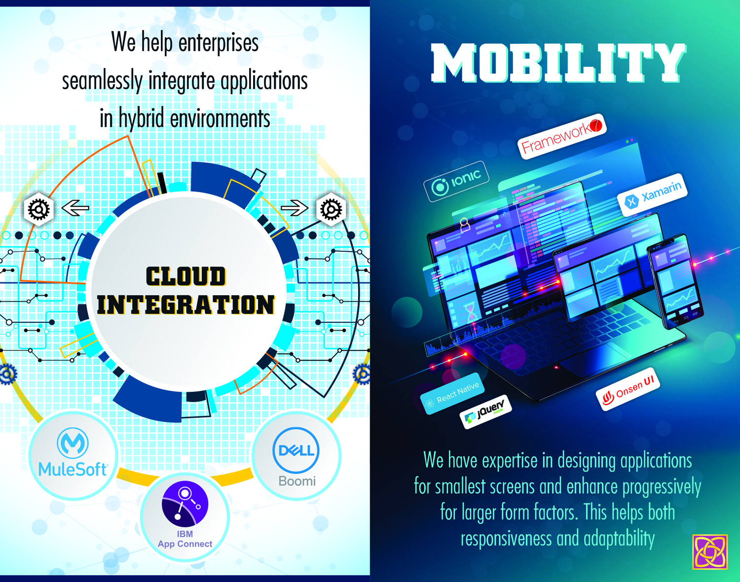

Slide 23
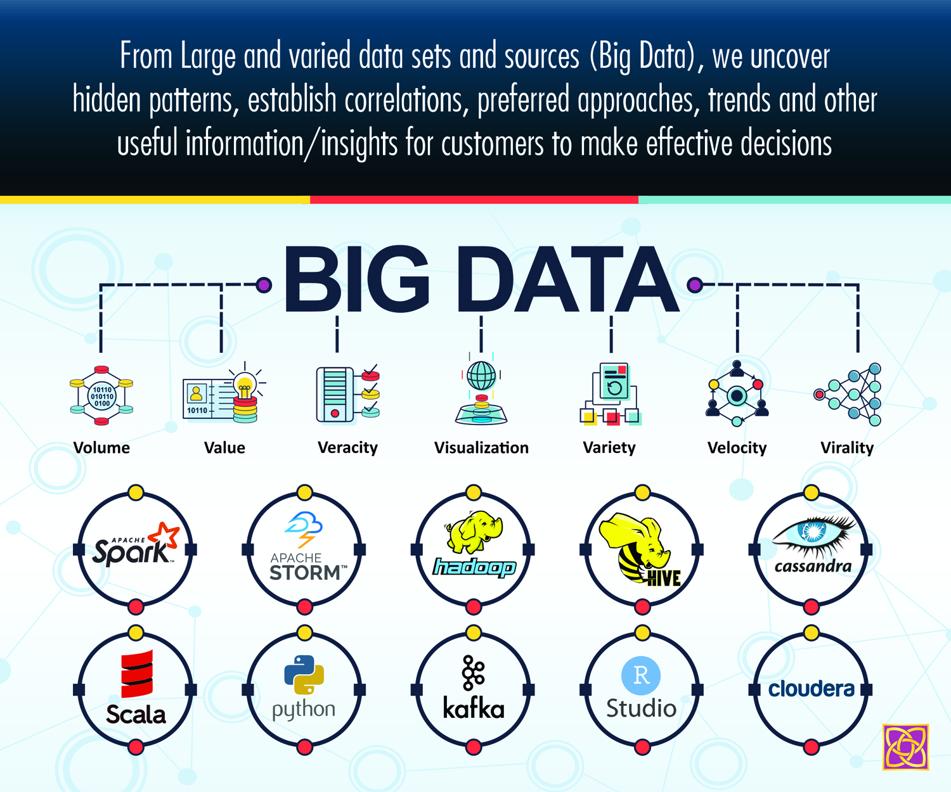

Slide 24
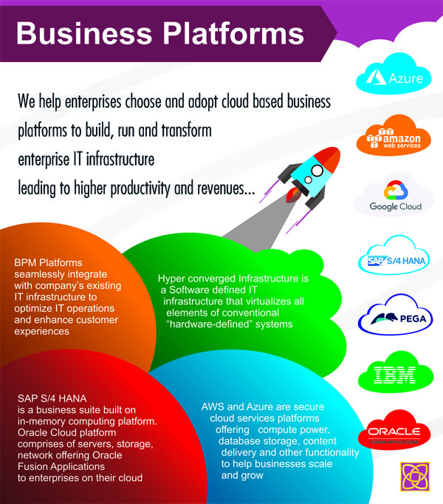

Slide 26
Tetra Talent Academy
To reflect Tetrasoft’s commitment to employees and customers by ensuring continuous learning and development of talent pool.
Areas nurtured:
  Digital Competence
  Technological Expertise
  Functional Skillsets
  Behavioral Leadership
Objectives:
  Knowledge Management
  Continuous Learning
Digital
Technology
Talent Academy
Behavioral
Skillsets

Slide 27
Tetra Talent Academy
Reflect
on Current
Capability
Demonstrate
Components
Aquire
Practice
Imbibe
RAPID

Slide 28

501
EXPERT
EXPERT
EXECUTIVE
401
PROFICIENT
PROFICIENT
SENIOR
301
COMPETENT
COMPETENT
MID LEVEL
201
AD. BEGINNER
AD. BEGINNER
ORGANIZED
101
NOVICE
NOVICE
FOUNDATION
TECHNOLOGY
DIGITAL SKILLS
FUNCTIONAL SKILLS
BEHAVIORAL LEADERSHIP

Slide 29
FOCUS AREAS
PRACTICE MECH.
Feedback Loop
OUTPUT
DIGITAL
CLASSROOMS
DIGITAL POD
BULLPEN
HIGHLY SKILLED
WORKFORCE
POINT SOLUTION
TECHNOLOGY
E-LEARNING
UDEMY
Etc..
KNOWLEDGE
DISSEMINATION
ROLE BASED TRAINING
(TRAIN THE TRAINER MODEL)
FUNCTIONAL
Methodology
Contractual commitments
Quality processes
Roles & Responsibilities
Transition Skills
WORKSHOPS,
CASE STUDIES &
ASSIGNMENTS
BENIFIT
DIGITAL
EXCELLENCE
BEHAVIORAL
CERTIFICATIONS
QUALITY SOLUTIONS
CUSTOMER DELIGHT
EMPLOYEE ENGAGEMENT
Cross-cultural skills
Leadership skills
Refine the Framework based on Learning/Feedback

Slide 30
Skill level mapping
FUNCTIONAL
SKILL SET
DIGITAL
TECHNICAL
BEHAVIORAL
L4
HIGH
HIGH
EXPERT
EXPERT
L3
HIGH
EXPERT
HIGH
HIGH
L2
MEDIUM
HIGH
MEDIUM
MEDIUM
L1
BASIC
HIGH
BASIC
BASIC

Slide 31
Outcomes
KNOWLEDGE SHARING
BOK
TRAINING
SESSIONS
Enterprise
Architecture
Orientation
Agile Enablement
Knowledge
Sharing
Repository
PEOPLE DEVELOPMENT
Refresher
Courses
Continuous
Learning
WORK SMART
Share
Experiences
Reuse of Code
Tools Usage
DevOps
Orientation
IMPROVING PRODUCTIVITY

Slide 32
Digital Services
Digital
Marketing
UI/UX
Security and
Digital
Assurance
Cloud and
Automation
Connected
Devices and
Mobility
Business Platforms
& Integration
Big Data and
Analytics
Enabling Digital Transformation
- Design and Technology Strategy
- Interaction and Visual Design
- UI Development and Re-engineering
- Enterprise Platforms UI Engineering
- Omni Channel Assurance
--Assuring customer experience
- Accessibility Assurance
- Digital Security
- Identity and Access Management
- Cloud Security
- Security Testing
- Cloud Architecture & Design
- DevOps Engineering & Automation
- Cloud Migration
- Cloud Operations Management
- Hyper Converged Infrastructure
- Robotic Process Automation
- IoT Solutions Engineering
- Platform Engineering
- Mobile Application Development
- Application Development & Maintenance
- Architecture and Solution Framework
- Data Lifecycle Management
- Data Visualization and Insights
- Predictive and Prescriptive Analytics

Slide 33
We enable our customers in…
Developing Strong integrated and secure network
  Creating strong platform to help secure data flow to
  act as Digital thread connecting the entire org
  Secure network to hold data loads and maintain integrity
Creating environment for employees,
partners and customers
  Creating digital workplace to leverage cloud business platforms and automation solutions to improve efficiency
  Customer/Partner first model to develop friendly
  ecosystem for customer/partner
D
C
We
Enable
Data and Application Management
(on premise and on cloud)
  Application rationalization based on the application/platform capabilities to empower and create value to the enterprise
  Effective Hybrid strategies
Creating secure omni channel experience
  Uniform experience across various form factors
  Mobile First Strategy
D
C

Slide 34
INNOVATION LABS
  DIGITAL INNOVATION PARTNERSHIP

Slide 35
Tetrasoft Innovation Labs
Tetrasoft Innovation Labs focus on Customers’ digital journey:
Innovation chain: Ideate, innovate, design, develop and transfer ownership of the products
Help customers innovate and implement empathy centric designs
Helps define Roadmap and blue prints for intelligent, conversational applications
Consists of industry veterans with deep functional and technical knowledge in financials and insurance
Consists of solid programming experts
This team also builds Tetrasoft’s IP Solutions

Slide 36
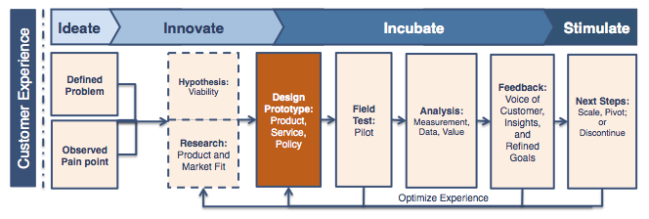
Tetrasoft Innovation Labs
Co-Innovation along with our customers using Innovation Lab Service
Design Thinking Expertise
Strong UIUX Team
Multi skilled technology team
Lab equipped with Dev Tools & Devices
Frameworks & Pre Developed Models for Jump Start
Experts in Design Thinking
Technology Expertise Multiple Domains
Industry & Business Context
Collaborate with Customer on Needs

Slide 37


