Slide 1

Centroxy Solution Pvt. Ltd.
Delivering Solutions That Matter To The Business...
www.centroxy.com

Slide 2
Who We Are...
We are IT Solutions, Consulting and Services organization specialized in providing customized, end-to-end IT solutions that achieve business success, leveraging leading technologies in a global delivery model. In addition to the excellent service capabilities that have been acknowledged by clients’ time and again, our real differentiator lies in our culture and value system.
We constantly strive in providing better quality services and, in due course, become seamless extensions of clients’ teams, delivering clear competitive advantage beyond traditional cost efficiencies. We propel our clients forward by enabling superior operational performance and we work within their existing processes and industry vocabulary to address targeted business challenges.
www.centroxy.com

Slide 3


Our Journey..
2024
We target to reach a turnover of 15 Million USD focusing on technologies serving the earmark technology areas
2020
Business was strategically aligned to various verticals with focus on IAM, Cyber Security services like PAM, EndPoint security , BI and app development using low code platform. Won some major deals from USA, Europe and Middle East. Currently have 85+ team.
2017
Successfully delivered some big projects. Became a partner of GLUU, a fast-growing IAM software company based out of USA​
2018
Delivered more than 7 projects of significant size. Company strength grew to more than 15
2016
Was incorporated as a Pvt. Ltd. Company
www.centroxy.com

Slide 4




IT Services
Data Services
We are constantly focused on designing and delivering the next generation applications and digital experiences for our customers. We specialize in Big Data & Business Analytics using AbInitio,SSAS, SSIS, SSRS, Power BI, Tableau, QlikView.
Application Development & Support
Specialize in web development services. Our web development services are high-performing, feature-packed and digitally transformative, designed to be user-friendly, fully functional & very secure.
Low Code Application Development
Innovative apps are made when you have the right application development practices in place. Centroxy empowers you and your team to turn big ideas into enterprise-grade apps in less time and with less resources using low code application development using tools like Mendix & Out systems.
Cyber Security Services
  Centroxy provides a ready to use, secured solution to enterprises which includes Identity Management, Access Management, Single Sign On, Multi factor Authentication, Password-less Authentication, Self Credential Management, API Gateway etc. We use GLUU,Okta,Sailpoint,Saviyint.
www.centroxy.com

Slide 5
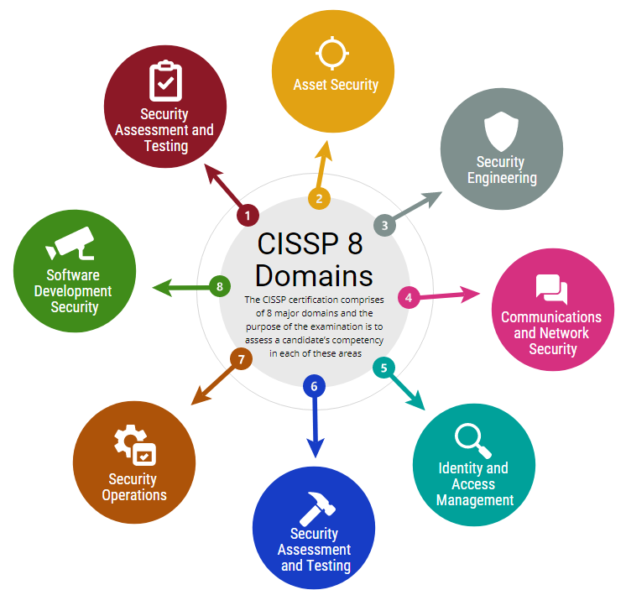
Cyber Security Services
Focus Area
Identity and Access Management | Security Assessment and Testing
Access Management Single Sign On (SSO) Federated Identity Management Multi Factor Authentication (MFA) Intelligent Access Identity Orchestration | Static Application Security Testing (SAST) Dynamic Application Security Testing (DAST) Interactive Application Security Testing (IAST) Third Party Risk Assessment Vulnerability Management Control Testing
Identity Governance & Administration (IGA) | Software Composition Analysis (SCA)
Privileged Access Management (PAM) | Penetration Testing (Pen Test)
IAM Services
Area Of Services | Managed Services
Identity and Access Governance (Sailpoint, Saviyint, OpenIAM ) | Technical Support, Product Upgrades and maintenance of medium to large scale IAM implementations
Authentication & Authorization (GLUU, Forgerock, Okta, Ping Identity ) | App Onboarding and Discovery of Privilege Accounts using standard processes
Single Sign On and Federation (GLUU, Forgerock, Okta, Ping Identity ) | User Account Lifecycle Management and Access Certifications
Privileged Access Management (CyberArk, Savyint, Beyond Trust ) | Core Privileged Access Management, Application Access Manager , End point Security
www.centroxy.com

Slide 6
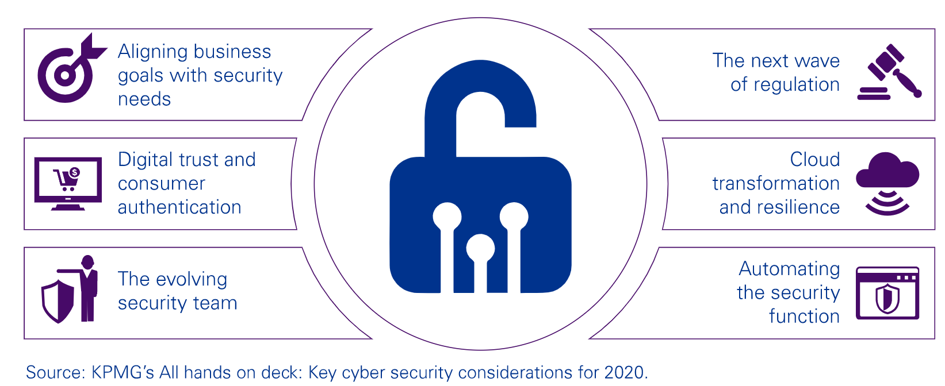
Cyber Security Key Focus Area
  Through strategy and governance, organizational transformation, cyber defense and cyber response. And cyber security professionals don’t just recommend solutions — they also help implement them. From penetration testing and privacy strategy to access management and cultural change
www.centroxy.com

Slide 7

Professional Services
Centroxy Professional Services division focuses on attracting high quality talent which are in great demand with our esteemed clients. We work proactively to understand the needs of the clients and we onboard the best fit talent.
Our Talent Acquisition team has the knack of attracting the best resources, evaluate them thoroughly to ensure clients spend the least time to select the candidate.
Are the best fit resource for the specific skill (technical, domain, soft) requirement.
Can engage directly with on-site teams and can work independently.
Are well versed in incremental features addition, phased/iterative development and frequent releases.
Is experienced with clearly defined handover across distributed members.
Delivers results that meet the quality and cost objectives of the clients.
www.centroxy.com

Slide 8


















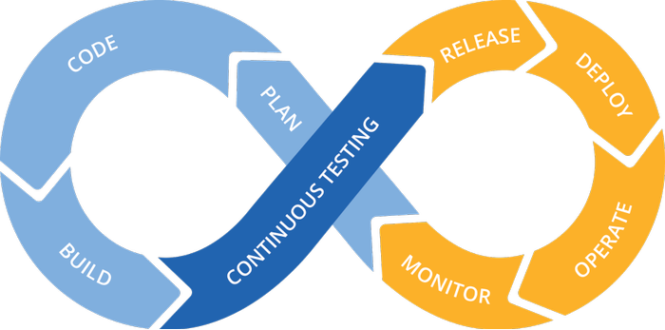














Our Technology Forte ...
www.centroxy.com

Slide 9

















Our Customers
www.centroxy.com

Slide 10
Keep in touch with us..
Contact Us:
Email: hello@centroxy.com
Phone: US: +1-(908) 857-0100​
India: +91 9339898121​
    Address:
    INDIA:
    3rd Floor, OCAC Tower Acharya Vihar,
    Bhubaneswar – 751013, Odisha, INDIA
    DUBAI:
    Centroxy Solution FZCO
    Dubai Airport Free Zone 3W, G016
    P.O. Box 371604, Dubai – UAE
    Dubai: +971-501735957
our office
our office
www.centroxy.com

