Slide 1



CORPORATE PORTFOLIO
CORPORATE PORTFOLIO
In pursuit of
a unique value creation thru Next Generation Technologies at www.aashdit.com

Slide 2












Index
Executive Summary
Aashdit Technologies is a next generation technology company that helps enterprises transform their businesses for the digital era. Established in 2015, Aashdit has traversed an eventful journey to evolve from humble beginnings into the organization it is today.
Our expertise expands across all horizons of the SDLC that holds the potential to deliver holistic products / services across industry verticals enabling niche technologies and new age standards..
Aashdit at a glance
Why aashdit
Java practice
Practice excellence
Happy Clientele
Service delivery framework
Service Portfolio
Journey Infographics
Mobility offering
Testing practice
ISO – 9001:2015
ISO – 27001:2013
ISO – 20000:2015
Certifications
Employee Strength
80+
Client Base
INDIA, USA, JORDAN,
DUBAI, MALDIVES
CORE ACTIVITIES
Web & Mobile Development
Business Consulting
Technology Service
Resource Outsourcing

Slide 3
Aashdit at a glance
Next generation development and solutions company
The Company
7+ Years as a IT Solutions Provider
80+ career driven technical resources providing all software services
Positive Revenue
ISO certified
Process Transformation
Industry Focus
BUSINESS CONSULTING
TECHNOLOGY SERVICE
RESOURCE OUTSOURCING
INDUSTRIALIZED SOLUTIONS,
‘AS-A-SERVICE’ MODELS
PROCESS STANDARDIZATION
EMERGING TOOLS & TECHNOLOGIES
FLEXIBLE OPERATING MODELS
Transaction Automation
Solutions Portfolio
  Custom Application Development Software QA and Testing
  Domain -E-Governance, Mobility, Payments, ERP, Analytics
  Agile Methodology
Technology Infrastructure
Software, Cloud, Server & Storage, Systems Integration
Digital Adoption
Credentials
Customers
AXIS BANK, ICICI BANK, Idco, OPRO, Atmosphere Groups, Odisha Government
Technology Partners
Digital Ocean, AXIS Bank, ICICI Bank
Integrations
RBI Treasury, Axis Bank Payments, ICICI Bank Payments
Ability to Invest
Relationships
Competencies
Assets
Decision Digitization

Slide 4
Journey Infographics
Road Map towards Innovation and Efficiency
Engagement – Top Tier Indian Bank
First Step – E-Governance
First Mobile Application – Banking
Reached a client size of 10
Improve Consistency
First healthcare project - US
START
2015
2016
Build and Incubate
Build and Incubate
Resource Deployment at East Africa
Digital Marketing & Social Media Management
Improve Consistency
Process Standardization
Centralize Management of Artifacts
.
E-Commerce -Jordan IT Firm
Engagement – Dubai Clients
Consolidate Environment & Tools
Reduce Maintenance
Resource Utilization Matrix
.
Nurture and Optimize
Nurture and Optimize
2018
2017
Streamlined Processes – Best Practices, Standard SDLC
Optimized usage of Environment & Tools
Establishment of a new corporate vertical across Maldives
Metrics & Measurement Framework
Flexible Resource Pool
Product Development Channels.
Nurture and Optimize
2019
2020
2021
  Unification of formal practices and standards into SDLC
Thrive and Accelerator
Thrive and Innovate
Corrective Actions & Continuous Improvement
Building reusable assets across the enterprise (process assets, automation framework etc.)
Improve overall Quality & Enterprise Maturity level
Predictable Performance, Skill Upgradation
Adding product enablers to our products.
Expanding our corporate vertical channel across the world wide

Slide 5





Service Portfolio
Custom Application Development
Social Media Management
Agile Methodology
Selenium
Angular
Java, NodeJS
Jmeter, LoadRunner, RFT
E-2-E Proposal Statement & Solution
Project Management
Mobile Automation
React
Spring, Microservices
Accunetix, Net sparker, Zap,
TECHNOLOGY SPCAE
SonarQube
TOOLS & METHODOLOGY
SERVICE DELIVERY
XML, Servlets, Hibernate
Nessus for Penetration testing of web application
Program Management
Account Management
JSP, HTML, CSS
Jenkins for Deployment
Web & Mobility Development
Post Implementation Support
Android, iOS, Hybrid
JQuery, AJAX
ECommerce
ERP
Supply Chain
Mobility
Analytics
Business
Services
Consulting
Development & Quality Analysis
Upgrades & Consolidation
AMC & Support
Hosting

Slide 6
Service Delivery Framework
1. Engagement
2. Project initiation
3. Solution delivery
4. Project closure
5. Support & maintenance
6. Account Management, Project Maintenance and Quality Assurance
Commence Engagement Process
Formal Commitment To Proceed
Formal Completion of Project
Warranty Period Commencement
3.2
Development
1.1
Sales Process
1.2
Prepare to Engage
2.1
Kick-Off & Plan
2.2
Design & Plan
4.1
Review
4.2
Close
5.2
Support & Maintain
5.1
Warranty Start
3.1
Design
3.3
Test
3.4
Deploy
Formal Commencement of Project
Check
Check
Check
Check
Design Specification
Prototype / POC
Development
System Test Plan
User Acceptance Cases
KT & Training
Defect Register
Deployment Plan
Estimate
Proposal
Readiness Assessment
SOW (Statement of Work)
Project Success Plan
Project Execution Plan
Project Schedule
Requirement Definition (BRD)
Post Implementation Review
Go Forward Plan
Support & Maintenance Agreement
Support Case Register Setup
Periodic Status Reports
Minutes of Meetings
Budget Tracking
Change Order
Issues & Change Register
Project Closure Report

Slide 7




















Happy Clientele
Delivering value and innovation

Slide 8




Practice excellence
The delivery governance model
Senior Leadership Team
Engagement Review: Agreement and performance
Strategic Objectives
Long term planning
Financial Review
Strategic
Senior Leadership Team
Executive Review
Program Leadership Team
Monthly review
Service Delivery / Performance review
Future Plan
Tacticall
Escalation Matrix
Account Leadership Team
Program Management
Project/Program Leadership Team
Weekly review
Demand Management
Change management
Weekly planning
Metrics Management
Operationall
Delivery Leadership Team
Project Team

Slide 9

Middleware Technologies
EJB
Spring
Java Practice
Advanced Technologies
Script Language
AOP
Reflection
Patterns
Deployment
NodeJS
AngualrJS
Javascript
Mongo DB
Application Servers
Java Web Development
Custom Java Development
Java Application Maintenance & Support
Mobile Development
J2EE Development
Java Migration
Java Integration
Java Software Development
Distributed Applications
JBoss
Apache Tomcat
Oracle AS
Oracle Weblogic
(former BEA Weblogic)
Websphere
SOA / REST
RMI
JMS
EJB
Java - CoE
Reporting
Presentation Layer
JSP
Crystal Reports
Jasper
JSF and JSF-based frameworks
Spring MVC, Spring Boot
Struts2
AJAX Frameworks
Desktop Applications
Data access
Swing
SWT
AWT
JPA
JDBC
Hibernate
Unit Testing
JUnit
HttpUnit
JMeter

Slide 10
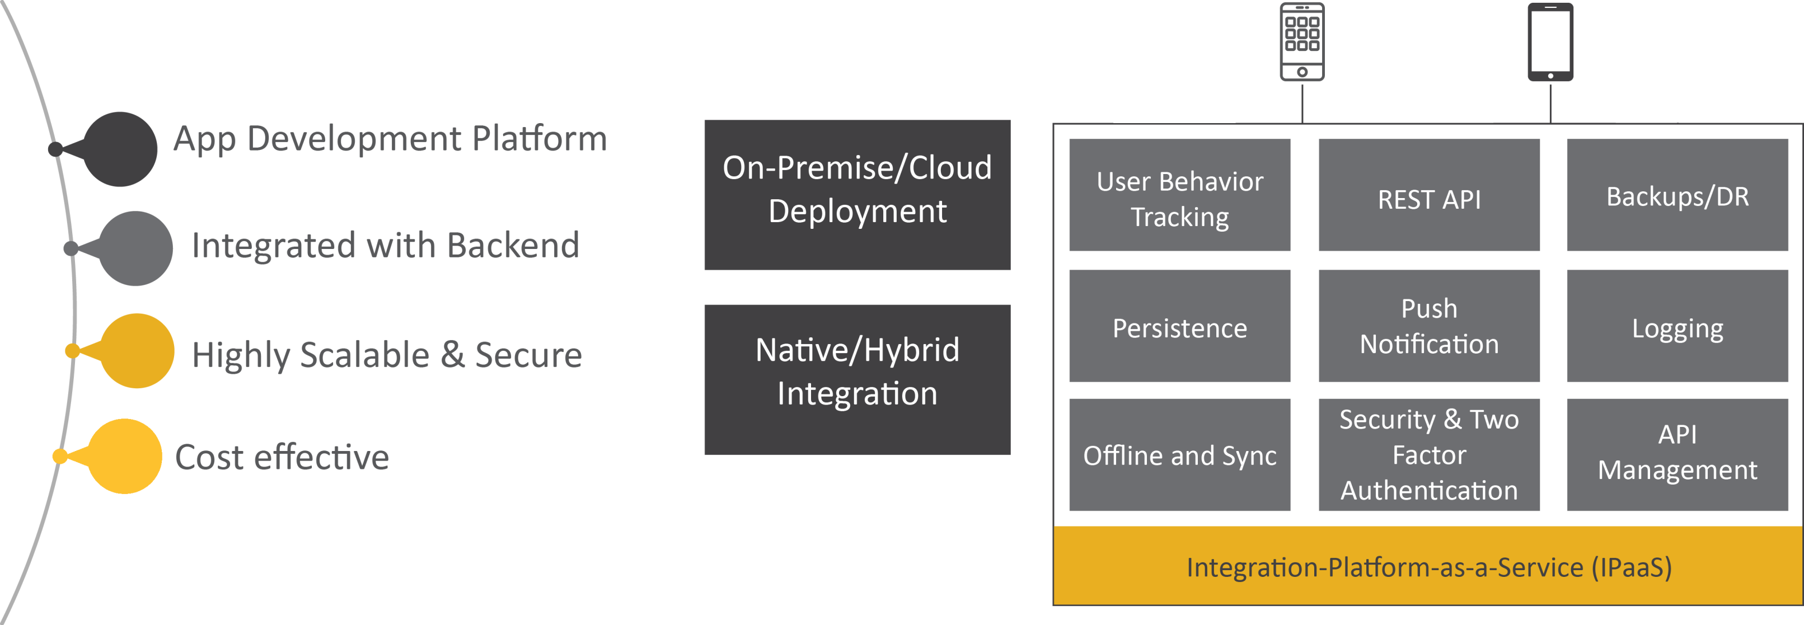
Mobility Offering
Projects
Manufacturing Shop floor
After Sales Service
EAM
“Mobility is the enabling centerpiece of digital convergence, an easiest portal into your digital self.”

Slide 11

Testing Practice
Automation Testing
Assessment
Regression
SOA
Mobile
Security Testing
Manual Testing
Assessment
Penetration
Web App
Benchmarking
Assessment
SIT
Migration
Compatibility
Regression
Assessment
Scalability
Load & Stress
Benchmarking
Performance Engineering
Leveraging:
Automation Tools
Penetration Testing Tools
Test Data & DB Testing
Performance Testing Tools
Security Testing Tools
HP QTP, IBM RFT, Cucumber Robotium, Appium, Python, Silktest, Jbehave, Selenium, SoapUI, AutoIT, Worksoft Certify
Accunetix, Nets Parker, ZAP, Nessus
Grid Tools, SQLEdit AnydbTest, dbUnit Camouflage
Jmeter, WebLoad SoapUi / LoadUi
Burp Suite, IBM App Scan, HP Web Inspect, HTTP Watch, NetCraft, Tamperdata, Nimap

Slide 12









Why AASHDIT?
Dynamic transformation
Digital ready solutions provider
ERP, Analytics, Mobility and Cloud Innovation focus to drive Transformation
Simplification and rationalization
Agile & Hybrid Model integration
Partner of Choice with global organization being a start up
Smart Operations – inline with needs
Flexible and “Client friendly” pricing models
Enhanced innovations
Unique combination of domain-vertical-technology COEs
and SMEs to drive tactical and operational improvements
Aashdit ’Specialist’ framework for driving customer specific Innovation
Idea generation & innovation culture within each delivery team
Adaptability and responsibility
Customer centric engagement and delivery model focused on operational excellence
Delivery centers & facilities aligned with customer needs
Aashdit management involved and invested in ensuring Customer’s success
In Summary
Trustworthy outsourcing partner
Outcome linked SLAs driven service delivery
Automation with tool driven service delivery
End to End accountability
Automation & Data Anayltics
Structured Governance model
Thought Leadership
Strategic Roadmapping & Visioning
Innovative Service delivery frameworks & platforms
Long-lasting customer relationship
Efficient talent pool
Strong technical and functional expertise with an attitude
of ‘Delivering Beyond the Contract’
Diversified Background & Domain knowledge
Stable and expanding long-term (5-10-20 year) relationships
Strategic outsourcing partner
Customer references & Introductions – revenue driver
VISION
To become a respected brand by providing innovative solutions that add value to our customers with the help of our passionate and resourceful team.
CORE VALUES
Focused
Professional
Innovation
Agility
Trust

Slide 13

THANK YOU

