Slide 1
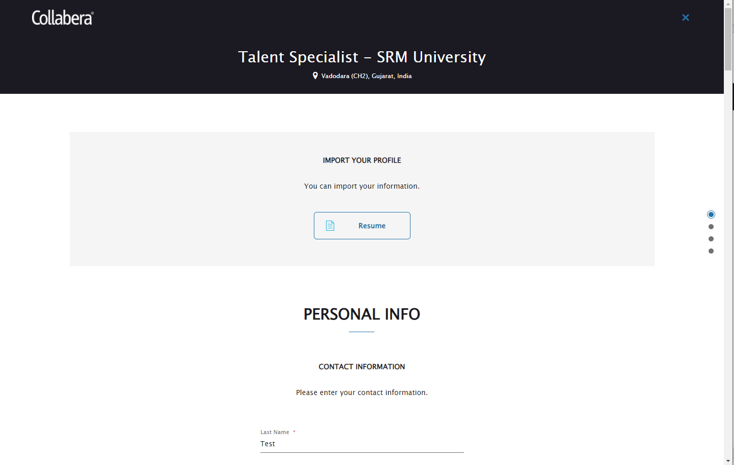
When candidate apply for any requisition then first section is the Profile Import. He can choose to upload his resume and fill some fields automatically based on the information provided in resume. He can skip this and move to the next section also.

Slide 2
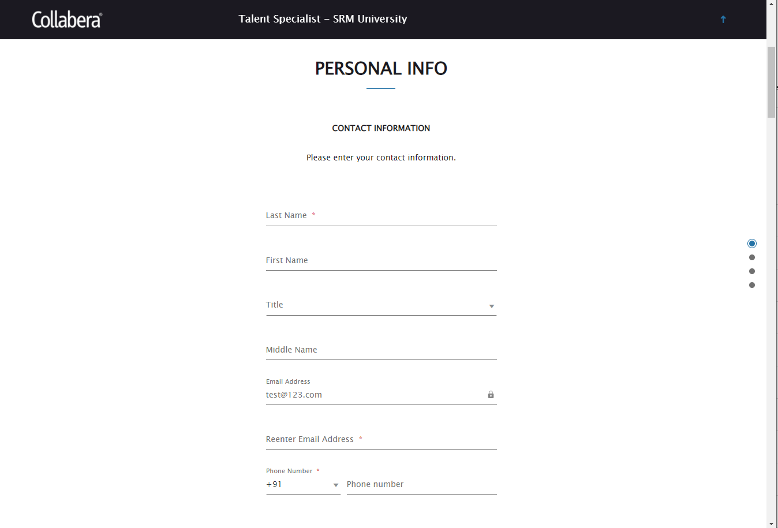
Step 1: In Personal Info section, fill the mandatory fields like Last Name, Reenter email address and Phone number.

Slide 3
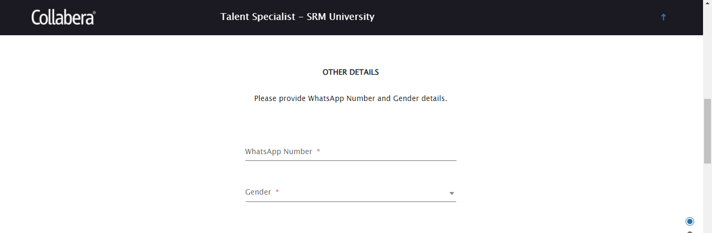
Step 2: Scroll down to Other Details section and provide the WhatsApp Number and Gender details.

Slide 4
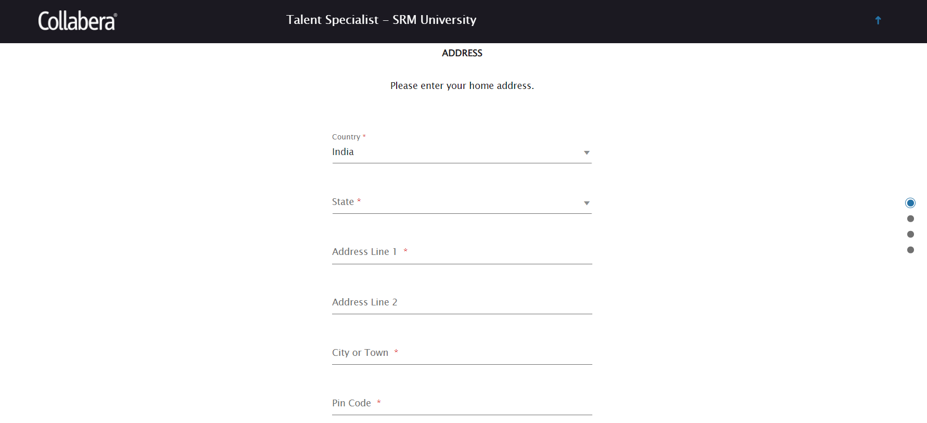
Step 3: Scroll down to Address section and fill the mandatory fields marked with aesterisk.

Slide 5
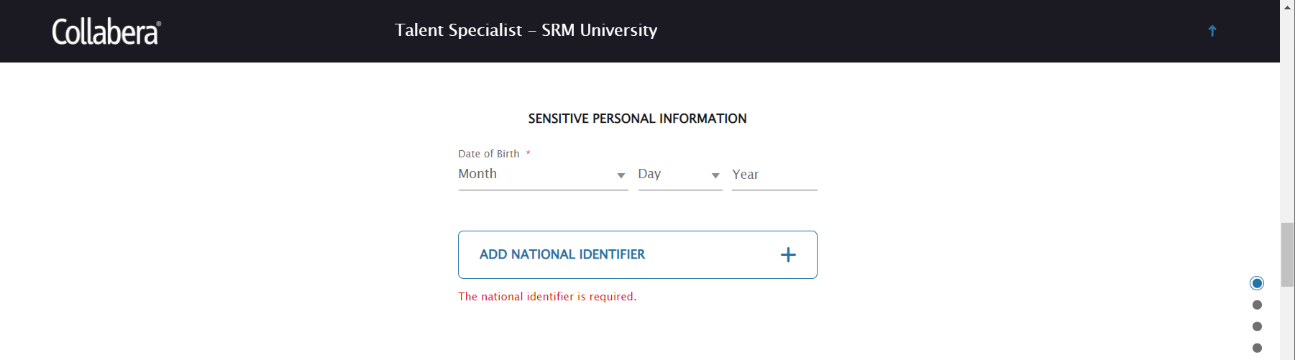
Step 4: Scroll down to Sensitive Personal Information section and fill the Date of Birth then click on ‘ADD NATIONAL IDENTIFIER’

Slide 6
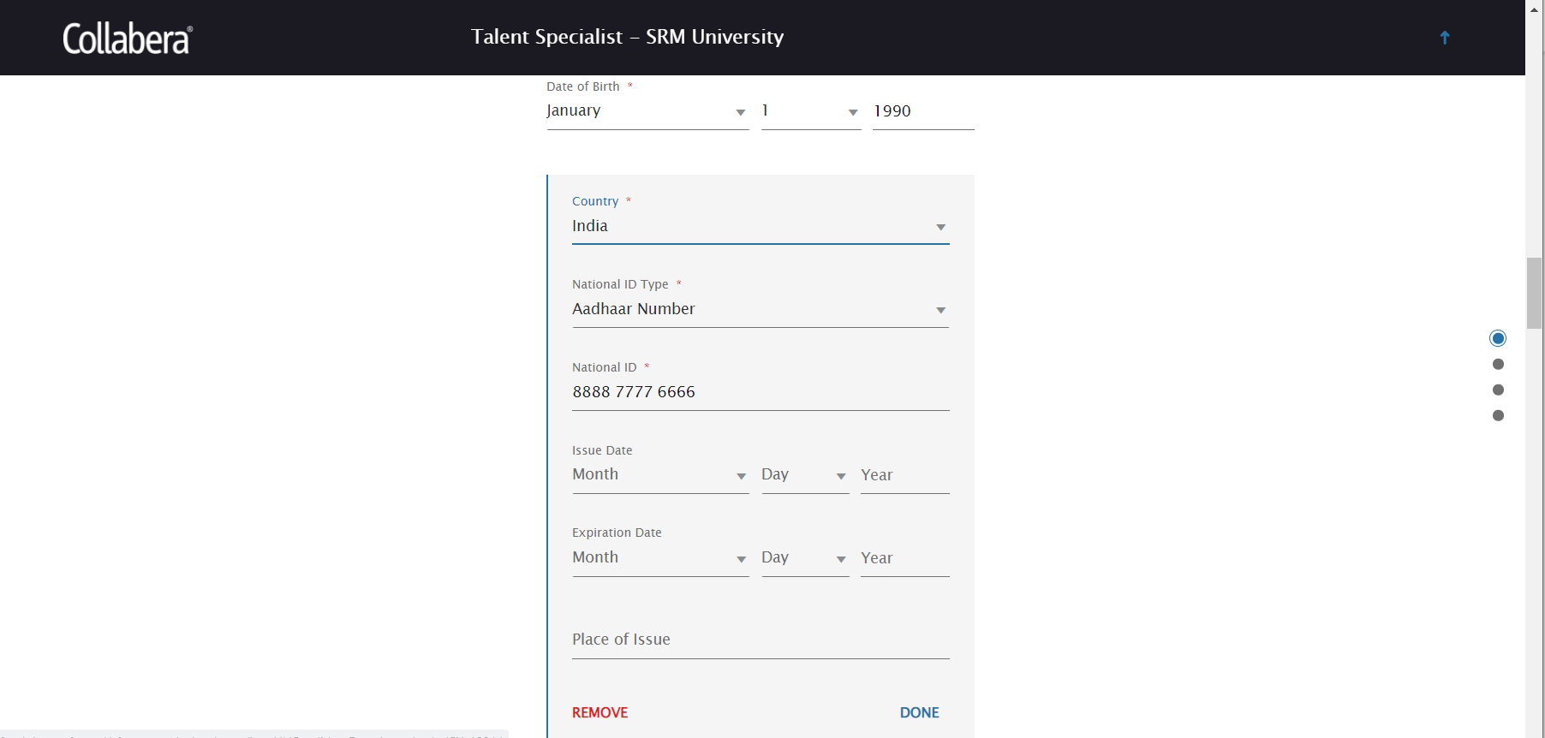
Step 5: Fill below mandatory fields in National Identifier.

Slide 7
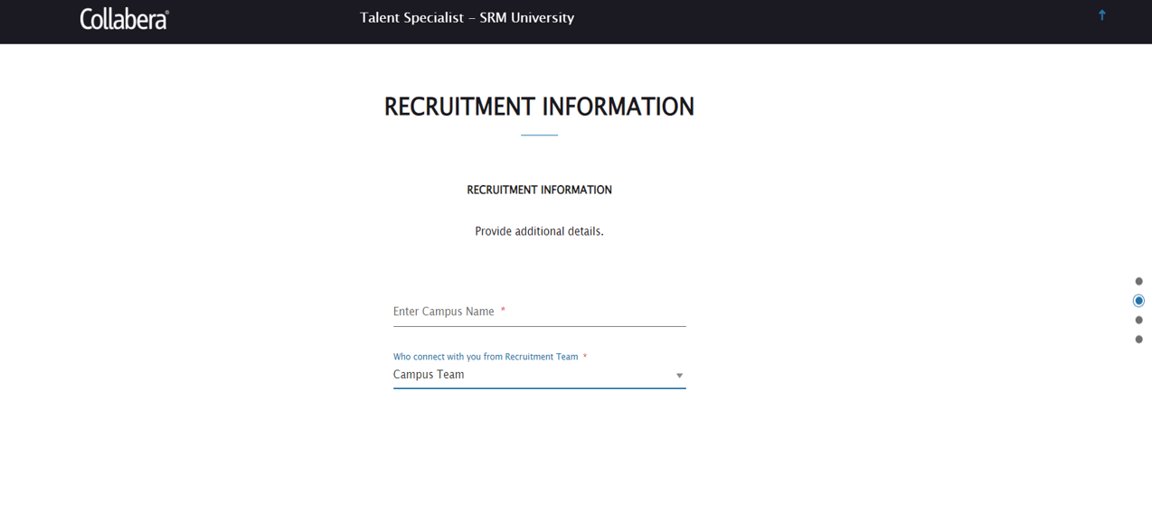
Step 6: Scroll down to Recruitment Information section. Enter the Campus Name and Recruiter Name who contacted you as shown.

Slide 8
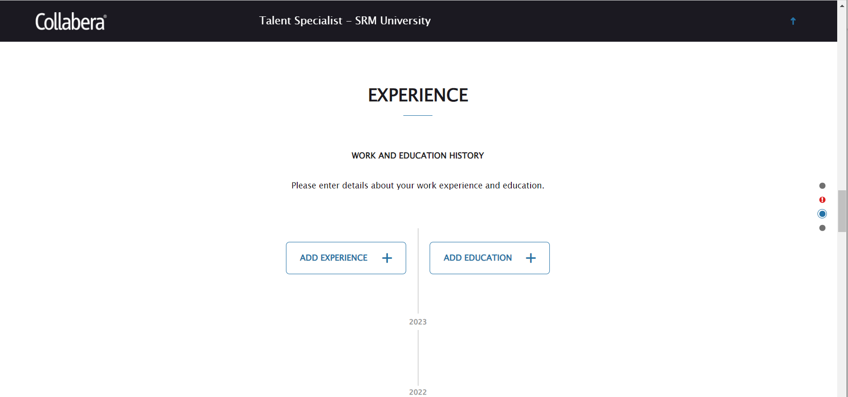
Step 7: Scroll down to Experience section. Click on Add Experience or Add Education button to add these details. These are not mandatory one can choose to skip these.

Slide 9
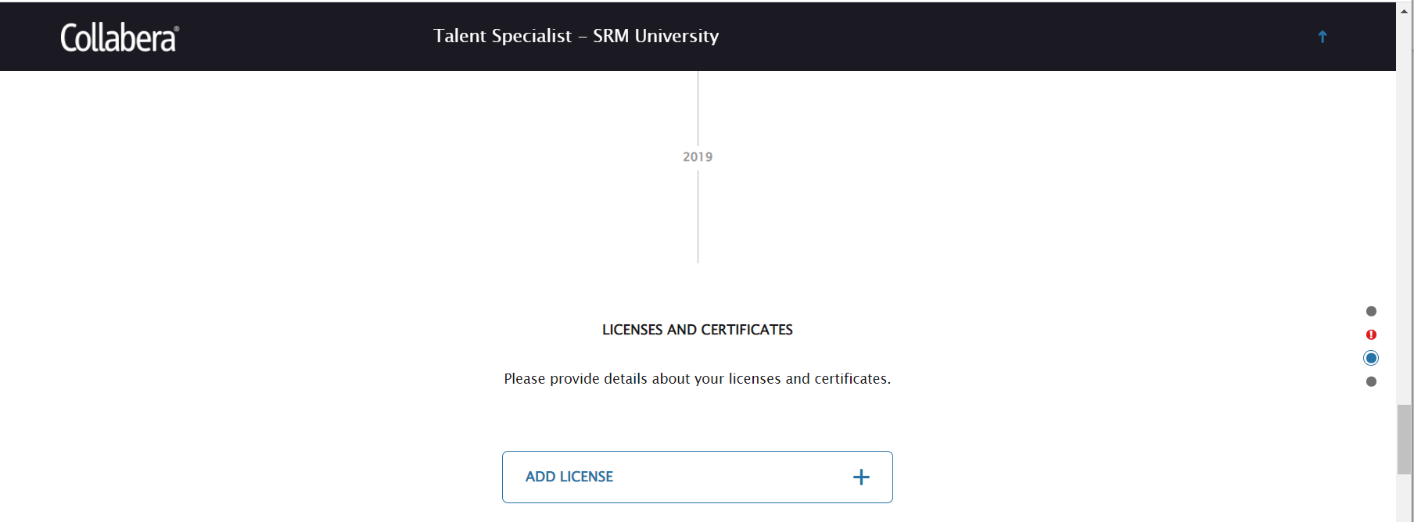
Step 8: Scroll down to LICENSES AND CERTIFICATION section. If you need to add anything then click on ‘ADD LICENSE’ and fill the details. This is also not mandatory.

Slide 10
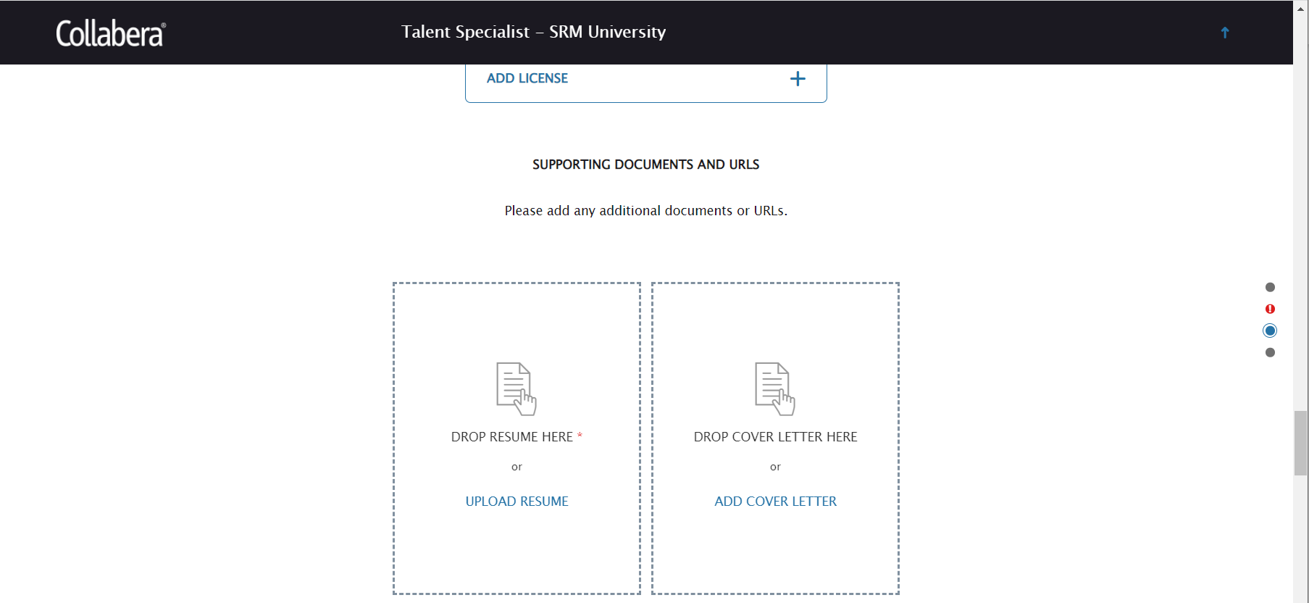
Step 9: Scroll down to SUPPORTING DOCUMENTS AND URLs section. Uploading resume is mandatory.

Slide 11
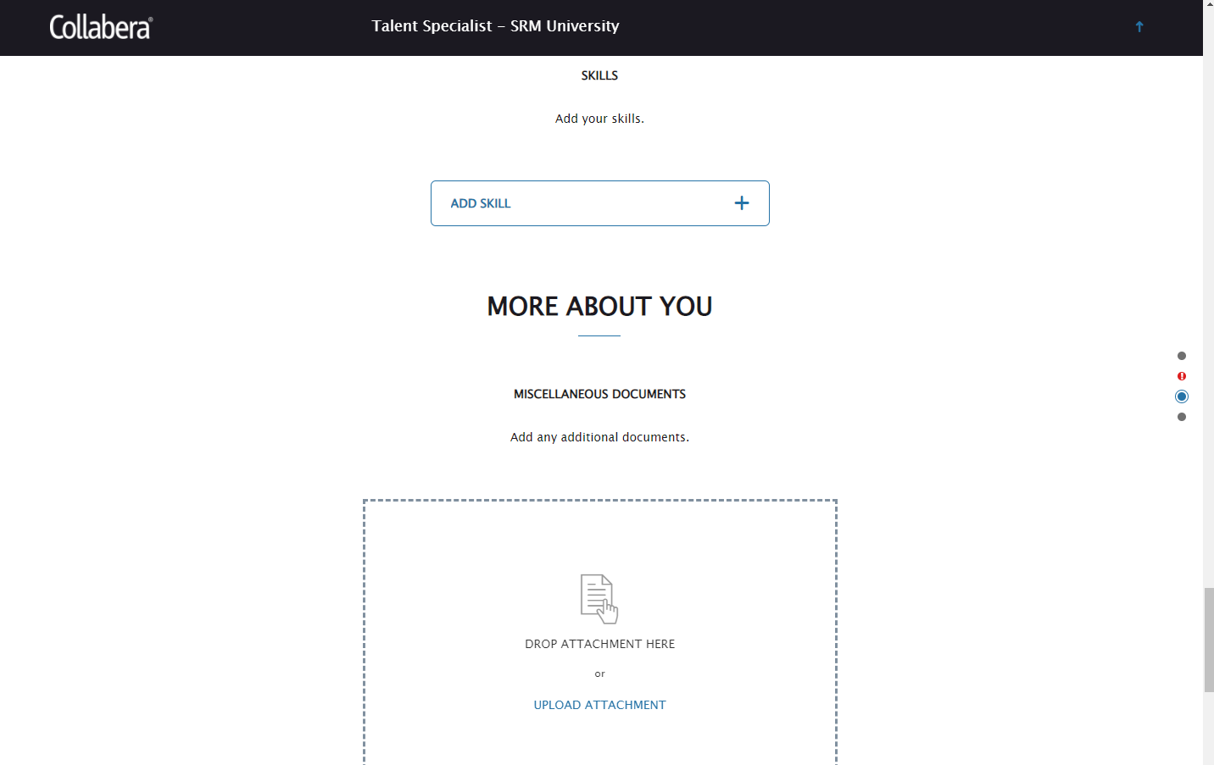
Step 10: Scroll down to Skills section, this is not mandatory. Then we have More about you section where candidate can upload any document he wants, this is also not mandatory.

Slide 12
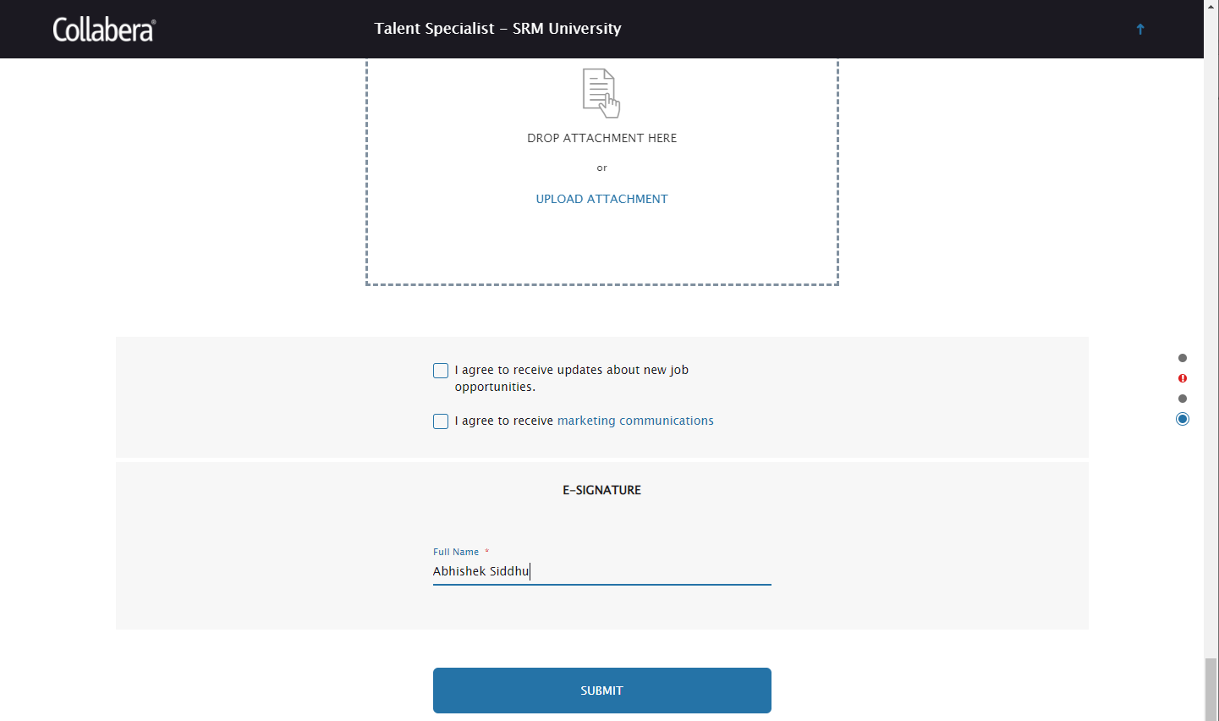
Step 11: Then in the end provide e-signature and click on Submit.

