Slide 1

Web_bocket
Making Your Journey to Building Your Carrier
www.webbocket.com

Slide 2
What is Web_Bocket ..?
We want to provide Curated Education to Students who want to grow , improve, learn and do something Big in their life. So, Learn the Curated Stuff and also show your friends and Juniors the Right Path.
We also provide Services , our work has opened up new frontiers, Here are some of the services in which we excel:
Mobile Application Development
Web Application Development
AI & ML Models
Cloud Support Services
ERP Management System
Digital Marketing Services
www.webbocket.com

Slide 3
Our Mission
Our Vision
Web_Bocket provides the best customer results possible and delivers the WOW factor through our services. Our mission is to be the expert in providing student training & internship and let them placed in a good companies. And we are here to support and achieve a good carrier to bright their future.
Web_Bocket was launched with a vision to achieve worldwide leadership in the sphere of IT and IT enabled services. We are focusing on technological innovations as much as proving true to the client expectation on the current projects.
www.webbocket.com

Slide 4
Web_Bocket provides Internship :-
Why Web_Bocket Different from others ?
Full-stack web development in MERN stack
Android Application Development
Data Science & Data Analytics using Python
Curated Content
One to One Doubt resolving
Live Project Discussion
Verified Certificate
Experience certificate
Tips & Tricks Discussion
Provide Linkedin hacks
Conduct Hackathons
www.webbocket.com

Slide 5
Internship Mode ??
College Training
In-House Training
Curated structure Course
Weekly 4 days Class
In-Hand Project Building
24*7 Doubt Support
Certificate of Completion
Job Assurance with Good Companies
Open Source Project Hacks
Talk with Developers
Curated Structure Course
Weekly 4 Days Classes
In-Hand Project Building
Certificate of Completion
One to One Doubt Clearing
Free wifi & Central AC Room
Talk with Developers
Job Assurance with Good Companies
Open Source Project Hacks
www.webbocket.com

Slide 6

Full-stack Web Development in MERN stack:-
HTML5
CSS3
Bootstrap
Tailwind CSS
JavaScript
React JS
Next JS
Node JS
Mongo DB
Git & Github
www.webbocket.com

Slide 7

Android Application Development:-
Intro to Java
Development Framework
Android File System
Location & Map Function
GEO Coders & Projection
Wake Locks & Text to Speech
Database
Git & Github
www.webbocket.com

Slide 8

Data Science & Data Analysis using Python:-
Python
Pandas
Matplotlib
Seaborn
Statistics
ML Libraries
Database (SQL)
NLP
Deployment
Git & Github
www.webbocket.com

Slide 9
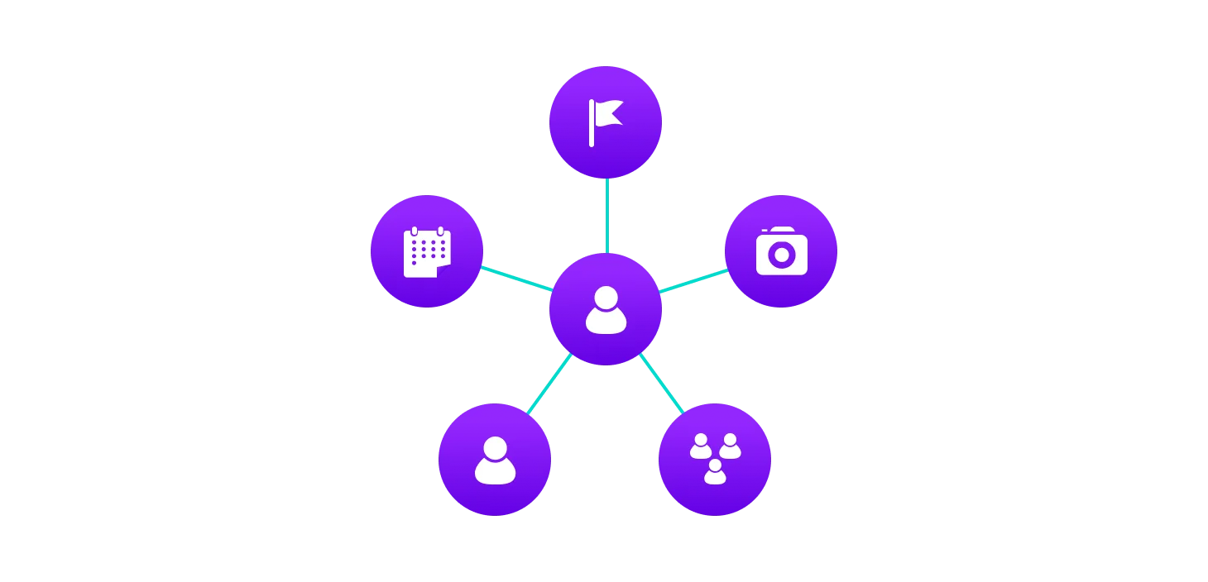
Data Structure using Java:-
Java Programming Language
Array
Linked list
Graph
Queue
Stack
Tree
Sorting Algo
Searching Algo
Hash Table
Heap
Matrix
Dynamic Programming (DP)
www.webbocket.com

Slide 10
Making Your Resume To , Building Your Carrier
We are with You
www.webbocket.com

Slide 11



You Can Reach US :-
Web_Bocket
web_bocket
Web Bocket
Web_Bocket Pvt. Ltd.
www.webbocket.com
Mail : web.bocket@gmail.com
Call : 6372833928 / 8328892097
Address : Nayapali , Bhubaneswar
Thank You

