Slide 1
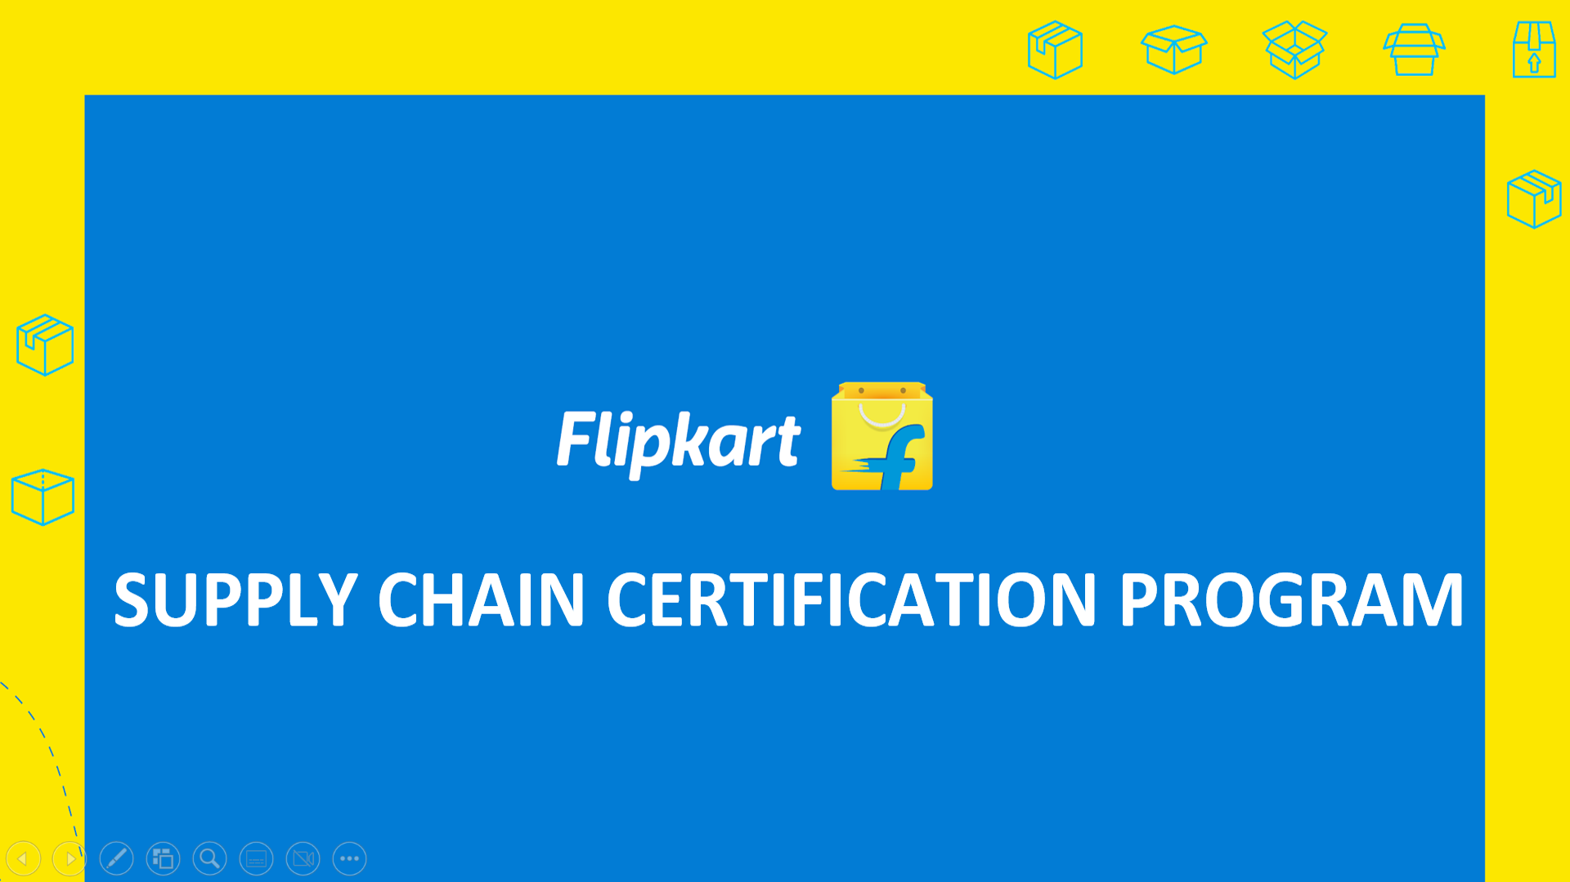

Slide 2














FK Journey
2007
Launches India’s 1st e-commerce company
2008
Launches 24x7 Customer Support
2010
Launches Movies, Music and Mobile Cash-on-Delivery
2011
Launches 30-day Replacement and
Card-on-delivery
2012
Acquires LetsBuy & Launches DigiFlip
2017
Becomes the most downloaded eCommerce App, acquires Jeeves F1
2016
Acquires Jabong and PhonePe, Launches No Cost EMI
2015
Launches Flipkart Lite
2014
Acquires Myntra and Launches the first Big Billion Day
2013
Launches Andriod App, Marketplace and Single-Day-Delivery
S
2018
Strategic investment by Walmart, Launches Grocery, FurniSure & 2GUD
2019
Launches Flipkart Video, Ideas, Games and support for vernacular languages
2020
Launches Voice Assistant, Flipkart Wholesale Business, Flipkart Leap Incubator & Flipkart Quick
2021
Acquires Cleartrip, Launches Flipkart Camera, Shopsy & native support for 11 languages

Slide 3




Org Structure
Technology Product & CX
Corporate Functions
CDO/M3
Category Design Operations / Marketing, Monetization, Merchandizing
Market Place Organization
Flipkart Org Struture
FPG
Fintech and Payment Group
Supply Chain and Jeeves
Flipkart Wholesale

Slide 4
Supply Chain Org Structure
Fulfilment Centre
Mother
Hub
City
Logistics
Large Appliances
& Furniture
Grocery
Line
Haul
Jeeves
and F1
Hyperlocal
Product Technology and Analytics
Design
Control Tower
Projects, Facilities and Infra
Quality
Process Excellence
Central Maintenance Team
Business Finance, Legal, Human Resources

Slide 5
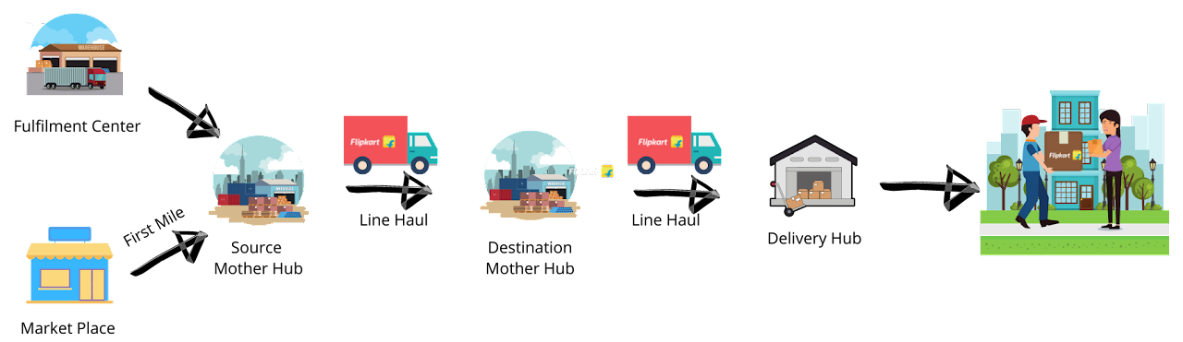
City Logistics
What is City Logistics?
Last leg of the supply chain where the packages are received from Mother Hub and then is connected to customers by a Delivery Executive called as Wishmaster. These Wishmasters are the brand ambassadors and the only point of direct face-to-face contact with the customers.
Notes:
TTJ G8 & Below
TTO G8 & Below
Candidate Satisfaction NPS (G8 & Below)
FTE I EWS Coverage
FTE I Reflect - Minimum 5 Feedback (G8 & Above)
FTE I Reflect Adoption % (G8+)
FTE I Engagement Score
FTE I NPS
Flipmarch Hiring
Successful PIP%
Succession Readiness =/>G8
Source Mix : Referal from 12% to 15%

Slide 6





Initiative & Approach
Supply Chain Certification Program
Fulfillment Centre/Mother Hub
Immersion
Leadership
Connects
Learning
Assignment
Supply Chain
Metrics Deep Dive
On the Job Training (OJT) in Hubs
B.Tech
Freshers
Tier2/ Tier 3/
Un-tiered MBAs
Classroom
Training
Hire Fresh Graduates as Trainees for a 2 Year certification program. Upskill them to become a trained talent pool

Slide 7

Value Proposition
01
Opportunity to work for Top Employer Brand
02
Opportunity to build career in Supply Chain Management
03
Supply Chain Certification Program
TRAINEE VALUE PROPOSITION
Access to structured training & developmental interventions
04
Opportunity to learn from
Best in Industry

Slide 8





Opportunities & Responsibilities
Exposure
Deep exposure to one of the E-Commerce Supply Chain BU i.e. City Logistics
Mentoring
Mentoring under seasoned e-commerce Supply Chain Professionals
What is in it for SCCP Trainees?
Execution Excellence & Agility
Build Muscle on Execution Excellence & Agility
Accelerated Learning
Accelerated Learning by solving for Real & Live Problems Statements
Execute Innovation Solutions
Opportunity to build & Execute Innovation Solutions

Slide 9
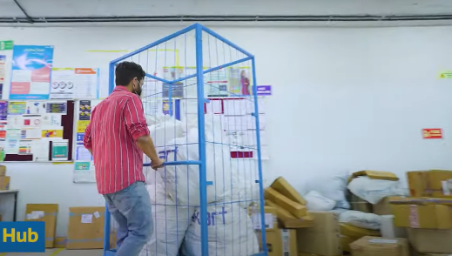
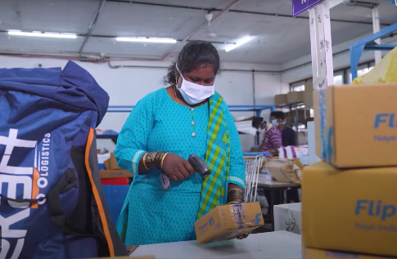
Learning Opportunities
Delivery hubs Operations
Learn how to manage Delivery hubs Operations.
Hub Performance
Learn how to analyse hubs level performance.
Talent Grooming
Understand how talent is groomed and prepared for the next level.
Improvisation
Learn how to Identify improvement areas, perform RCA & strategize mitigation Plan
Customer Experience
Learn how to Handle Customer Experience
Attendance Management
Learn how attendance is captured and rosters are maintained
Availability & Hub Management
Learn how to ensure availability & Management of all hub assets, Bags, POS Machines etc
Manage Complex Operations
Learn how to Manage Complex Operations at Scale
Innovation
Learn how to Drive and Implement innovation
Acumen Upskill
Learn how to Sharpen your data analytics, design & financial acumen

Slide 10












Skills Required
Analytical Mindset
Ownership
Planning and Organizing
Zeal to Learn and Perform
Problem Solving at Scale
Agility
Through Aptitude Test
Through Behavioural Event Interview

Slide 11
Stipend & Benefits
Metro
Rs 30,000
Non - Metro
Rs 25,000
20 leaves allowed in a calendar year.
Medical Insurance cover of Rs 1 lakh (self only)
Accidental Insurance cover of Rs 7.5 lakh
Term Life Insurance cover of Rs 7.5 lakh

Slide 12

Evaluation Process
SCCP
SCCP Preliminary Assessment
Shortlist
SCCP Advance Assessment
Interview Round 1
Functional Round
Interview Round 2
HR Round
Candidate
Logical Reasoning
Quantitative Aptitude
Verbal Aptitude
Computer Skills
Domain Skills
Personality Traits
Communication Skills
Ensure that your Laptop Camera is ON
Keep your CV ready max 2MB PDF

Slide 13



Thank You

