Slide 1



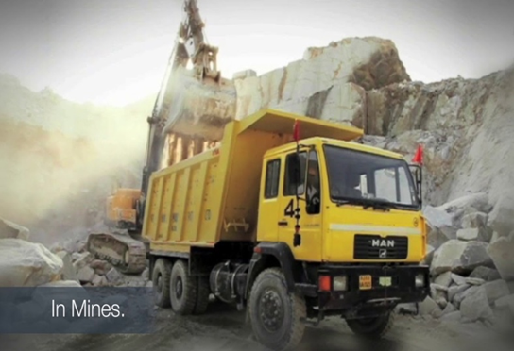

MAPL
A COMPLETE MINING SOLUTION..
(AN OHSAS CERTIFIED COMPANY 18001: 2007)
MANAGALA ASSOCIATES PVT. LTD
MRINAL COLONY, STATION ROAD,
BARBIL, KEONJHAR, ODISHA - 758035
Contact no.-06767270209

Slide 2
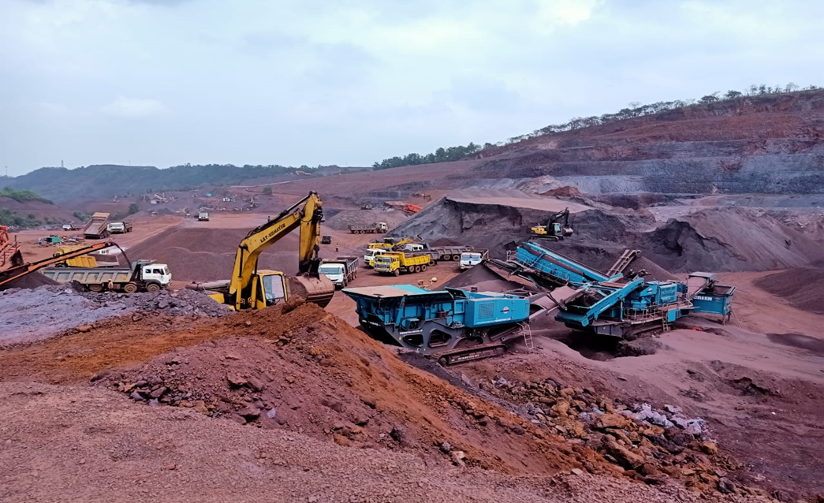
About us
Mangala Associates Pvt Ltd registered under the company act 1956 as a Pvt Ltd company, Dated 19 November 2012.
Company Overview :
  Mangala Associates Pvt. Ltd. is a leading company in the mining and transportation industry. We specialize in providing comprehensive mining services, transportation solutions, and equipment hiring services to esteemed clients such as JSPL, Tata Steel, Adani, Essel Mining, and Thriveni Earthmovers. Our company was incorporated in November 2012, and we have been actively involved in the mining sector since 2014.
Mining Services:
  We offer a wide range of mining services, including exploration, extraction, and processing of various minerals. Our team of experienced professionals ensures that all mining operations are conducted efficiently and in compliance with industry standards. We utilize advanced technologies and equipment to maximize productivity and minimize environmental impact.

Slide 3
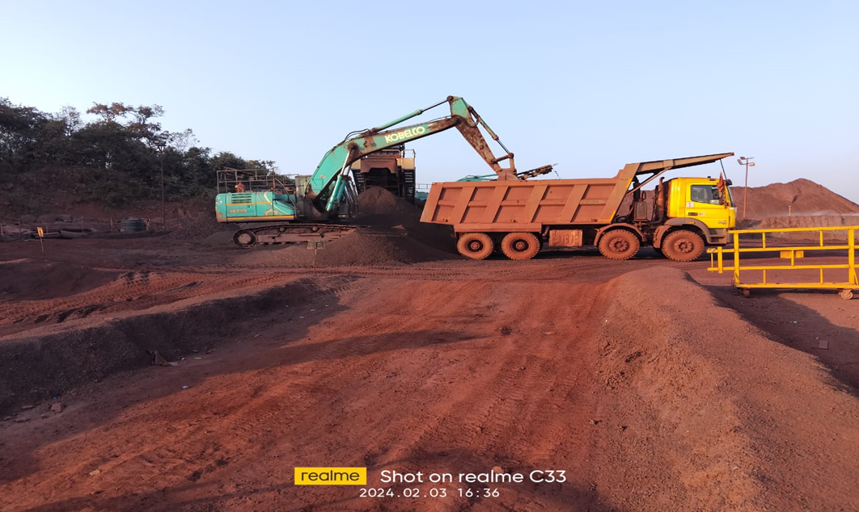



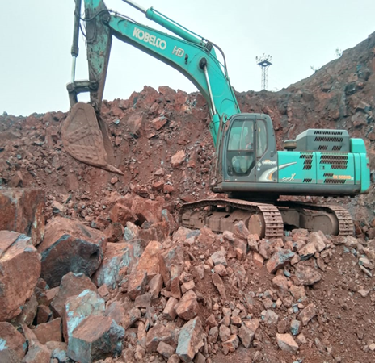
TRANSPORTATION SOLUTIONS
With a fleet of well-maintained vehicles and a dedicated team of drivers, we provide reliable and efficient transportation solutions for the mining industry. Our transportation services cover the entire supply chain, from transporting raw materials from mines to processing plants, to delivering finished products to customers. We prioritize safety and timely delivery to meet the specific requirements of our clients.

Slide 4


Equipment HIRING
  We understand the importance of having the right equipment for mining operations. Therefore, we offer a comprehensive range of mining equipment for hire. Our fleet includes excavators, bulldozers, dump trucks, loaders, and other specialized machinery. All our equipment is regularly serviced and maintained to ensure optimal performance and reliability.
01
Contract mining
02
Equipment selection
03
Material handling
  The company is a custodian of more than 950 strong workforce comprising mostly of skilled personnel led by a group of competent, qualified experienced engineers and managers.
04
Infrastructure development and Civil work

Slide 5
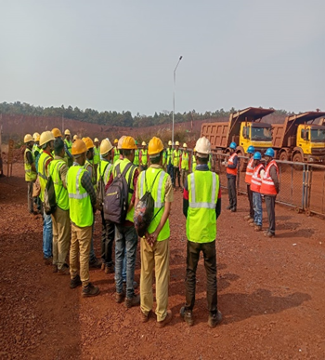
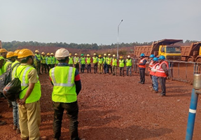
MISSION:
  Our mission is to provide exceptional mining, transportation, and equipment hiring services to our clients. We strive to achieve operational excellence, promote sustainable practices, and contribute to the growth and development of the mining industry.
VISSION:
  Our vision is to become a leading player in the mining and transportation sector, recognized for our professionalism, reliability, and commitment to delivering superior services. We aim to expand our operations, diversify our client base, and continuously innovate to stay ahead in the industry.

Slide 6
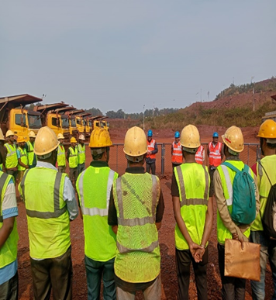
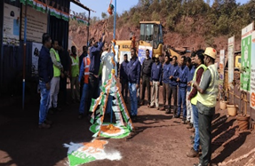
CORE VALUES
We conduct our business with honesty, transparency, and ethical practices.
Integrity:
We prioritize the safety of our employees, clients, and the environment in all our operations.
Safety:
Quality:
We strive for excellence in all aspects of our services, ensuring the highest standards of quality.
Customer Focus:
We are dedicated to understanding and meeting the unique needs of our clients.
Team Work:
We foster a collaborative and inclusive work environment, encouraging teamwork and mutual respect. Wit our extensive experience, strong client relationships, and commitment to excellence, Mangala associates Pvt. Ltd. is the ideal partner for all mining, transportation, and equipment hiring needs

Slide 7
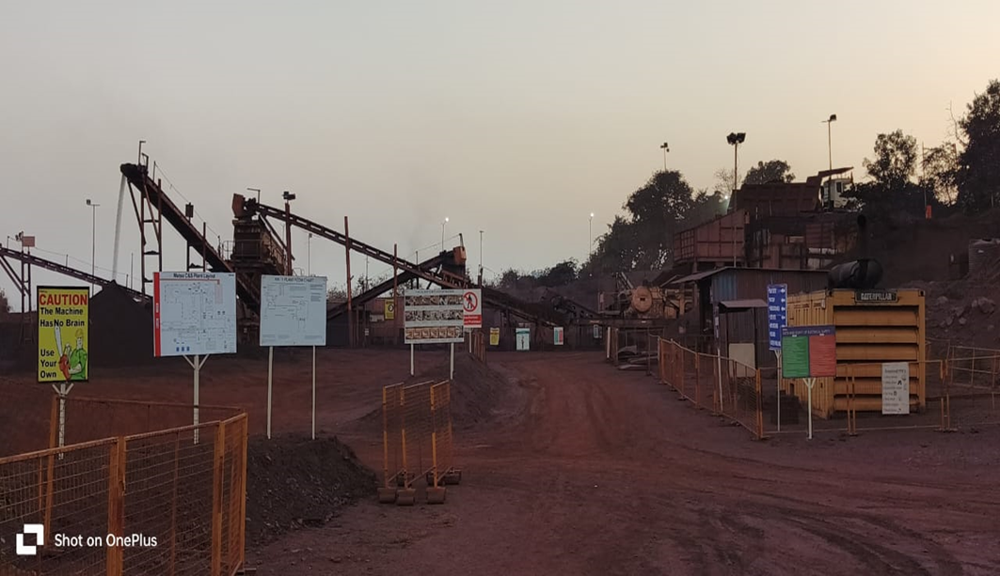
Safety and environmental consciousness
Mangala Associates Pvt Ltd. places a high priority on environmental awareness and safety in all facets of business operations, including equipment rental, transportation, and mining. To protect the environment, the communities in which we work, and the welfare of our employees, we scrupulously abide by the regulations established by the government and the Directorate General of Mines Safety (DGMS).
Mining
  Mangala Associates Pvt Ltd. places a high priority on environmental awareness and safety in all facets of business operations, including equipment rental, transportation, and mining. To protect the environment, the communities in which we work, and the welfare of our employees, we scrupulously abide by the regulations established by the government and the Directorate General of Mines Safety (DGMS).
  Environmental Protection: Committed to environmental stewardship, we adhere strictly to regulations, manage waste responsibly, and practice sustainable mining. Our efforts include proper reclamation of mined areas, ensuring minimal environmental impact.

Slide 8
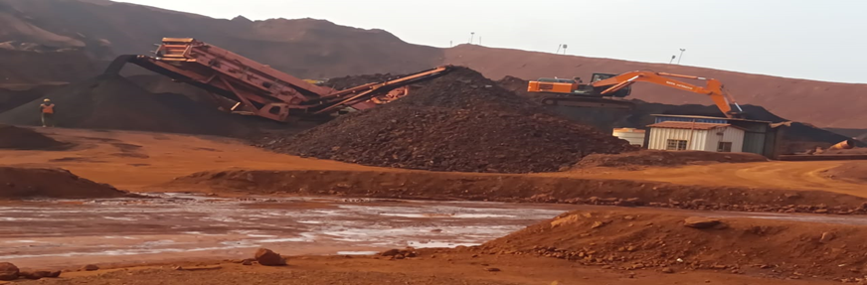

Equipment Hiring
Transportation
  Safety Standards: We rent out well-maintained, secure equipment to our clients. We perform routine maintenance and inspections on our equipment to guarantee peak performance and reduce the possibility of mishaps.
  Environmental Considerations: We place a high priority on using machinery and equipment that complies with environmental laws and is eco-friendly. We advise our clients on how to minimise their equipment's negative environmental effects and push them to embrace sustainable practices.
  Through the integration of these safety and environmental awareness initiatives into our corporate profile, we exhibit our dedication to conscientious mining, transportation, and equipment procurement. We constantly aim to go above and beyond DGMS and government regulations to safeguard our workers' health and welfare, preserve the environment, and promote sustainable development.
  Safe and Efficient Fleet: To guarantee the safe transportation of materials and goods, our transportation fleet is continuously maintained and outfitted with the newest safety features. We place a high priority on driver education and following traffic laws in order to reduce the likelihood of collisions.
  2. Emissions Control: We take proactive steps to lessen our carbon footprint by putting emission control systems in place and buying fuel-efficient cars. Regarding vehicle emissions, we abide by government laws and work hard to enhance our transportation methods on a constant basis to reduce our negative environmental effects.

Slide 9
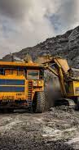
CLIENTELE
  Steel Authority of India Limited ( SAIL)
  Tata Steel Khondbond Iron Mines
  Tata Steel Manganese Mines
  Essel Mining & Industries Limited (EMIL)
  Jindal Steel & Power Limited (JSPL)
  M/s Sarda Mines Pvt. Ltd.
  Adani Enterprises Ltd- Natural Resources
  Metso India Pvt. Ltd.

Slide 10
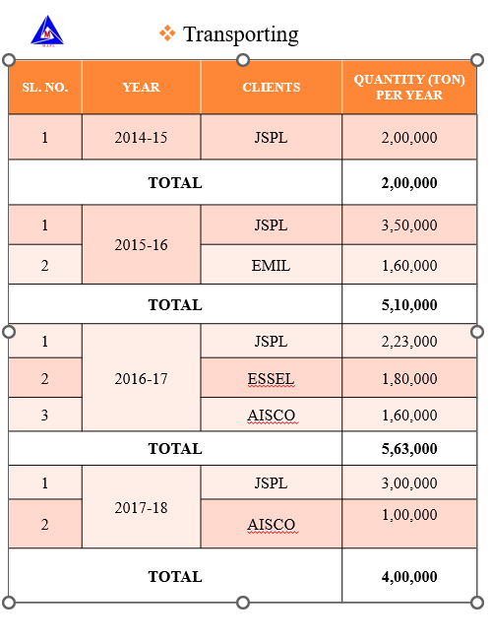

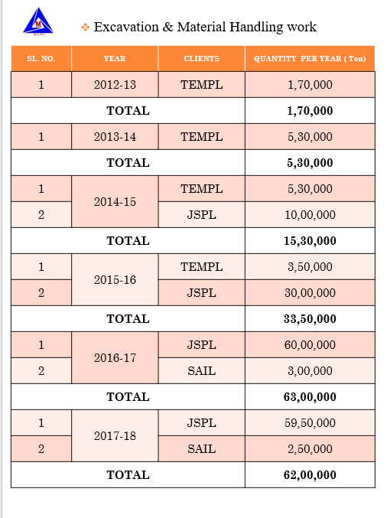


Slide 11
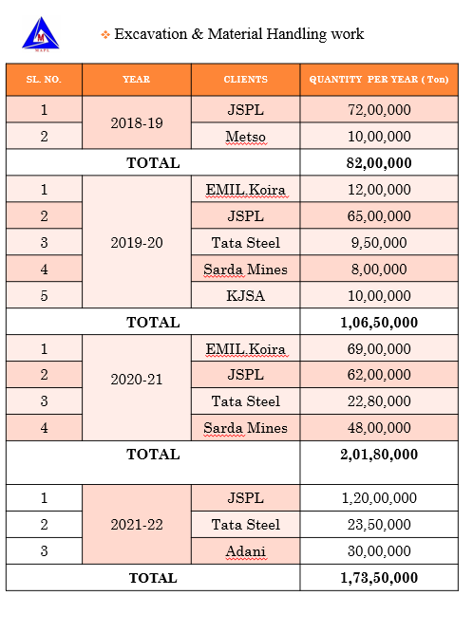
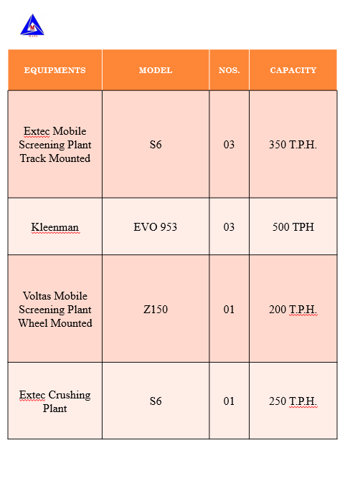

Slide 12
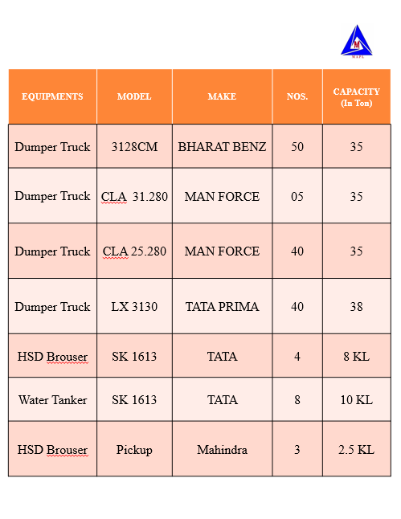
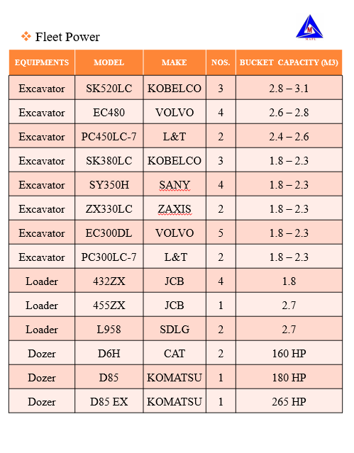

Slide 13
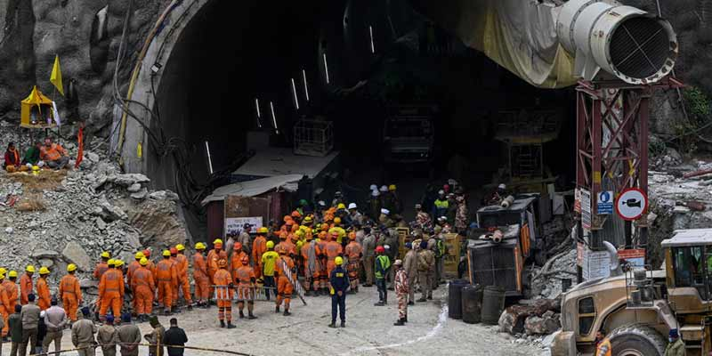

EMPLYOEES BASE
Our workforce consists of more than 1,000 people.

Slide 14

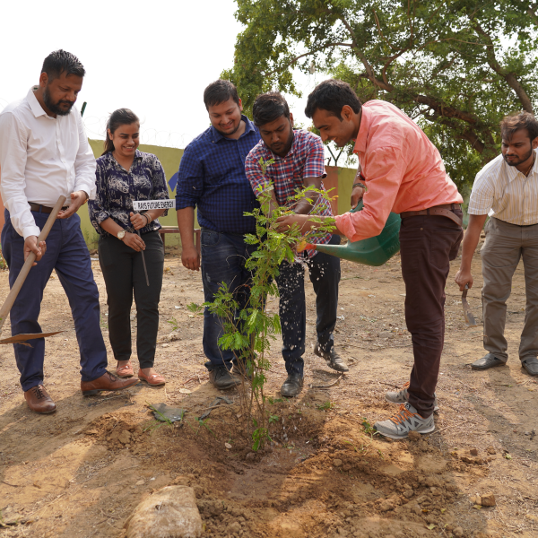

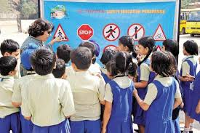

CSR
We are equally consious for our enviroment as well as perifery.

Slide 15



