Slide 1



Slide 2


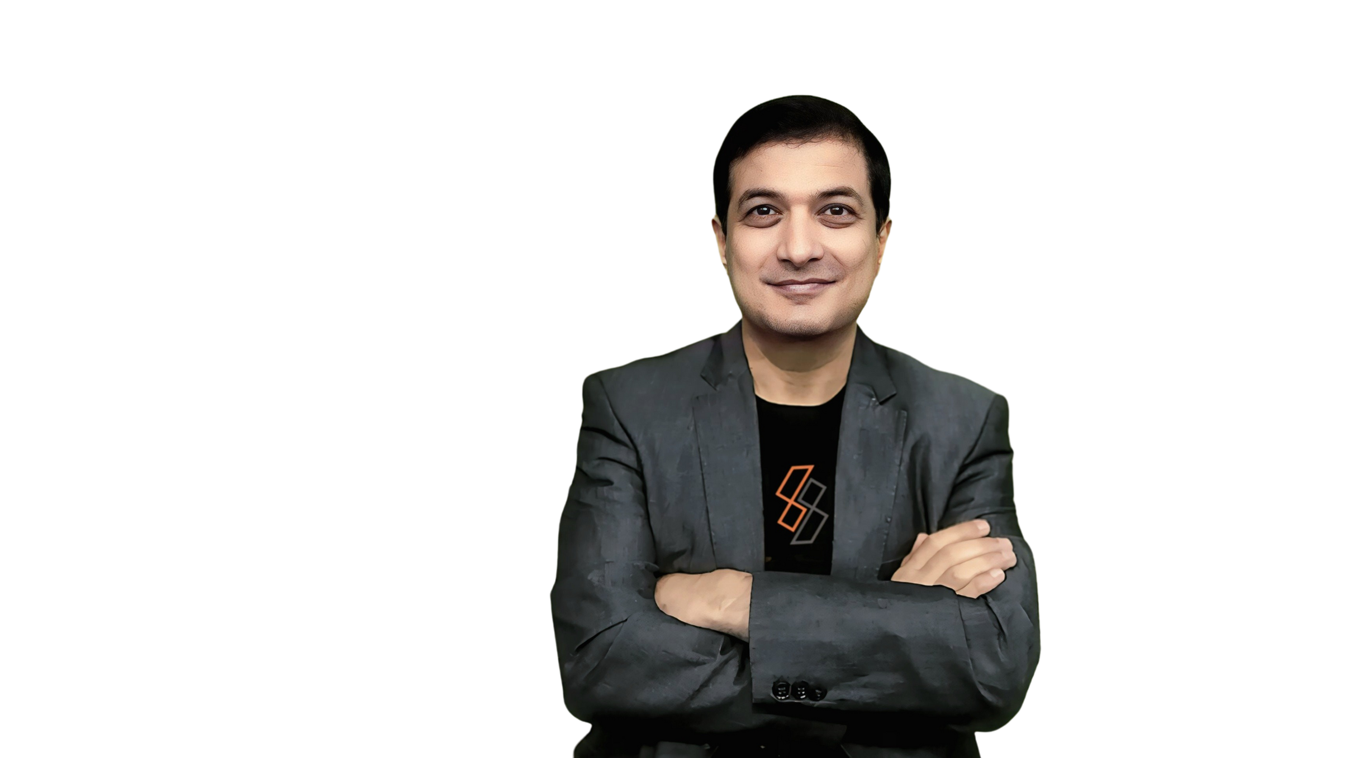
Hello, I'm
Gaurav Vasishta
CEO ~ Salesamore
  B2B Sales Connoisseur specializing in sales strategy, process, and implementation
  Expert in B2B Lead Generation, created Client Acquisition System ACTIONS
  Rainmaker and Demand Generation Wizard known for building robust lead pipelines and delivering exceptional results
  Skilled in Account-Based Marketing (ABM) and a master of Go-To-Market (GTM) strategies

Slide 3

Welcome to SalesAmore
  Not Just a Job, But a Launchpad for Your Success!
  Connecting Fresh Talent with High-Growth Careers
Are you ready to step into a future-proof career?

Slide 4

Why Are You Here Today?
🎓 Graduating Soon? You Have Two Choices:
  A slow, outdated job with limited growth
  A fast-growing career where you make an impact from Day 1
SalesAmore is NOT just another company – We shape careers!

Slide 5

The Reality – Tech is Changing Fast!
🚨 Traditional tech jobs are becoming outdated!
  AI & Automation are replacing routine coding & support jobs.
  Companies now need professionals who can blend business, sales, and technology.
  The future belongs to Sales Technologists, Business Analysts, and Digital Growth Experts.
Are you ready to future-proof your career?

Slide 6




Why Choose SalesAmore?
We Offer More Than Just a Job!
Fast-Track Career Growth
Grow 2X faster than traditional roles.
Hands-on Learning from Day 1
Work on real-world business challenges.
Industry Exposure & Global Clients
Gain valuable experience.
High-Earning Potential
We reward performance, not just experience.
Join a company that invests in YOU!
A Supportive & Friendly Team
Work with mentors who help you succeed.

Slide 7

Your Career Path at SalesAmore
  Structured Training – Learn industry-relevant skills.
  Hands-on Projects – Work on live client challenges.
  Industry Exposure – Collaborate with top business minds.
  Growth & Promotions – Get fast-tracked career advancement.
  Leadership Opportunities – Become a key driver in the company.
We don’t hire employees, we create future leaders!

Slide 8

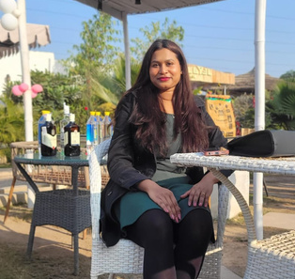
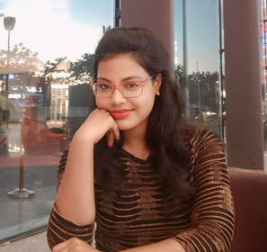
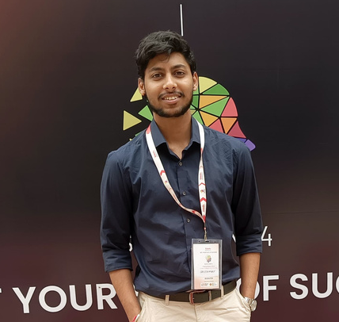
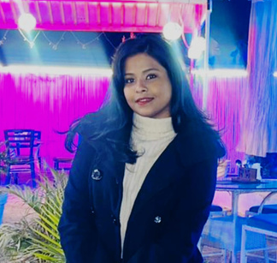
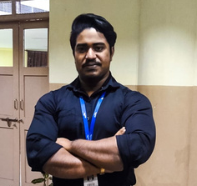

Success Stories – Freshers Who Made It Big!
Meet 5 freshers who joined us last year & are already thriving!
M.S. Sharmistha Lenka
Suhana Sahoo
Jasmeet Singh
Bhagyashree Behera
Subham Barik
Senior Growth Specialist
Head of Outreach at @Salesamore
Automation Expert at Salesamore
Growth Catalyst at Salesamore
Automation Lead at Salesamore
Leading the team at Salesamore, Head of Growth Specialist
Senior Lead Generation Strategist | Expert in Revenue Growth & High-Performing Team Management
Specialize in streamlining B2B sales and marketing processes through automation and strategic outreach
Driving growth for small and medium-sized businesses (SMBs).
Transforming complex backend processes into seamless, high-impact solutions that drive efficiency and productivity.
Government College of Engineering, Keonjhar
Gandhi Engineering College, Bhuvneshwar
Government College of Engineering, Keonjhar
Gandhi Engineering College, Bhuvneshwar
Silicon University, Sambalpur

Slide 9

What Sets Us Apart?
Traditional Jobs vs. SalesAmore Careers
  Slow growth → Fast-tracked career path
  Outdated skills → Future-proof business expertise
  Limited exposure → Work with global clients & experts
  Just another employee → Key player in an innovative team
Choose a career that values YOU & accelerates YOUR success!

Slide 10

Who Are We Looking For?
  Action Takers – Ready to take ownership.
  Innovators – Passionate about change & transformation.
  Visionaries – Focused on long-term career growth.
  Go-Getters – Want to break barriers & lead industries.
If you fit this description, SalesAmore is the place for you!

Slide 11

Limited Openings – Are You In?
We’re hiring the best minds for a future-proof career!
📌 Roles Available:
🎯 Growth Catalyst - Marketing
🎯 Junior Automation Engineer
🎯 Demand Generation Associate
🎯 Prompt Engineer - Marketing
📩 Apply Now & Secure Your Spot!

Slide 12





Your Future Starts Today!
+91 8288007706
Why Wait? Take the First Step Toward an Exciting Career!
www.salesamore.com
Let’s Connect – Your Dream Job is Just One Step Away!
Digisson Edtech PVT.Ltd
2nd Floor, Sebiz Square,
IT - C6, Sector 67, Mohali
Join SalesAmore & Be Part of Something Bigger!

Slide 13

LET’S SELL MORE TOGETHER!

