Slide 1
iqigai Assessment Instructions
For any issues/ queries/suggestions please write to
support@iqigai.ai

Slide 2
If you have app already installed, skip to Slide #12

Slide 3
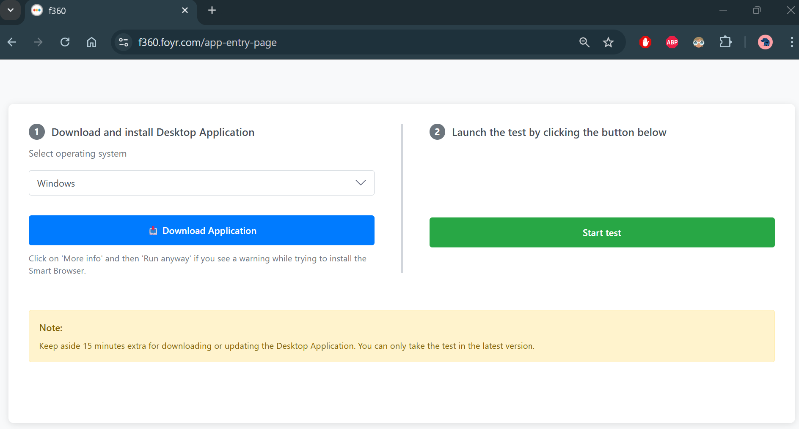
The URL on your mail will redirect you to this page, download the app file
Download URL ->
https://f360.foyr.com/app-entry-page
Window users - download .exe file
Mac users - download .dmg file

Slide 4
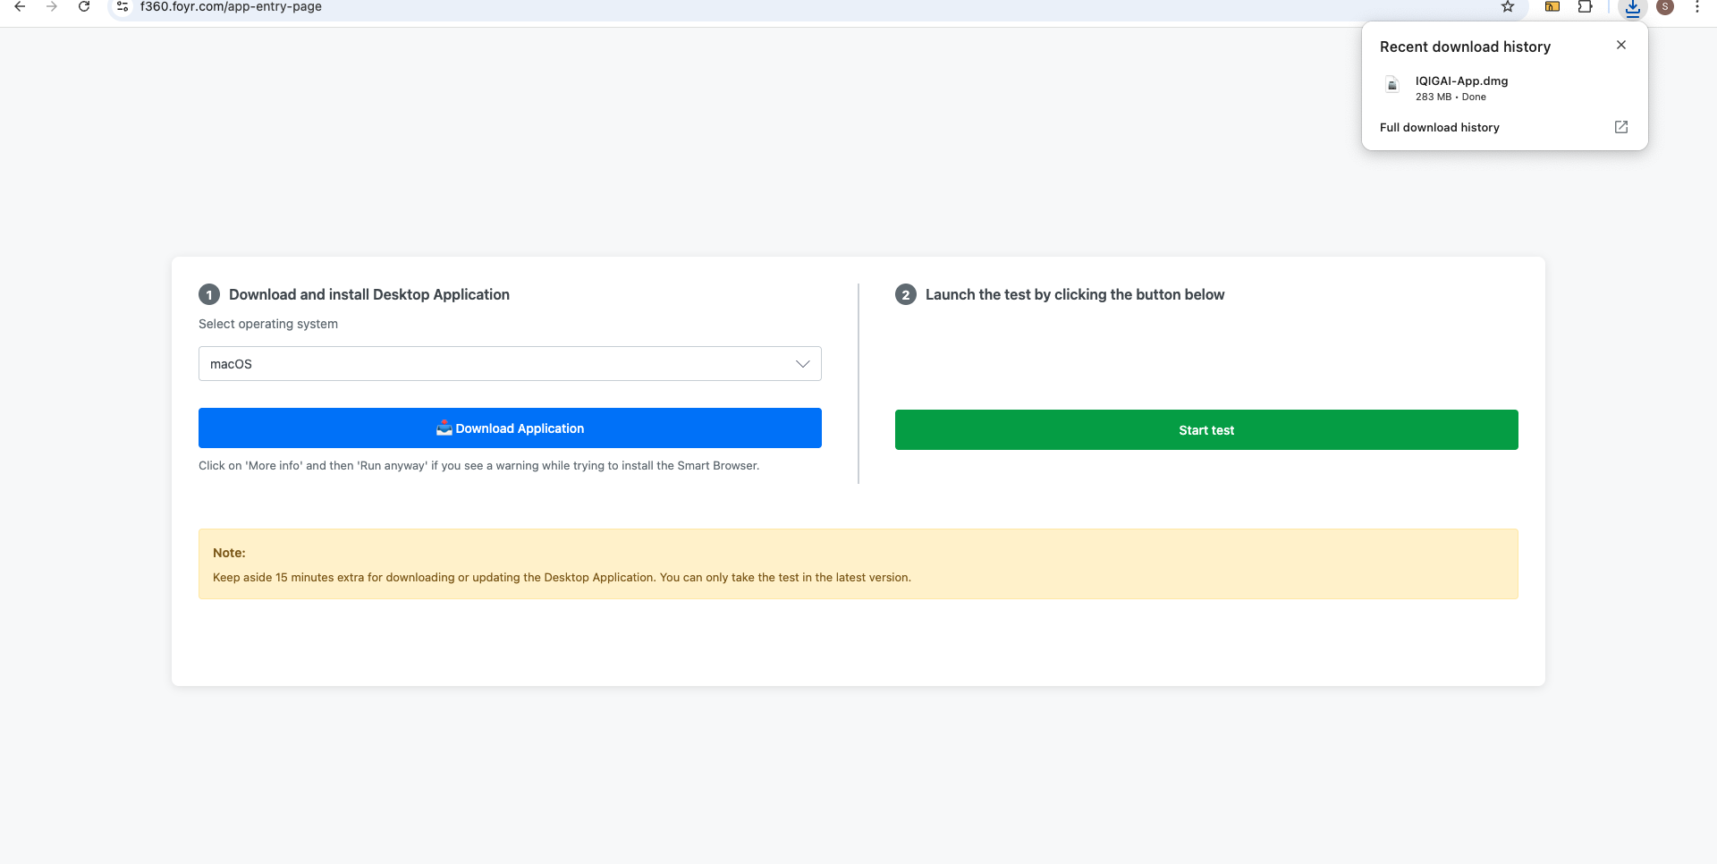
Click Download and open downloaded folder
Window App Installation
Open downloaded folder

Slide 5
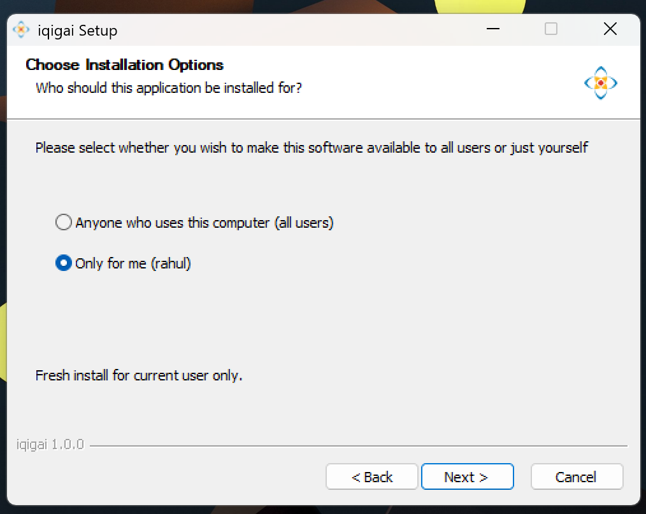
On installer select install “Only for me” and go next
Window App Installation

Slide 6
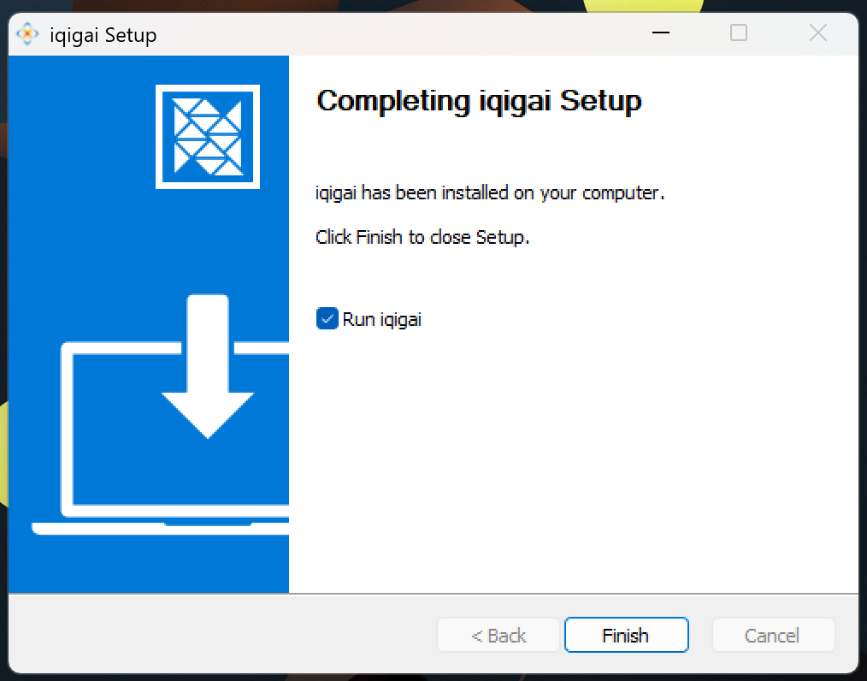
Once done, finish and launch app
Window App Installation

Slide 7
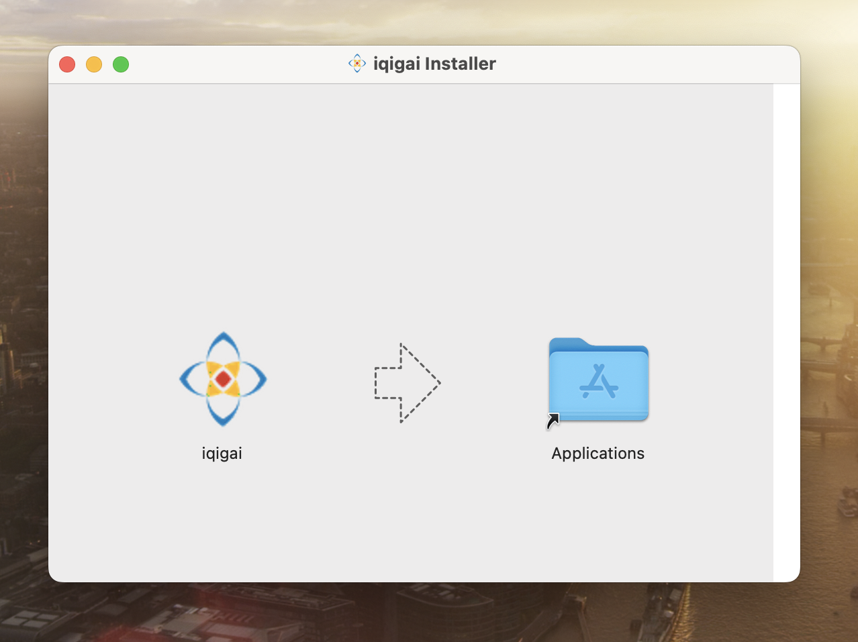
Open downloaded app and slide app to Applications
MacOS App Installation

Slide 8
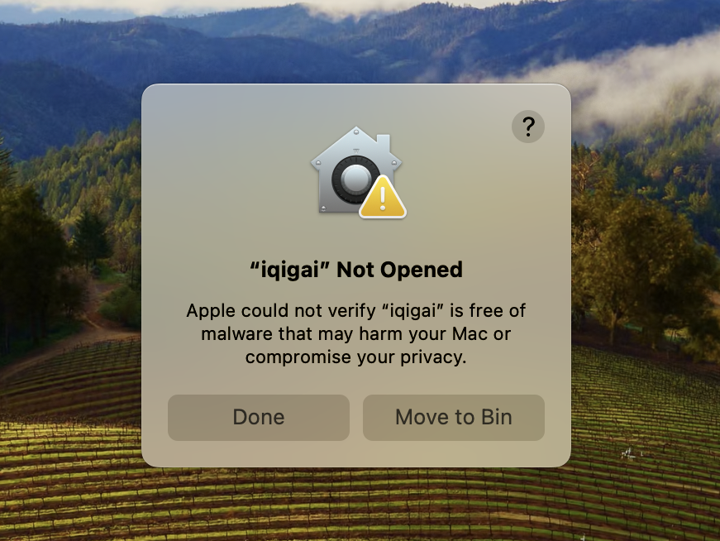
Click on Done when you try to open the app
MacOS App Installation

Slide 9
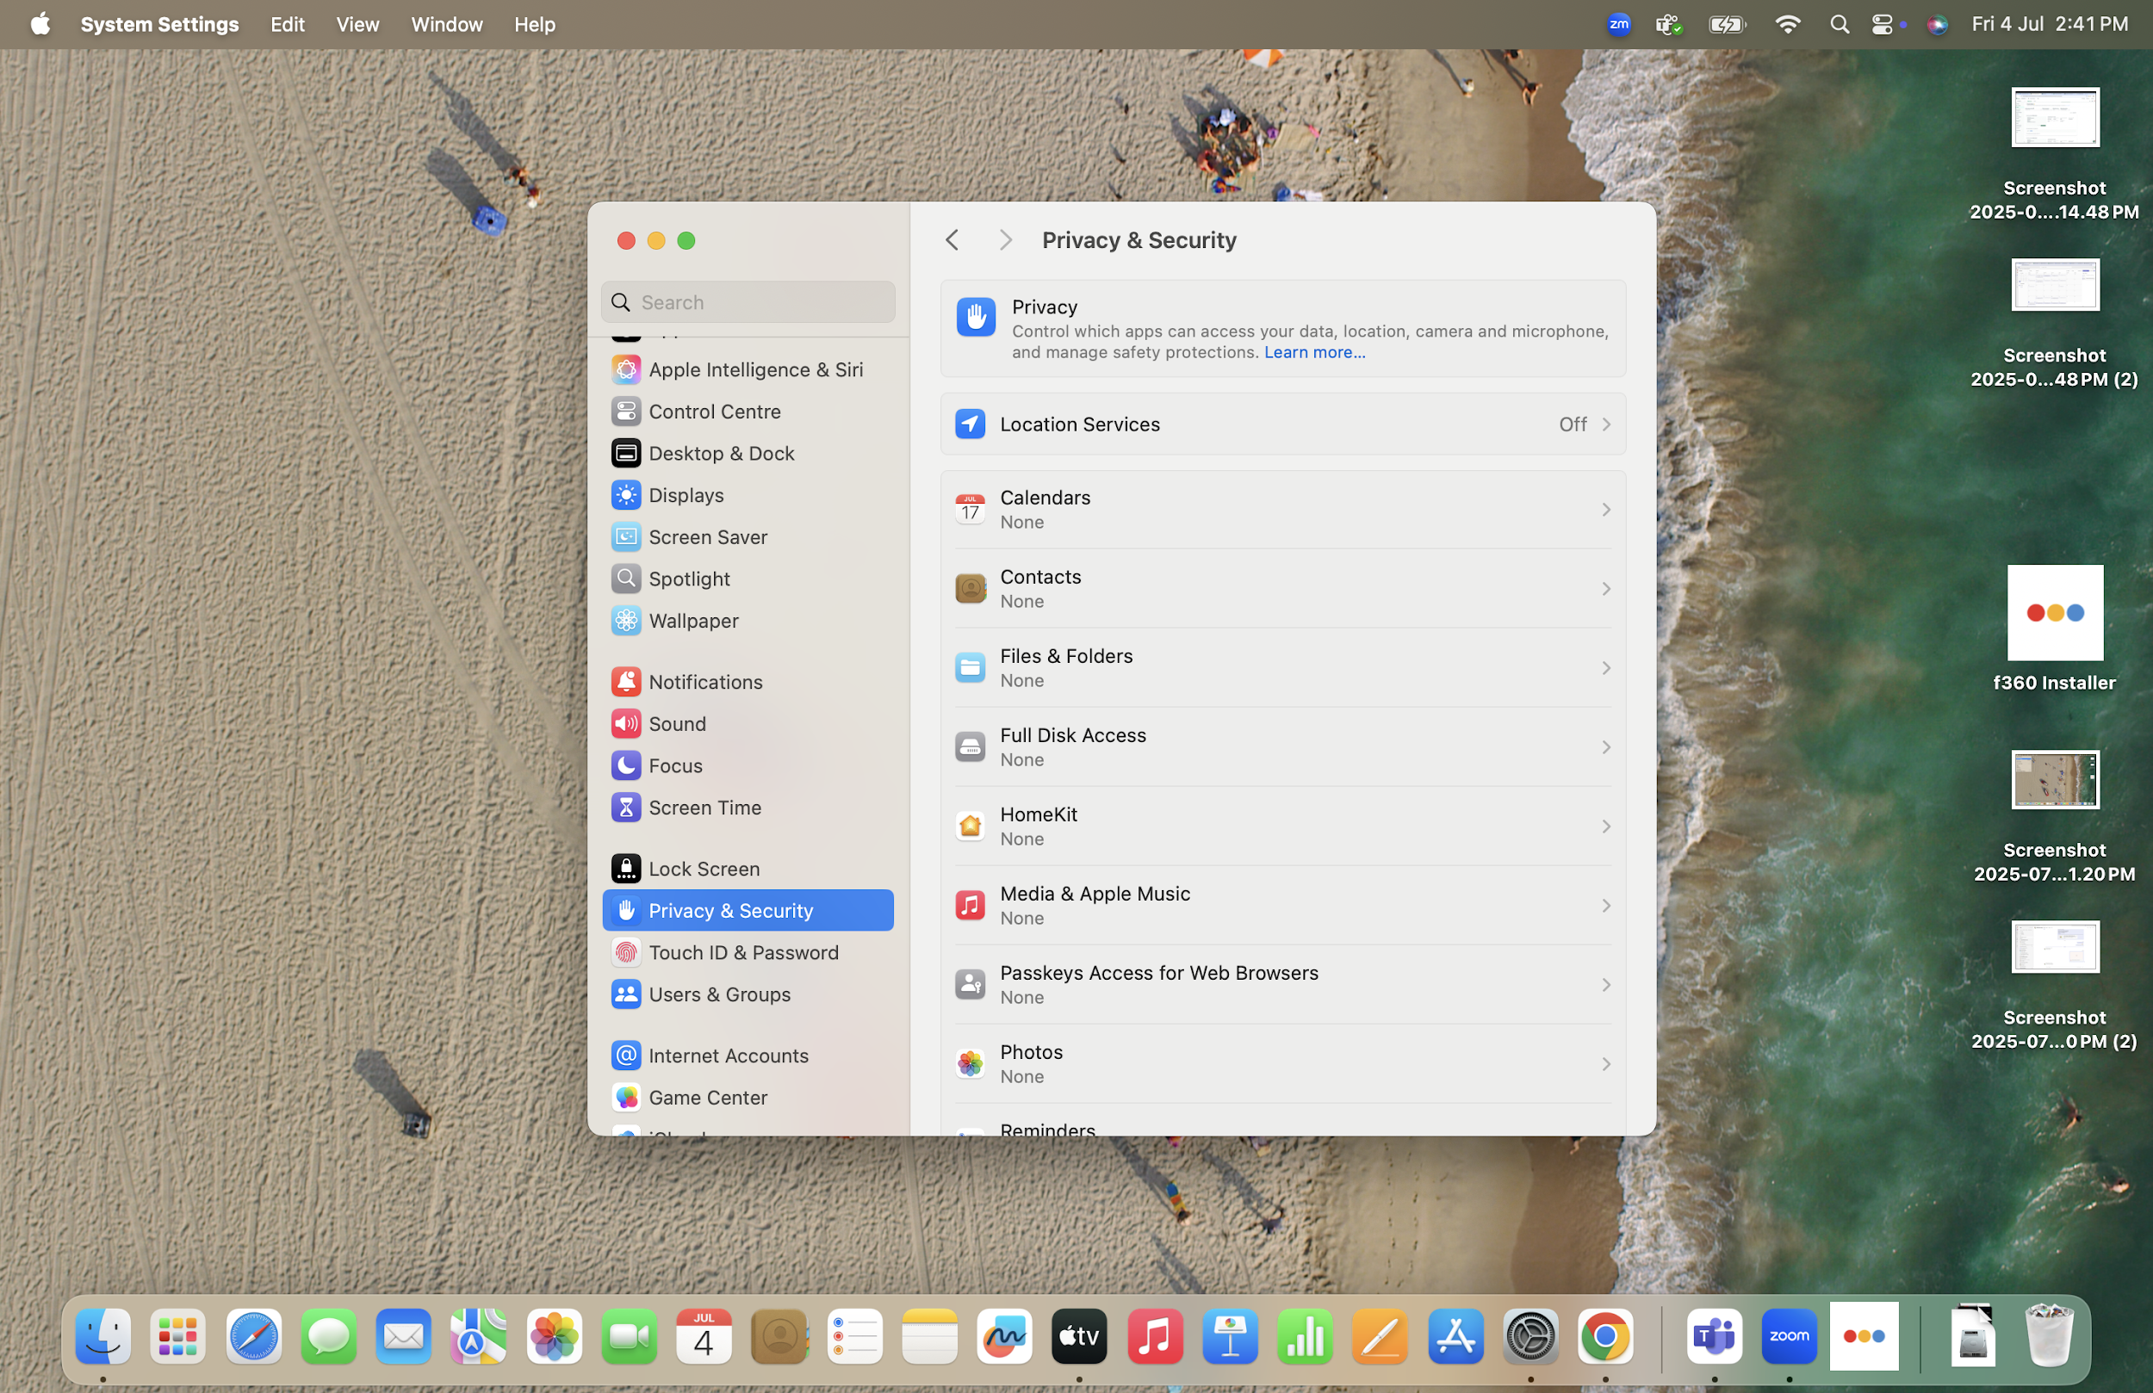
Open “Privacy and Security” under System Settings
MacOS App Installation

Slide 10
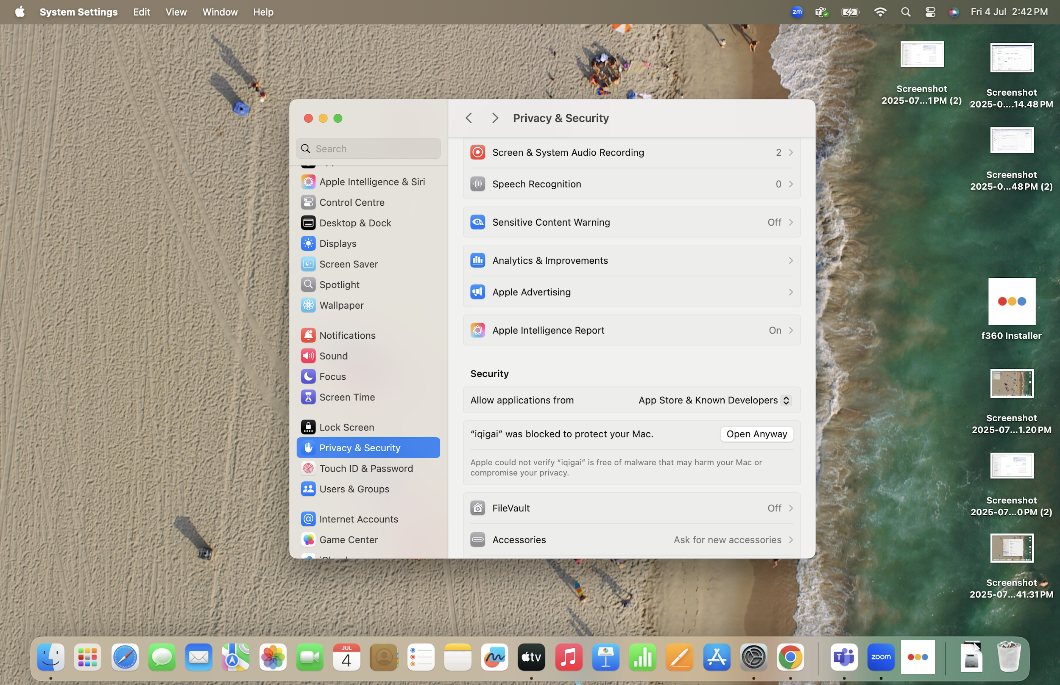
Scroll down and click Open Anyway
MacOS App Installation

Slide 11
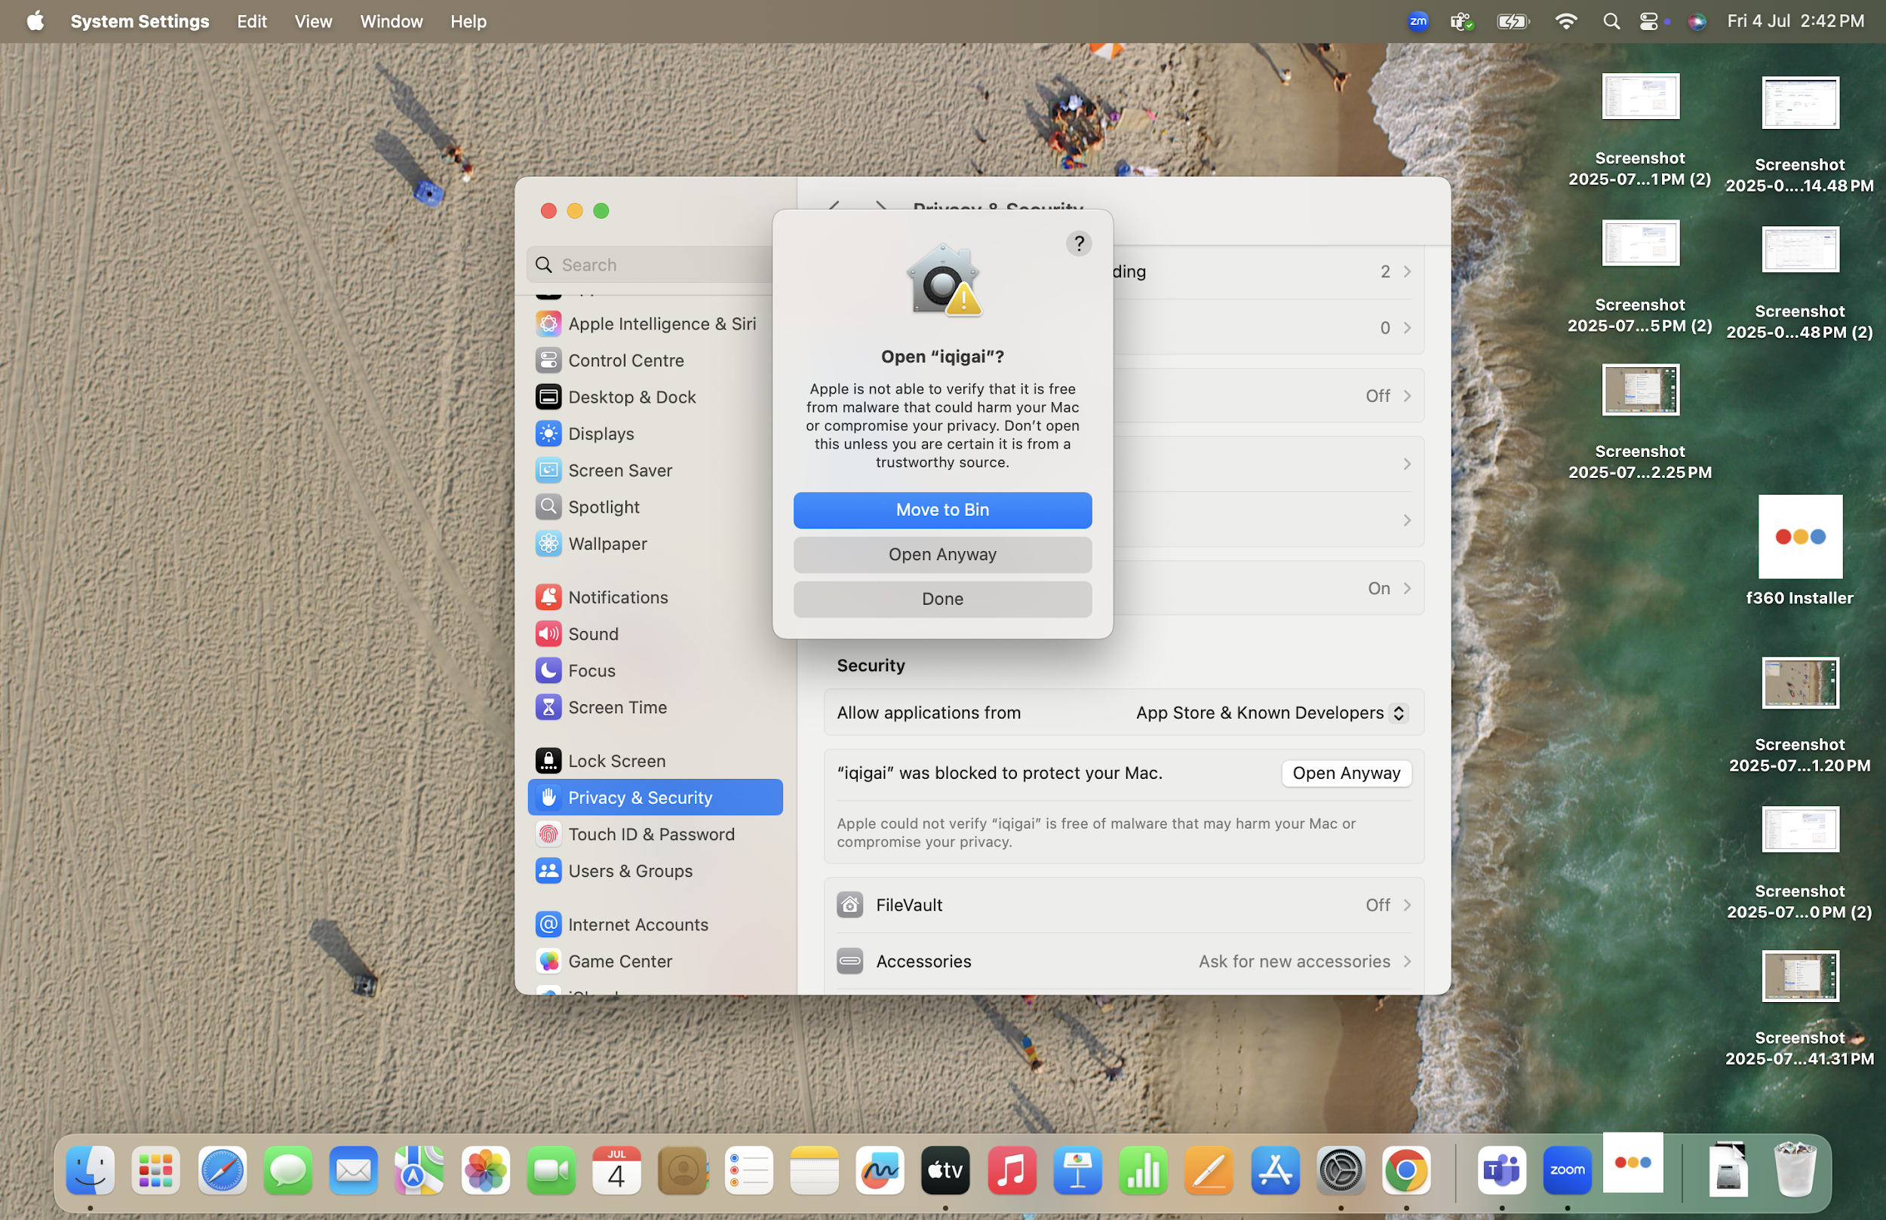
Click Open Anyway and this will install the App
MacOS App Installation

Slide 12
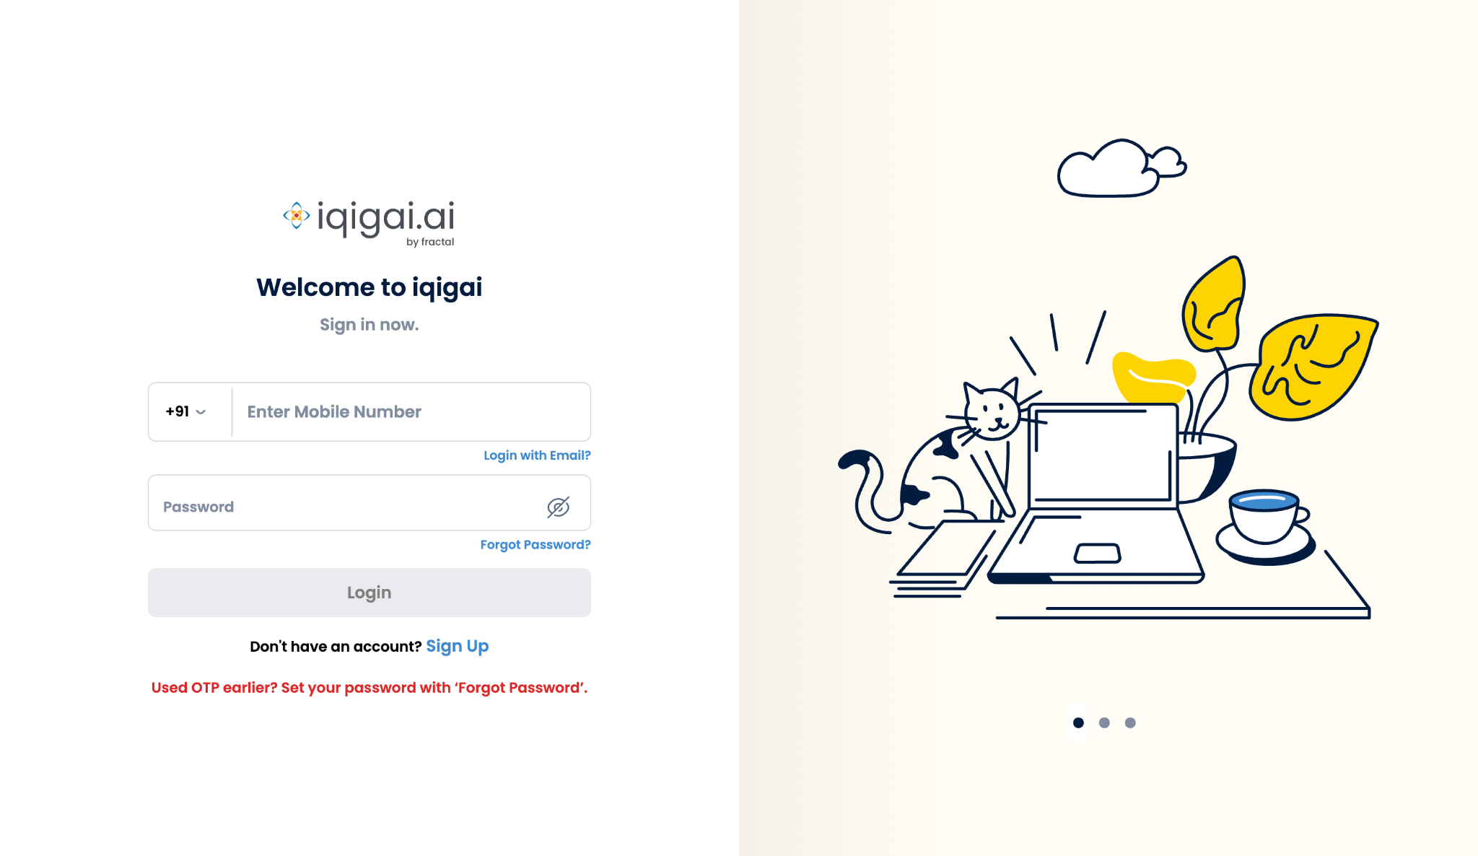
Sign in app using your mobile number or email address

Slide 13
Use Forgot Password if you don’t have password

Slide 14
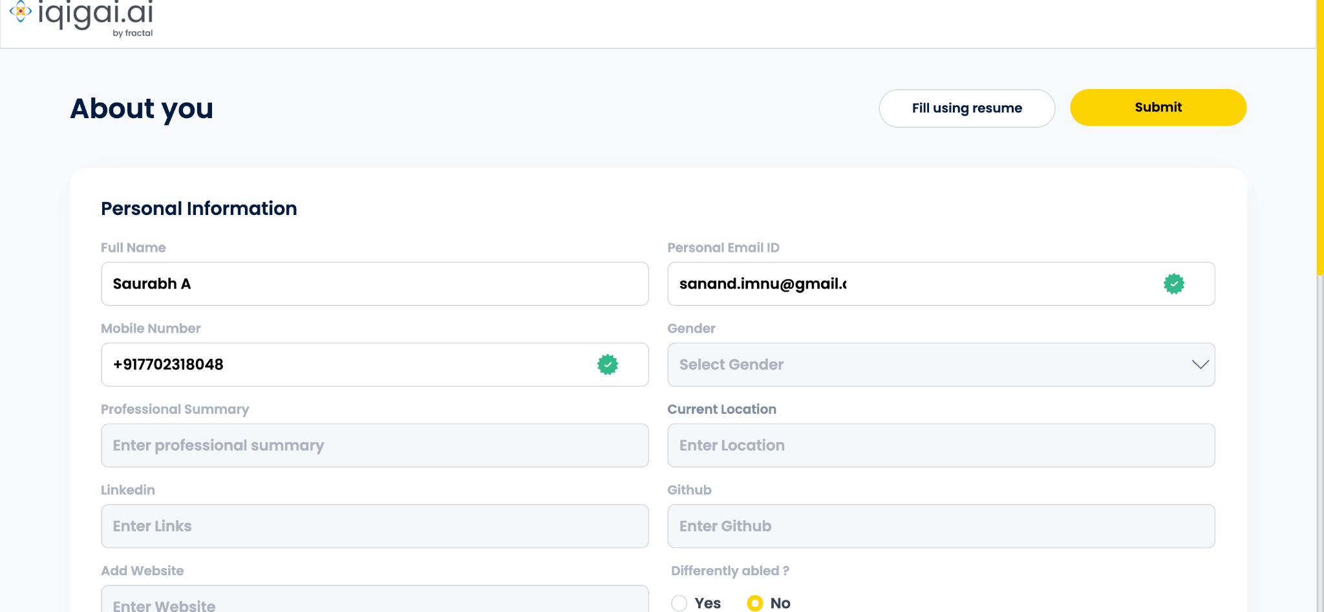
Fill in relevant details

Slide 15
You can use resume upload to fill details automatically

Slide 16
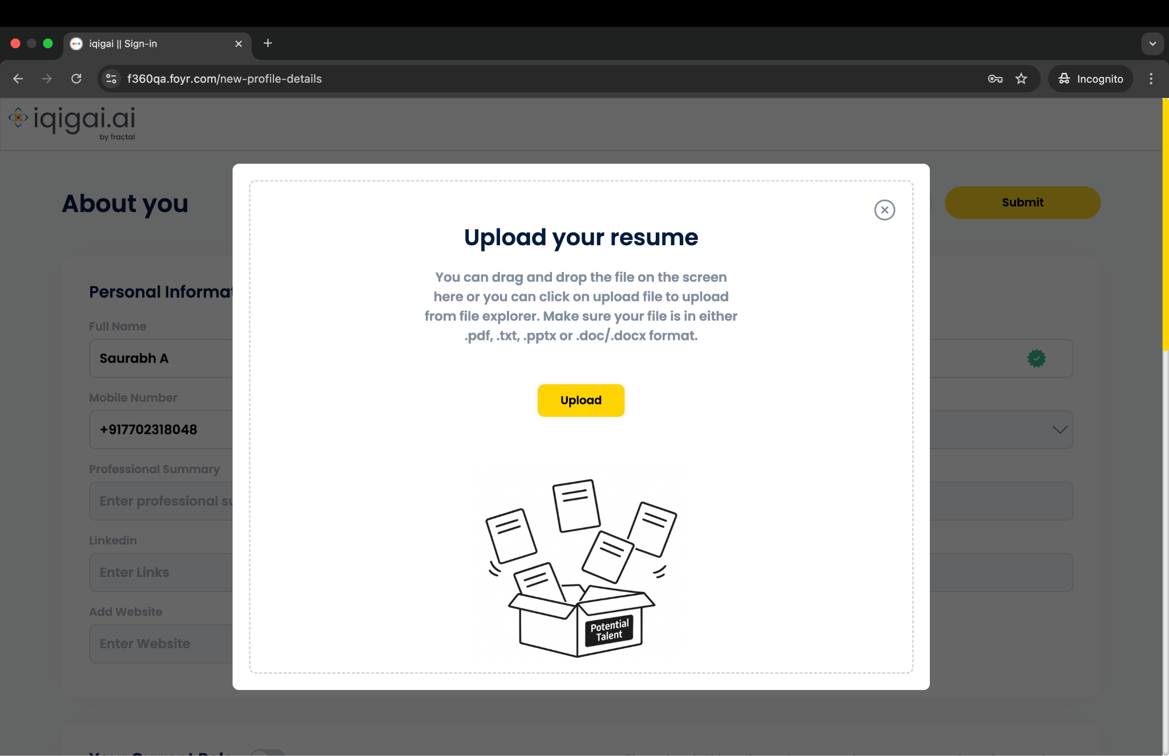
Drag & drop resume or use Upload button

Slide 17
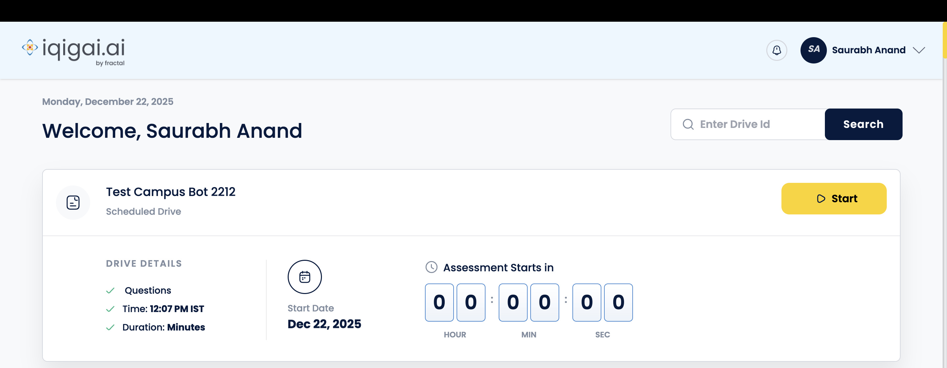
You will be auto-registered for the drive

Slide 18
Click on dropdown to upload latest resume

Slide 19
Click on Start button

Slide 20
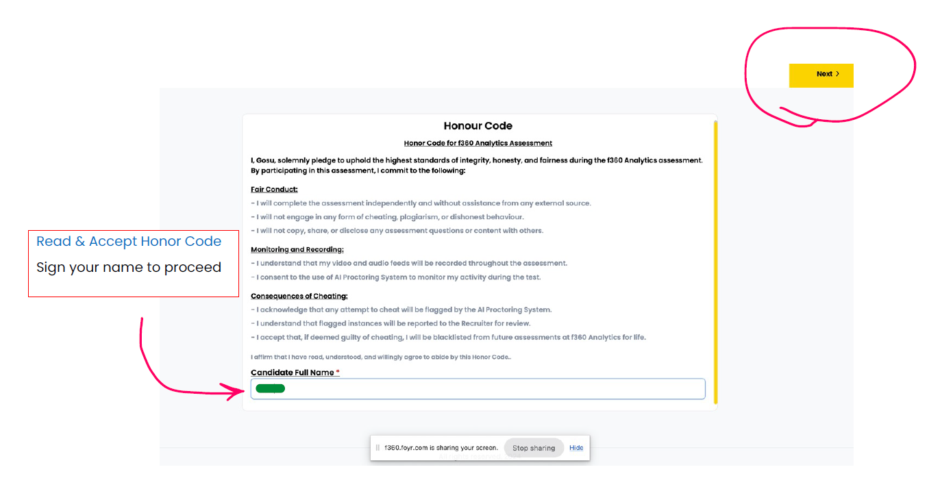

Slide 21
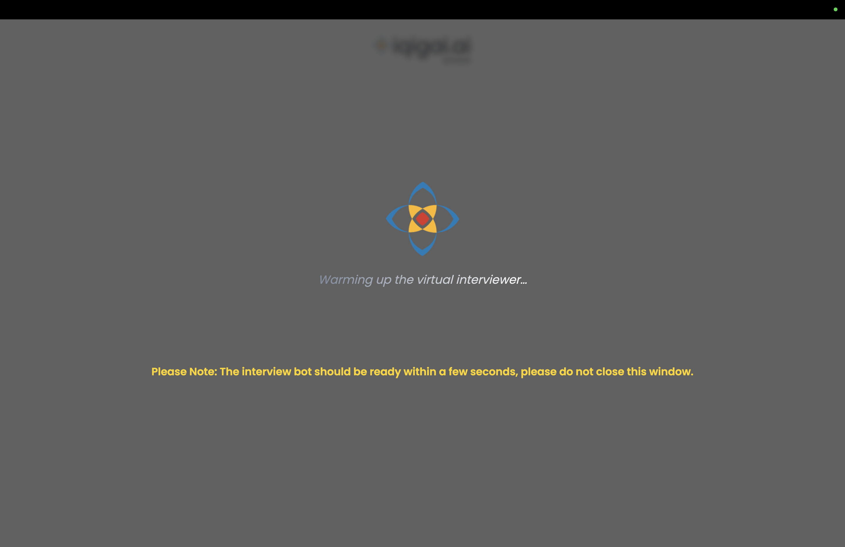
Loading Screen

Slide 22
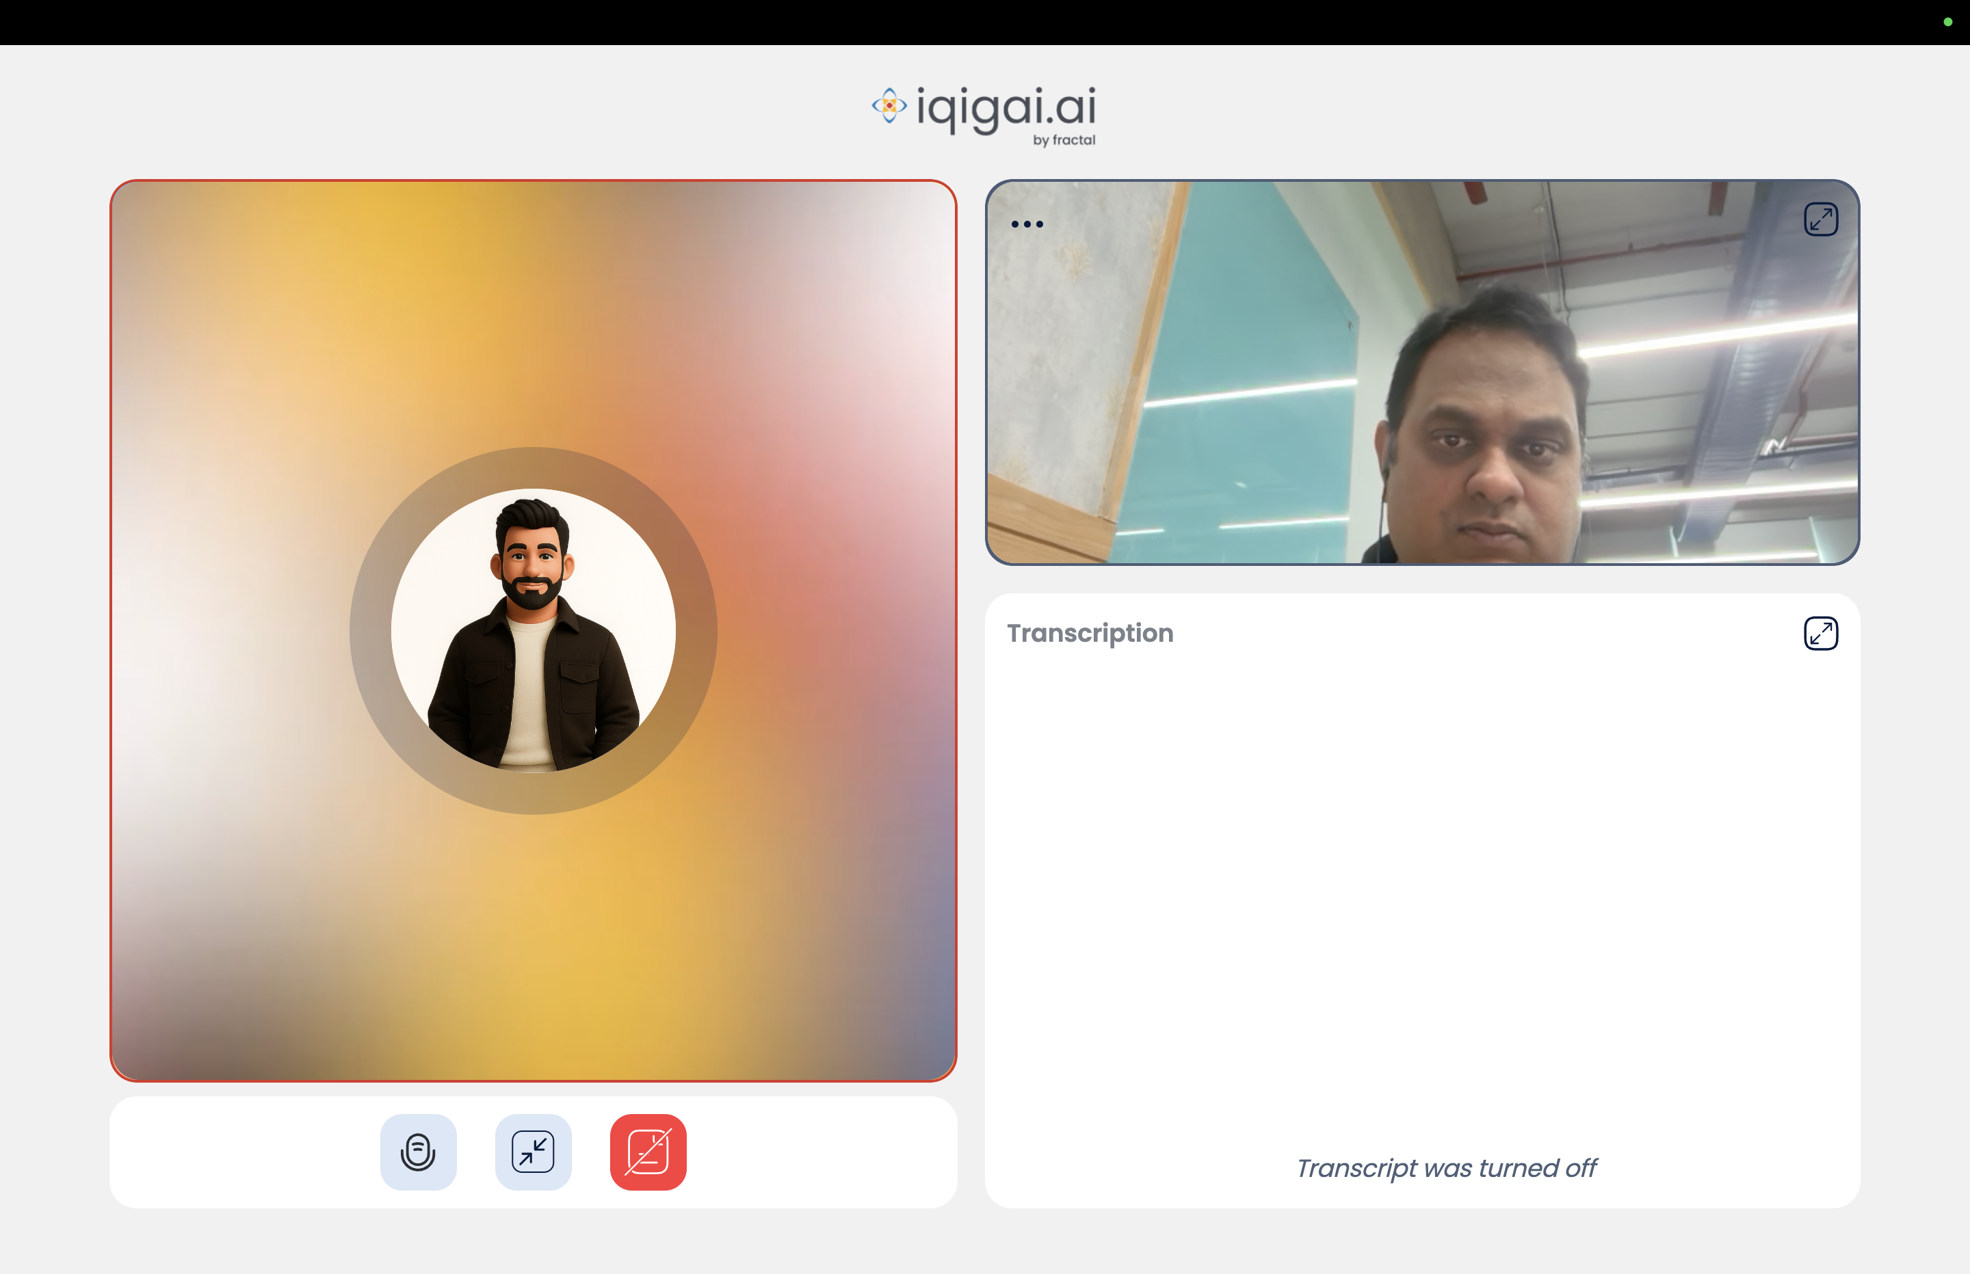

Slide 23
ALL THE BEST!

