Slide 1




India’s Most Trusted Online Higher - Education Company

Slide 2

Jaro Education – Shaping the Future of Learning
Democratizing Quality Education, Empowering India
Jaro Education acts as a bridge between top universities and ambitious learners, making world-class education accessible through technology.
1st Mover
in Online Higher Education and Upskilling
Profitable since 2009
On a standalone basis
3,50,000⁺
Careers Transformed
Partnerships with top IIMs, IITs and Universities
Empowering Career Growth
of Working Professional’s
200+ Executive Programs
in Management, Technology & Leadership etc.

Slide 3








Leading IIMs
IIM Ahmedabad
IIM Kozhikode
IIM Mumbai
IIM Indore
IIM Trichy
IIM Nagpur
IIM Vishakhapatnam

Slide 4







Leading IITs
IIT Madras
IIT Delhi
IIT Bombay
IIT Kanpur
IIT Roorkee
IIT Jammu
IIT Palakkad

Slide 5
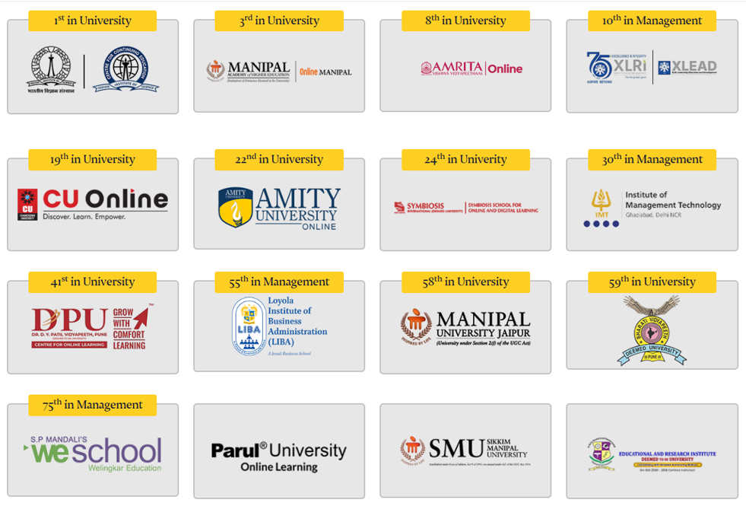
Our Partners
(NIRF Ranked Universities)

Slide 6



Our Partners (International)
Wharton Interactive School (University of Pennsylvania)
#12 in QS 2024: World Ranking
Rotman School of Management (University of Toronto)
#21 in QS 2024: World Ranking
Swiss School of Management
#8 in Herald’s: Best Value for Investment

Slide 7
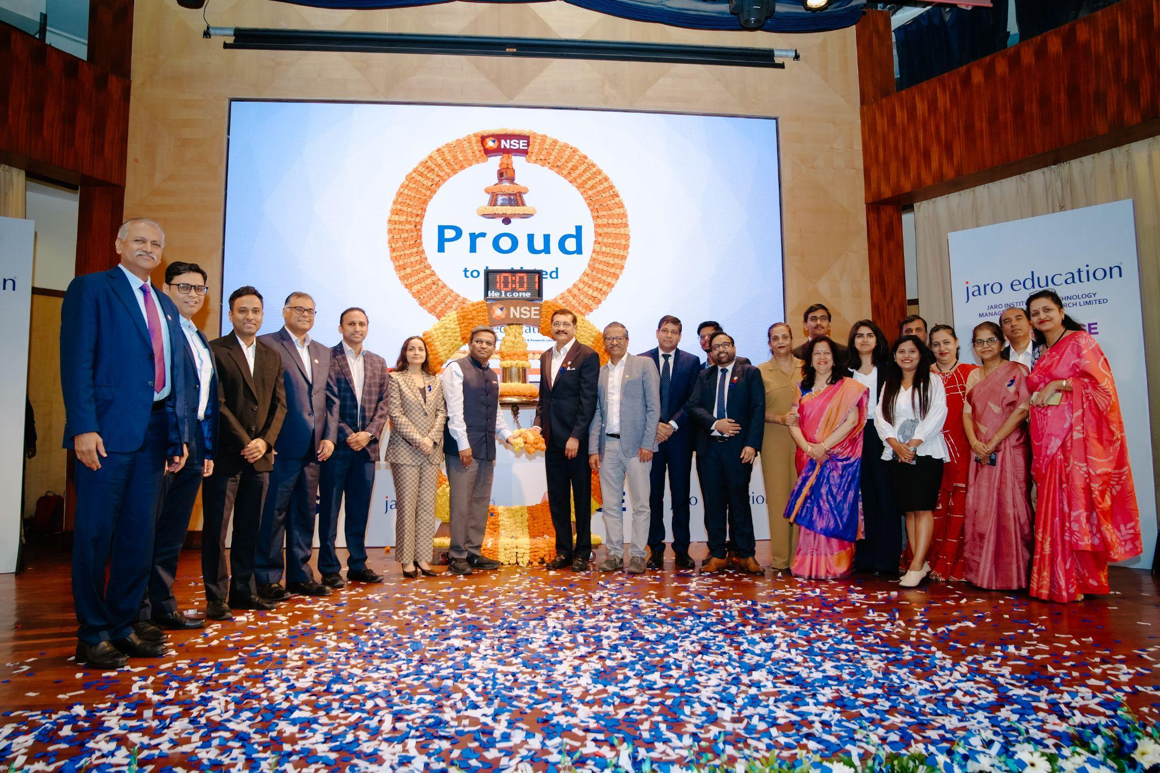
We got Listed on 30th Sept 2025 on NSE & BSE
We are amongst the initial online higher education and upskilling company’s to get listed on NSE & BSE. This marks a significant milestone in the education industry and serves as proof of a good business model with strong governance.

Slide 8




What We Do?
Business Intelligence & Research
Collaborate with IIMs/IITs to design impactful programs
Marketing and Learner Acquisition
Connect IIMS, IITs, and top Universities with aspiring professionals
Tech & Infrastructure Support
Seamless learning platforms
Learner Feedback Loop
Continuous improvement & experience excellence

Slide 9




Why Jaro is Poised to Grow?
Favourable industry trends
Total Addressable Market - ₹13,200 Cr (FY23) → ₹41,500 Cr (FY28) which represents a of CAGR 25.7%
NEP 2020: Online Degrees = Full-time Degrees
Massive learner acceptance
Higher Education GER to be increased to 50% by 2035 (currently 29%)
Improved Acceptance by Companies and Working Professionals
Growing demand for online MBAs from top-tier universities
Digitization & Rural Reach
Even IIMs, IITs, and Top ranked Universities education is now accessible to tier 2,3 & 4 cities.
Due to COVID-19, India’s work from home & learn from home have become the new normal

Slide 10



Why Join Jaro Education?
Be Part of India’s Leading EdTech Growth Story
Fast-Track Career Growth
Work with India’s leading Online higher EdTech brand
Early Leadership exposure
Learn from the Best
Mentorship from seasoned leaders (CEO 18 yrs, VP (Sales) 15+ yrs, CFO 15 yrs, CMO 14 yrs, VP (IT) 15 yrs)
Make an Impact
Increase accessibility of premium education across India
Contribute to Viksit Bharat & Atmanirbhar Bharat
Grow with a Profitable, Trusted and Listed Brand
Backed by marquee investors – Singularity, Abakkus, Shubhkaam
Stable, performance-driven culture with strong recognition

Slide 11
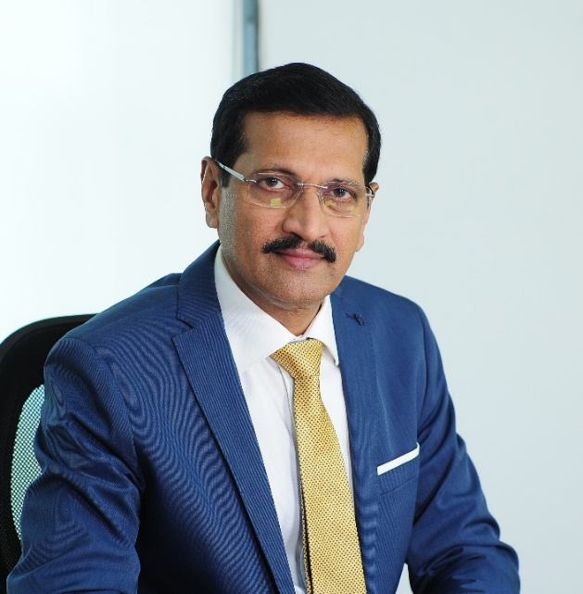

Our Leadership
Dr. Sanjay Salunkhe
Chairman & MD
Ms. Ranjita Raman
CEO

Slide 12

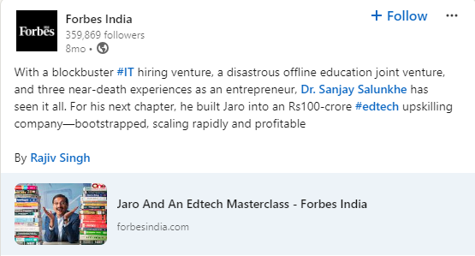
Media Highlights
Jaro Education Founder, Dr Sanjay Salunkhe announces ESOP buyback with 400% returns to employees
The edtech firm issued shares to its key employees in Feb 2017 at Rs 50 per share and the company buy backed those shares at Rs 250 per share in Dec 2021 by providing the employees 400 per cent return on their investment.

Slide 13

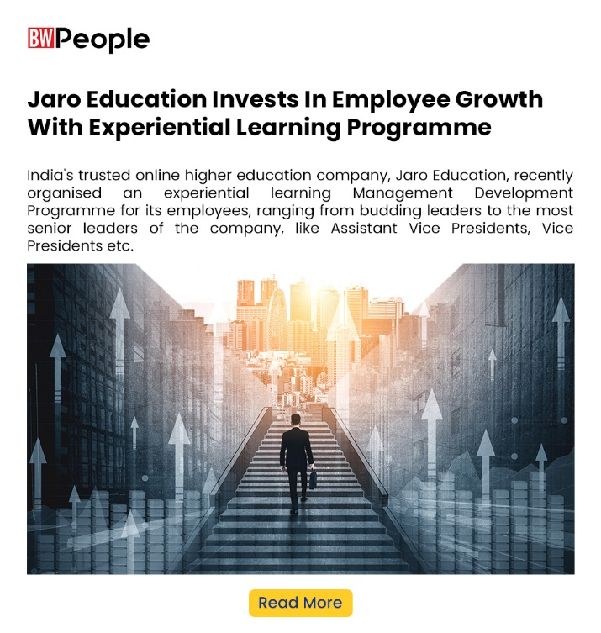
Media Highlights

Slide 14
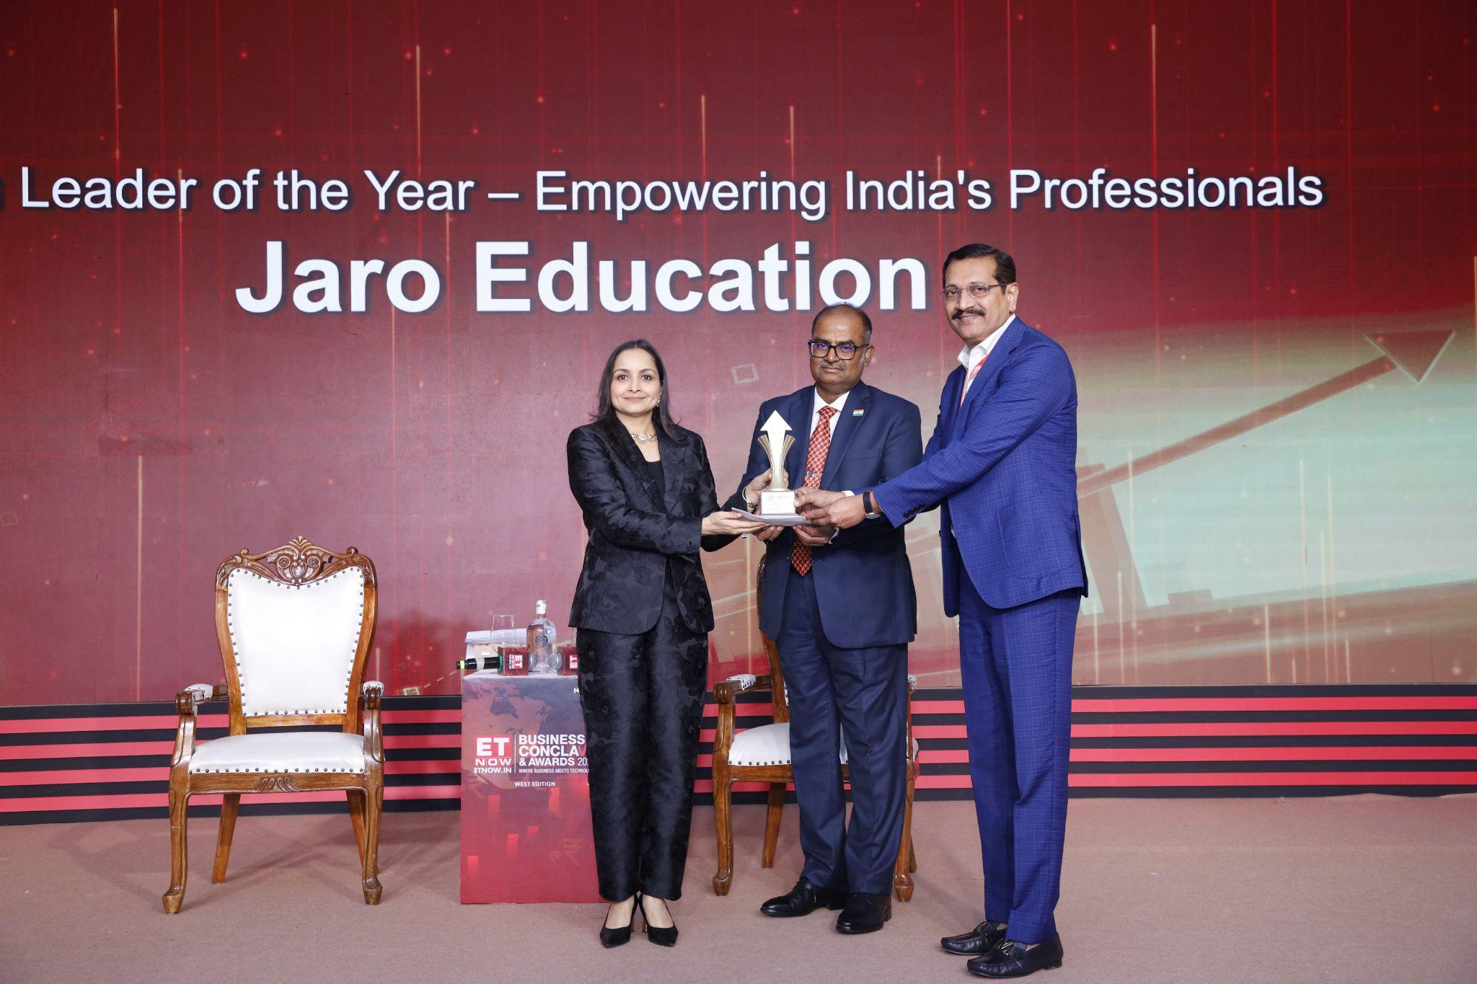
Awards & Accolades
Winner of the EdTech Leader of the Year Award at the ET NOW Business Conclave & Awards 2025

Slide 15

Awards & Accolades

Slide 16
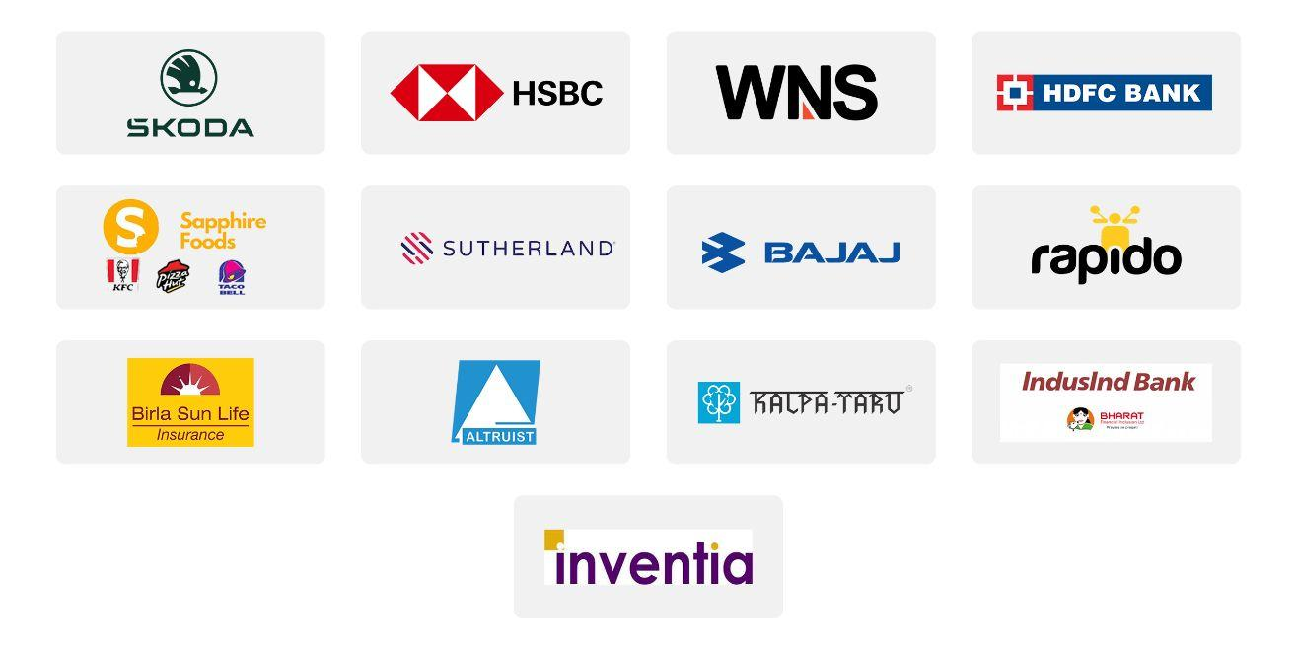
Our Corporate Associations
… more than 1,000+ associations

Slide 17
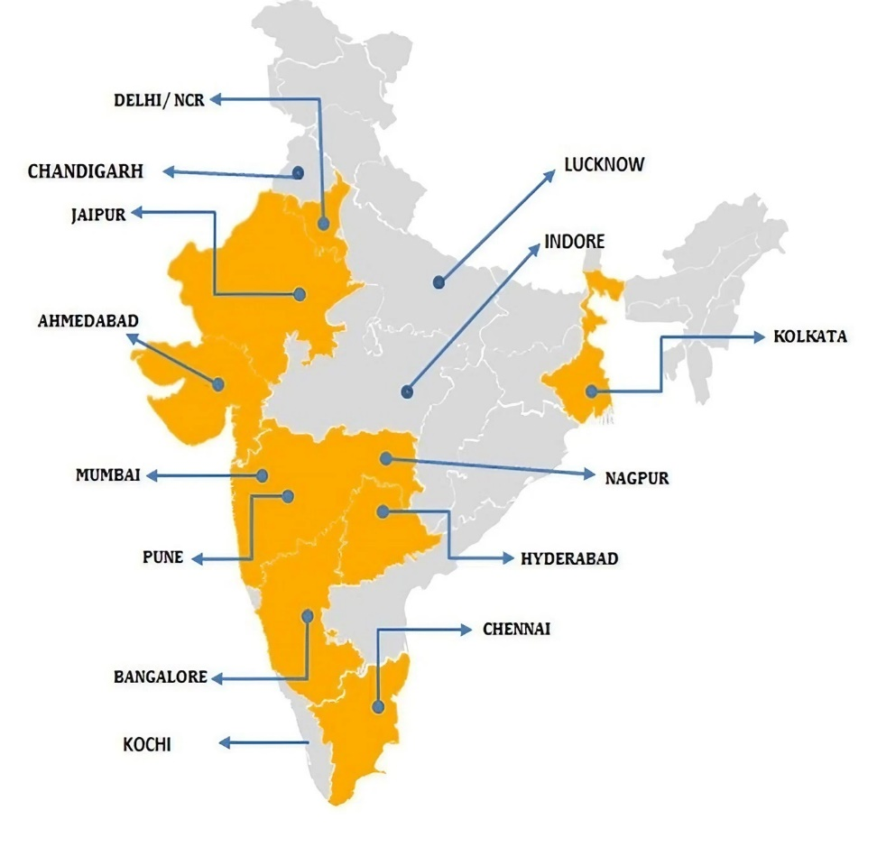
Our Presence
14+
Cities
23+
Offices
850+
Employees

Slide 18



Job Description
Roles & Responsibilities
Department: Sales (career counsellor)
Designation: Graduate Trainee / Management Trainee
What You’ll Do (Day-to-Day)
Own the entire end-to-end sales process — from first contact to closure
Engage with at least 80-100 working professionals or 2-3 hours of talk-time daily to understand their upskilling goals.
Conduct counselling sessions via calls or video to match learners with ideal programs
Maintain and nurture a strong lead pipeline through CRM & follow-ups
Collaborate with academic partners to ensure seamless enrolments
Work Schedule
Days: Monday – Saturday
Timings: 10:00 AM – 7:00 PM

Slide 19

What this role offers?
Attractive fixed pay with good incentive earning
Achieve more, earn more, Employee Stock Option Plan (ESOP’s) after 3 years of good work.
Specialize in Education counselling
Educating and giving growth in career is a good deed, than selling FMCG products like whitening cream, hair oil OR insurance products.
Great learning opportunity while Performing
With lot of career growth opportunities higher education career counselling jobs are in great demand. Women Executives and Managers do very well in counselling and hence women are more successful. For e.g. CEO, CMO and others.
Exposure to India’s Top Universities & Executive Programs
Continuous improvement & experience excellence

Slide 20
The Growth Curve
36 Months onwards
Asst. Manager &
Above Promotions
Making Careers, Not Jobs
18-24 Months
Leadership Training
Yearly Bonus (PCCB)
24-36 Months
Team Leader
MT / GT – upto 12 months
Notes:
Font change to 18

Slide 21
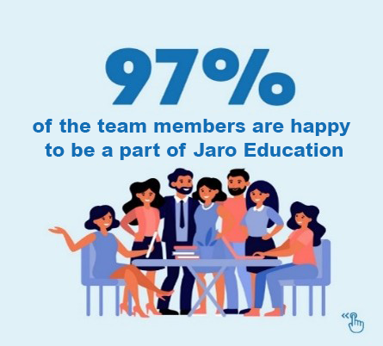
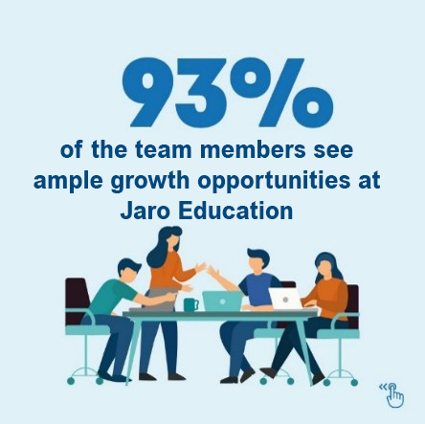
Highlights - Employee Satisfaction Survey

Slide 22
Remuneration Structure (Zone 1 - Metro)
Locations* | Mumbai, Pune, Bengaluru, Hyderabad, Chennai & Gurugram
Category | Graduates (Per Month) | Post – Graduates (Per Month)
Fixed Salary | Rs. 40,000 | Rs. 50,000
Additional HRA** for Mumbai | Rs. 10,000 | Rs. 10,000
Monthly Incentives | Rs. 20,000 | Rs. 25,000
Travel Reimbursement | Rs. 3,000 | Rs. 3,000
Performance - cum - Continuity Bonus | Rs. 2,00,000 p. a. | Rs. 4,00,000 p. a.
Total (Annual C. T. C.) | Rs. 10,76,000 p. a. | Rs. 14,56,000 p. a.
*Candidates can choose up to 3 preferred job locations. Final job location will be allocated basis requirement.
**Additional HRA is provided only upon relocation to Mumbai. Candidates currently residing in Mumbai are not entitled to this component.

Slide 23
Remuneration Structure (Zone 2)
Locations* | Lucknow, Chandigarh, Jaipur, Ahmedabad, Kochi, Kolkata, Indore.
Category | Graduates (Per Month) | Post – Graduates (Per Month)
Fixed Component | Rs. 30,000 | Rs. 40,000
Monthly Incentives | Rs. 20,000 | Rs. 25,000
Travel Reimbursement | Rs. 3,000 | Rs. 3,000
Performance - cum - Continuity Bonus | Rs. 2,00,000 p. a. | Rs. 4,00,000 p. a.
Total (Annual C. T. C.) | Rs. 8,36,000 p. a. | Rs. 12,16,000 p. a.
*Candidates can choose up to 3 preferred job locations. Final job location will be allocated basis requirement.

Slide 24




Non - Monetary Incentives
Filmfare Passes
Las Vegas Vacation
iPhone
IPL Premium Tickets
and many more….

Slide 25
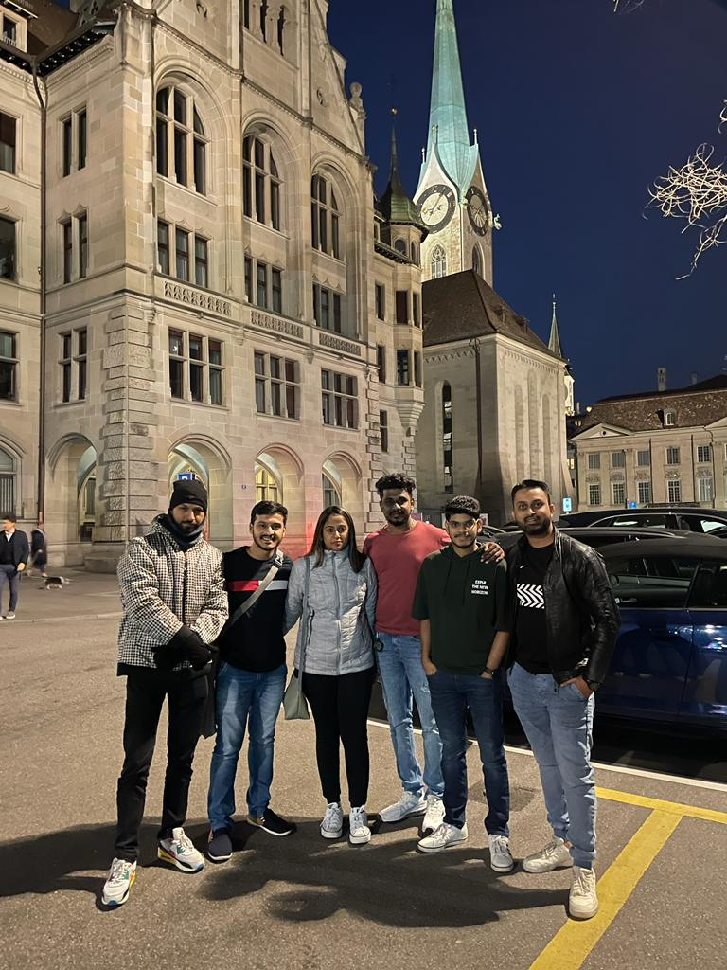
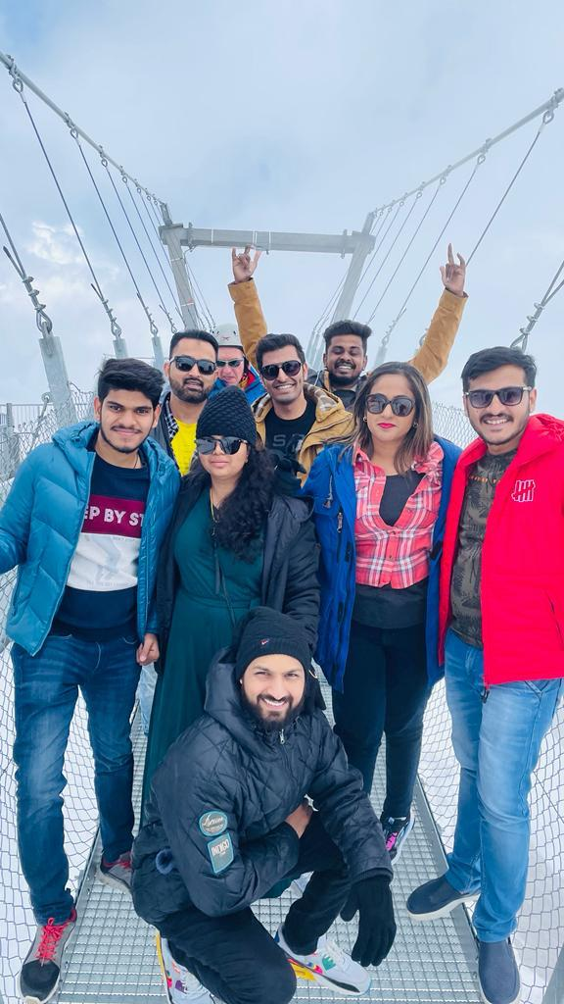
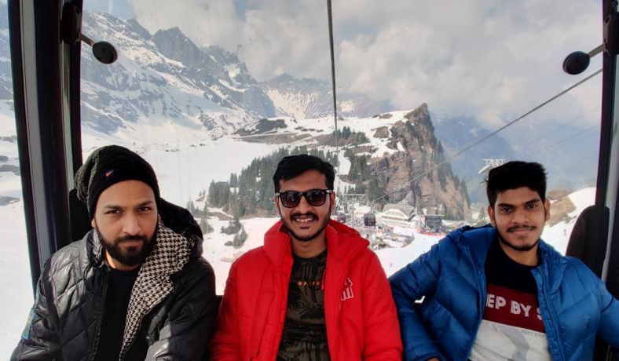
International Trip to Dubai, Singapore, Europe & more…
Bharati Vidyapeeth

Slide 26
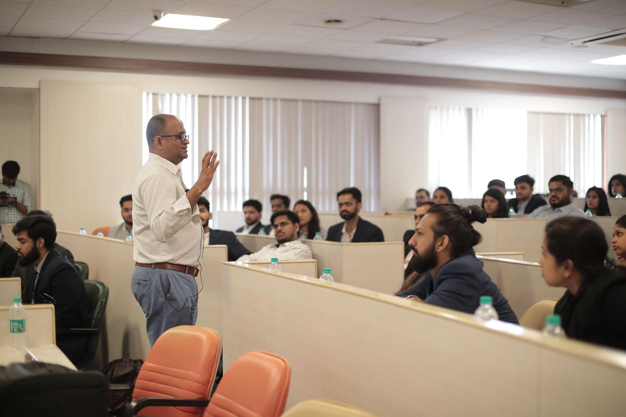
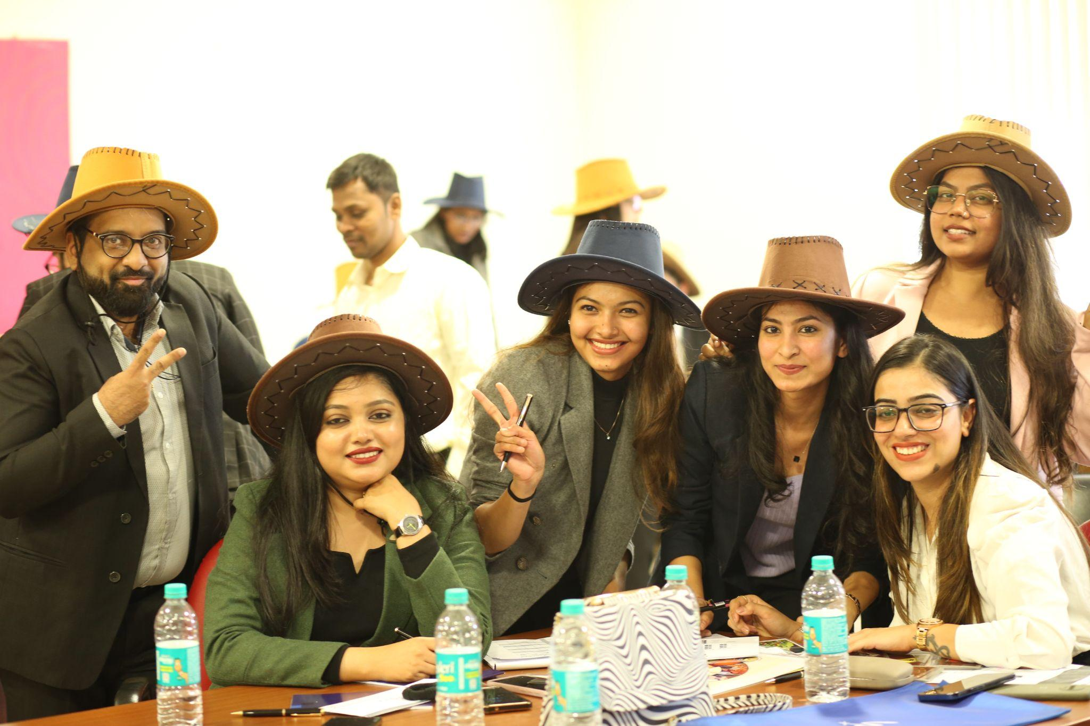
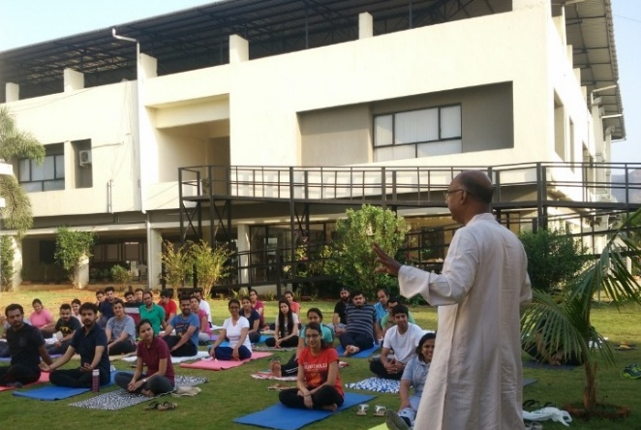
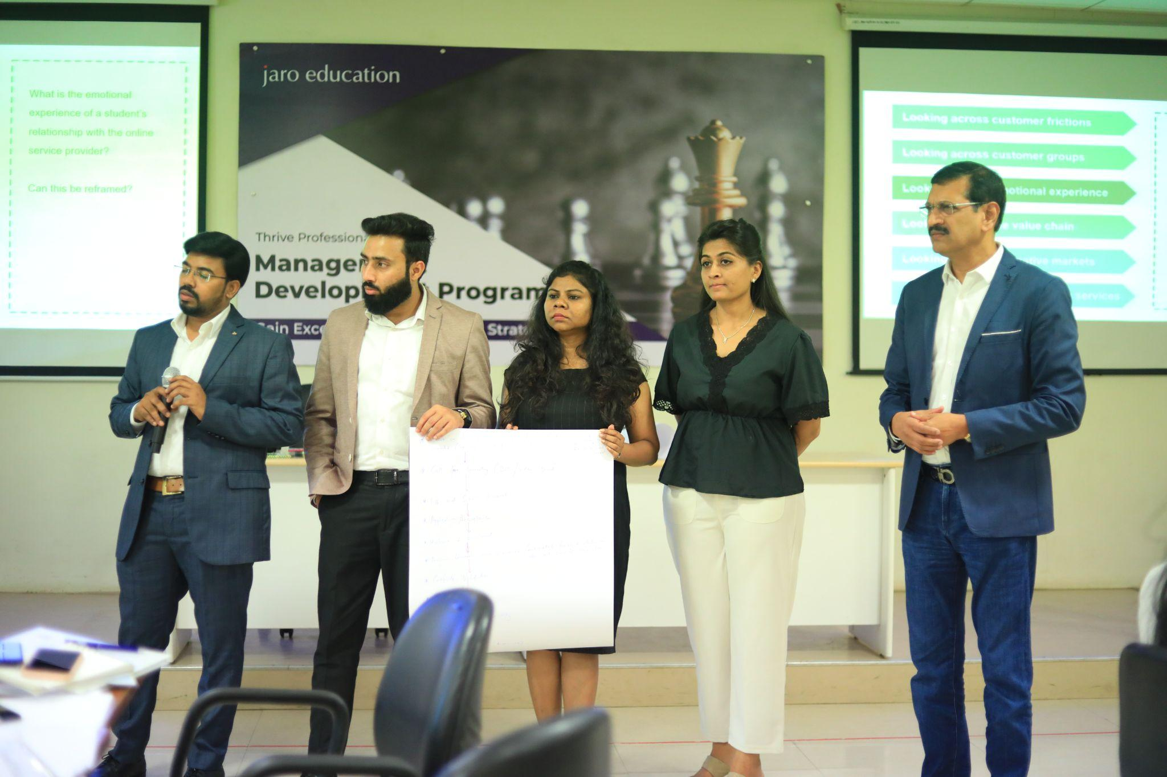
Learning & Development

Slide 27
What We’re Looking For
1
Excellent Communication & Convincing Skills
2
Learner’s Mindset & Resilient Nature
3
Self motivated & drive to overachieve numbers
4
Strong follow up & closure skills
5
Should stay updated with recent EdTech trends
6
Ethical selling, as it is Education
Notes:
Sales Traits

Slide 28
Thank You !

Slide 29



‘Q & A’ Session
Follow us -
JaroEducation
jaroeducationofficial
jaro_education

