Slide 1
SQUARE YARDS
Every Home has a Story

Slide 2

INTRODUCTION

Slide 3
India Real Estate: The Largest and Last Unorganized Trillion Dollar Opportunity in the World
Market Size of Real Estate in India (USD Billion)
Urbanization: India vs. Global Peers (% of population)
▲ +18% urbanization growth by 2040
WHAT THIS MEANS FOR INDIA
China — The Benchmark
USA — Growth Never Stops
India — The Opportunity
10 Mn
homes/year at peak urbanization
83%
urbanized — still one of the world's
largest construction markets
250 Mn
people moving to cities by 2040
60 Mn
homes needed vs only 0.5 Mn built/yr today
20× more than India builds today
Even at near-full urbanization, housing demand never plateaus
India is at the cusp of the greatest real estate volume explosion the world has ever seen

Slide 4
SQUARE YARDS JOURNEY

Slide 5
India Buys Home Every 30 Minutes From Square Yards
SCALE AT A GLANCE
#1 Platform by Revenue, GTV & Transactions
₹ 74,000 Cr
₹ 2,18,000 Cr
Value of Homes sold till FY26
Value of Loans disbursed till FY26
▸ Run rate: ₹15,000 Cr/yr
▸ Run rate: ₹90,000 Cr/yr
▸ Ranked 5th largest vs principals
▸ Ranked 10th largest vs private banks
Revenue
GTV
EBITDA
FY27E
FY76E
FY27E
₹ ~3,000 Cr
₹ ~1,42,000 Cr
₹ ~320 Cr
Annual revenue run rate
Gross transaction value estimate
Path to double-digit margins
1Mn+
8 Mn+
6,000+
100+
Active Listings
Monthly Traffic
Employees
Cities

Slide 6
Square Yards is the largest integrated PropTech player with various offerings
Square Yards
Magic Bricks
99 Acres
REA India
No Broker
Inception |  | 2014 | 2007 | 2006 | 2010 | 2014
Latest available revenues |  | $232 mn (FY26) | $34.2 mn (FY23) | $50 mn (FY25) | $84.6 mn (FY25) | $89.2 mn (FY24)
Global Prescence |  | India, Middle East, Australia, Canada | N/A | N/A | UAE | UAE
Search / Listing
Transaction / Brokerage
SaaS
Rental / Property Management
Mortgage / Finance
Interiors
 | Non-Exhaustive list
Fully exhibits the function
Partially exhibits the function
Doesn’t exhibit the function
Source: Company information

Slide 7
Square Yards stands out as a rare Consumer Tech startup delivering both high growth and high margins
AMONG INDIA'S ELITE CONSUMER TECH COMPANIES
GROWTH
REVENUE
PROFITABILITY
51%
$230+ Mn
On Track for
Double-Digit
EBITDA
CAGR — Last 5 Years
Annual Revenue (FY26)
Margins
5th Highest growth rate among all Consumer Tech startups in India
Top 30 among all Consumer Tech startups in India by revenue
Top 5 among Consumer Tech startups in India by margin profile

Slide 8
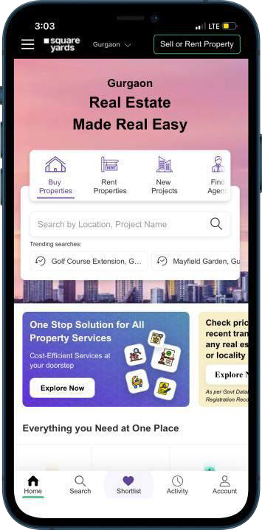
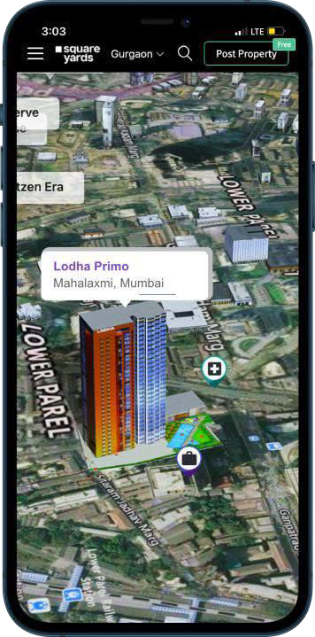
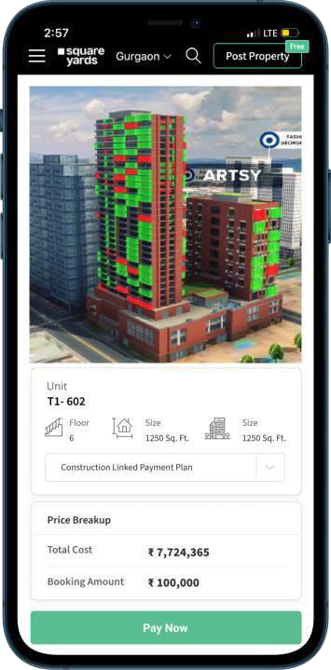
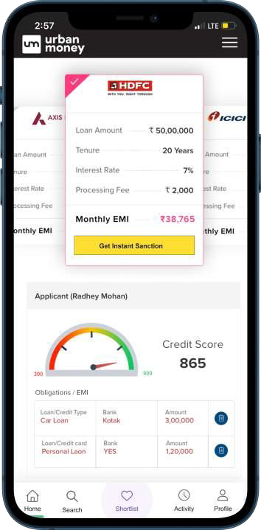
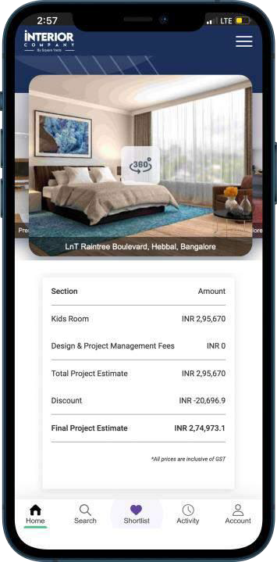
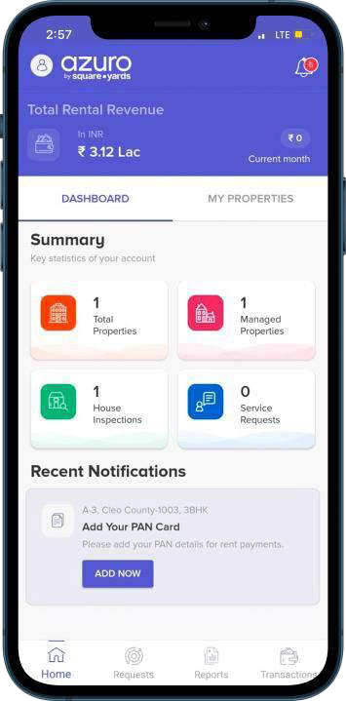






Entire Consumer Journey Across Lifecycle in an Integrated Platform
Search
Ground Research
Buy
Borrow
Interiors
Rent & Manage
Largest real estate supply-side platform in India with 1m+ listings, attracting 8m+ unique visitors every month
Research portal with integrated tools such as heatmaps, investment scores, price analytics and transaction history
Transaction enablement
via E-payments and E-signatures
Mortgage fulfilment via credit bureau integration, identity, address and income verification
Search, receive quotes, design and purchase interior and furnishing for your property
Asset management, legal, technical & valuation services. App-based rent collections, property inspections, e-tracking of maintenance requests
OUR GROUP BRANDS

Slide 9

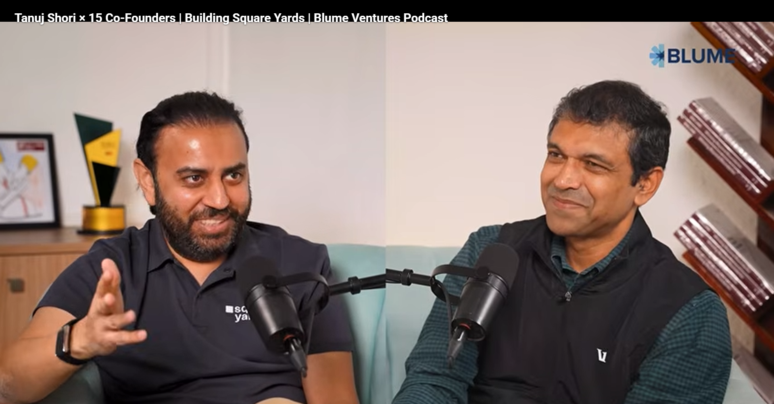
Square Yards Targets IPO Within the Next 12–18 Months
Future of Square Yards: Destiny avenged, IPO as governance, and building for decades
CLICK!

Slide 10





Our Accomplishments

Slide 11
OUR GROWTH PHILOSOPHY

Slide 12
7 ingredients of Growth
1
Setting the benchmarks, doing something that has never been done before.
Chaos, love the madness.
Hard work, exponential growth need exponential sacriﬁces.
Ethics, do the right thing when no one is watching.
All Disruption starts with introspection.
Discipline is doing what needs to be done, even if you don't want to do it.
One person with Passion is better than forty people merely interested.
2
3
4
5
6
7

Slide 13

Culture of Growth: The Tools (1/3)
The Goal Sheet
Earn upto 12 appraisals/year
336
15%
Promotions in 3 Month
Salaries will run your homes; Incentives will manage your lifestyle & ESOPs will create GENERATIONAL WEALTH!
- Tanuj Shori (CEO)
Highest appraisal 120% in a year
Average Hike in 3 Month
Aspire to become Country Head within 3-5 years
ESOP Programme
4 5%
Employees holds ESOPs
Opportunity to become equity owner in the Company
Only Startup who provides ESOP at every level
Incremental Incentives in form of ESOPs at all levels

Slide 14




Culture of Growth: The Tools (2/3)
Incentive Programme
Best in Class
Avg Performer makes 85% of Salary as Incentives
International Career Opportunities
Regular internal movement opportunities to build Global Career
5 0%
Completely Merit Performance based selections
Incentives paid in Advance
INR 410 Cr
Incentives Disbursed in Last 5 Years
INR 108 Cr
Disbursed in Last FY Year

Slide 15
Culture of Growth: The Tools (3/3)
SCENARIO 1
SCENARIO 2
SCENARIO 3
Getting Started
Building Momentum
Full Potential
5
10
15
transactions
per year
transactions
per year
transactions
per year
Revenue / Transaction
Revenue / Transaction
Revenue / Transaction
₹5 Lakhs
₹5 Lakhs
₹5 Lakhs
Total Revenue
Total Revenue
Total Revenue
₹25 Lakhs
₹50 Lakhs
₹75 Lakhs
YOU EARN
YOU EARN
YOU EARN
₹5 Lakhs
₹15 Lakhs
₹25 Lakhs
You can earn upto 40% of Revenue as Incentives

Slide 16
LIFE AT SQUARE YARDS

Slide 17
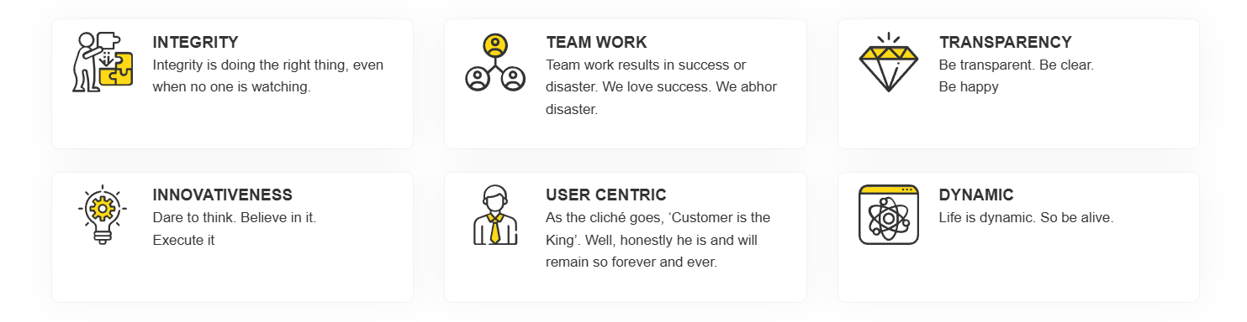
Our Ethos
At Square Yards, our goal is to turn transactions into life changing experiences. We thus strive to constantly better ourselves through self-reflection and keep our ethos as the foundation of our conduct
We are of a strong opinion that our employees are the architects of our success and growth. We thus leave no stone unturned to extend our gratitude and appreciation to them.

Slide 18











Our Festivals: Annual Retreat & Fire Fest
Performance matters! Deliver your best to be a part of Square Yards Annual Festivals!!

Slide 19

Work Play Party: All Hardest
PLAY!

Slide 20

Our Dollar Day: Incentive Disbursement Celebration
PLAY!

Slide 21
WHAT’S IN FOR YOU?

Slide 22
Hiring Process
Group Discussion (Mafia)
Personal Interview (2 rounds)
Why should we hire you?
(Video Round)
1 DAY PROCESS

Slide 23
Training &
Onboarding
Program
3
4
Months
LPA
Training
Program Duration
Fixed Compensation
at Joining
Graduate Associate · Campus Batch
5
5
One of the most evolved & rewarding
talent roadmaps in the consumer startup space.
LPA
Lakhs
Fixed Compensation after 6 months
Performance linked Compensation
(for a median performer)

Slide 24
Benefits & Perks
5-DAY WORK WEEK
GLOBAL MOVEMENT OPPORTUNITIES
AUTO-APPRAISAL
ESOP PROGRAM
BEST INCENTIVE STRUCTURE
TOOL-FIRST WORKFLOWS
SPEED OVER POLITICS
HEALTHCARE & INSURANCE
TRANSPARENT GOALS & CLEAR SCORECARDS
FUN, DYNAMIC ENVIRONMENT

Slide 25
OUR PEOPLE

Slide 26
Our People: Proof of Long-Term Growth
PEOPLE WHO STAYED, THRIVED & CAME BACK
LOYALTY
GHAR WAPSI
ENTREPRENEURSHIP
70
540
56
Employees — 10+ Years
Ghar Wapsi — They Came Back
CEOs Created
In an industry known for churn, 70 Square Yards employees have proudly built decade-long careers here.
They left. They saw the rest. They came back — 540 employees chose Square Yards over everything else.
Square Yards is a masterclass in entrepreneurship — we have created 56 CEOs.

Slide 27
Why Square Yards?
You are aspiring to work in
the Largest Organisation
in the
Largest Sector
in the
4th Largest Economy
in the World.
The opportunity of a generation — and it starts with YOU joining Square Yards

Slide 28
THANK YOU
Reach out to us at campus@squareyards.com

